Slide 1
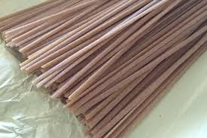
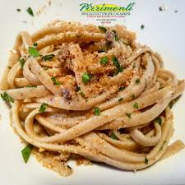
Calabrian Struncatura
Ingredients
- Struncatura pasta (or wholewheat linguine/spaghetti)
- 40 g of anchovies in olive oil
- 6 big olives or 30 g of capers
- Fresh or dried chilli pepper
- Extra vergin olive oil
400 g of cherry tomatoes
Parseley
- A clove of garlic
- 40 g of breadcrumbs

Slide 2
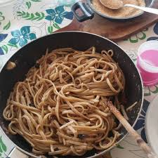
Cooking method
Simmer the cherry tomatoes in boiling water for a few seconds, put in cold water, peel and cut them into quarters.
In a large pan, put a tablespoon of oil and melt the anchovy fillets with the garlic clove and chilli pepper, add the coarsely chopped olives, after a minute the tomatoes and let go for about ten minutes on medium heat eliminating the garlic (if you prefer) at the end of the cooking.
Toast the breadcrumbs with a little oil in a pan and keep it aside. Boil the trofie in plenty of salted water, drain it and add it to the seasoning by jumping for a minute. Portion and sprinkle with the toasted breadcrumbs.Serve quite hot.
There can be different versions of the recipe
-You can add dried tomatoes instead of fresh ones.
-You can use black olives.
-You can use other herbs or spices.

