Slide 1
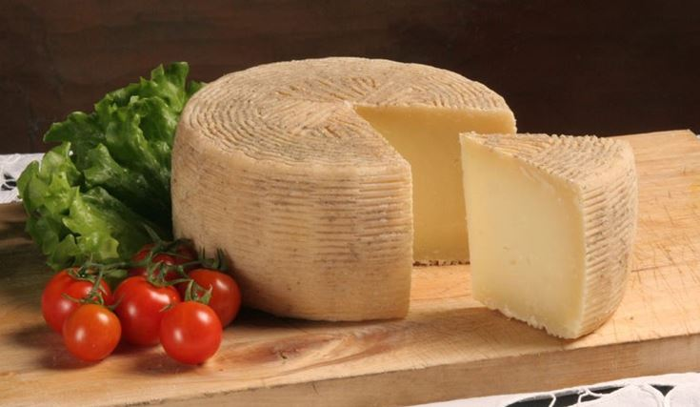
Pecorino Crotonese
Pecorino Crotone is a cheese typical of the entire province of Crotone obtained from sheep's milk. Has obtained the recognition of the protected designation of origin (D.O.P.)
It is produced with whole sheep's milk, coming from sheep raised exclusively in the production area. Its maturation lasts up to two years. It can be eaten as an appetizer or other typical products of Calabrian cuisine. It is also consumed as a cooking ingredient and can be grated to accompany the first courses.

Slide 2
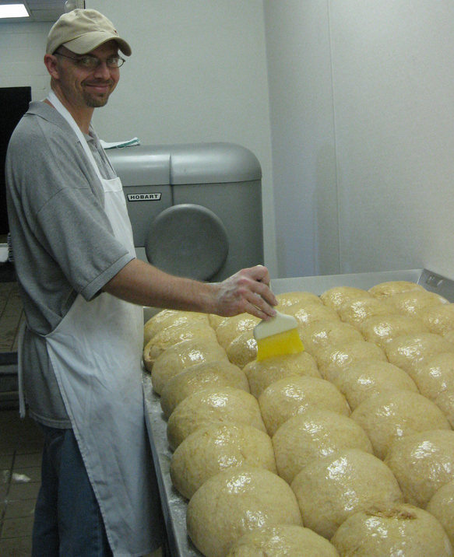
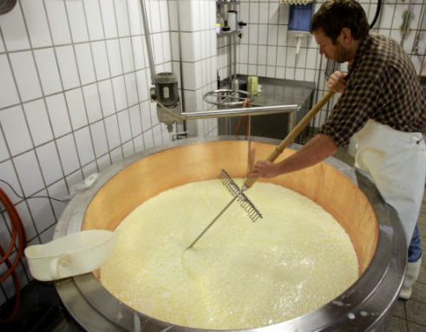
Characteristics of the cheese
It is produced in three types. The Fresco has thin crust and the typical stripes of the basket. The dough is soft, compact, sometimes creamy, white or slightly straw-colored. The holes are sparse. The Semiduro has a thick crust, with the typical stripes of the basket, of a light brown color. The dough is compact, semi-hard, with sparse eyes. The stagionato has a thick, hard crust, with the typical stripes of the basket, of a light brown color. The pasta is hard, compact, with rare holes.

