Slide 1
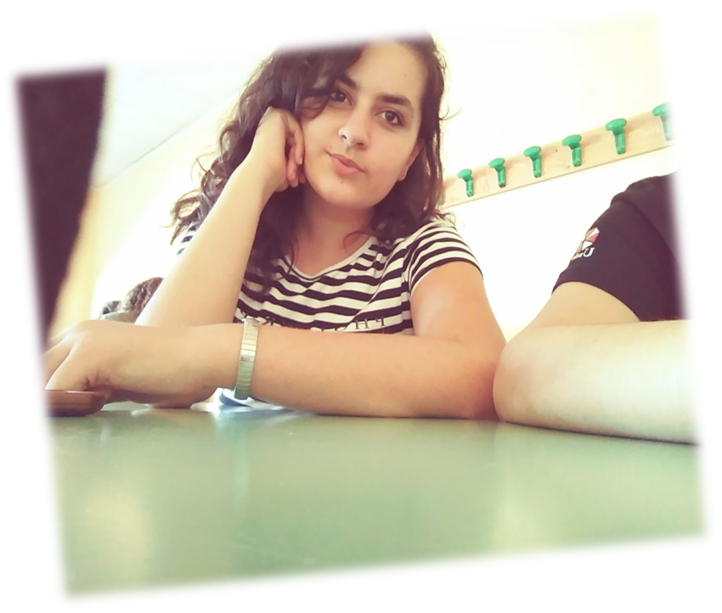
Egi’s presentation

Slide 2
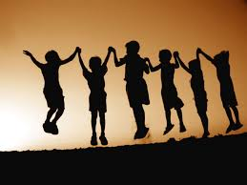
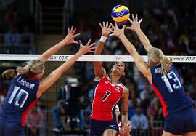
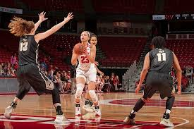
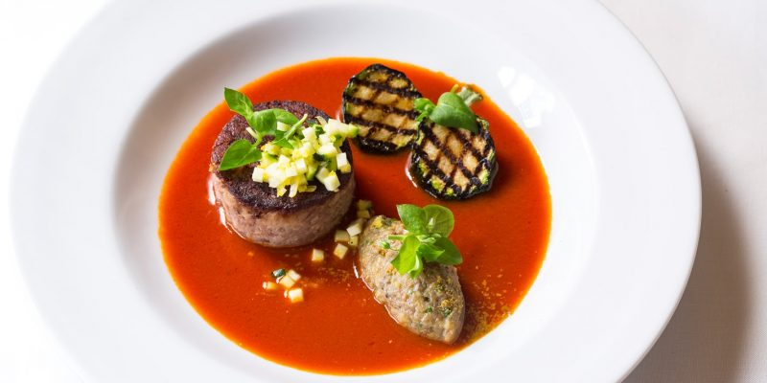
Hello , I’M Egi
Hello, my name is Egzona Rexha , it is an Albanese name because I'm from Albania but I live in Italy .
I'm 15 years old ; my city is Reggio in province of Reggio Calabria . I attend a Hotel and Catering Vocational School , I'm in the second class.
I love staying with my friends and playing volleyball and basketball with them.

