Slide 1
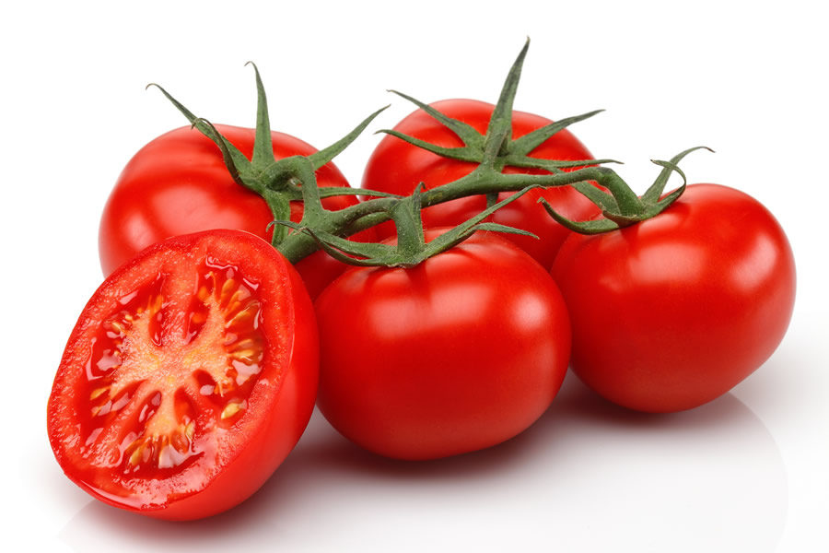
Pomodorini di Pachino
Pomodoro di Pachino (PGI) is an Italian fruit and vegetable product with a protected geographical indication from the provinces of Syracuse and Ragusa.
The vegetable does not belong to the traditional agriculture of the island, being a variety introduced in 1989 by the Israeli seed multinational HaZera Genetics, which had obtained it through selection assisted by markers. In certain areas of Italy the vegetable is also known as the pendolino.

Slide 2
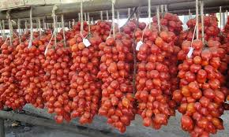
PRODUCTION AREA
The Pachino tomato is massively cultivated in the Sicily region and in southern Italy in general; this type of tomato is characterized by a very tasty and consistent pulp, from fruits with shiny skin and a high conservation time. The Pachino tomato has a sweet taste that makes it especially suitable for preparing salads but also condiments for pasta and so on. Although this type of plant gives the best results if grown in large areas, more and more frequently we find the tomato Pachino present in small gardens of our cities. This vegetable can adapt to different climates and soils and, even if it prefers climate and temperatures in the southern regions, where cultivation is more widespread, it has spread widely also in the northern regions where it seems to give satisfactory results.
Ground
As for the climate, the Pachino tomato can adapt to different terrains, including stony ones; it prefers not very acid or neutral soils and, the adult plants, can tolerate even those rich in salt.

Slide 3
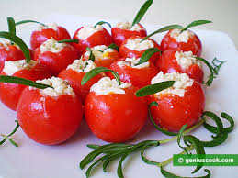
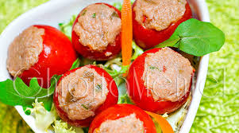
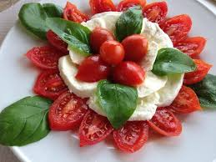
Collection and conservation
Pachino tomatoes are harvested from July to October. This operation is done manually when the tomato has reached the right maturation and a bright red color.
You can keep them in the refrigerator for about fifteen days
Property
Besides being very good and tasty, Pachino tomato also has many properties useful to our body. We all know how this type of tomato can be refreshing and refreshing, especially in the summer, but recent studies have revealed that eating many tomatoes, including Pachino ones, can be useful in preventing certain types of cancer. Pachino tomato is also very rich in vitamin C, minerals and antioxidants. It can also protect us from the onset of infectious diseases and skin problems.

