Slide 1
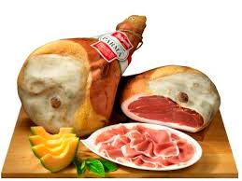
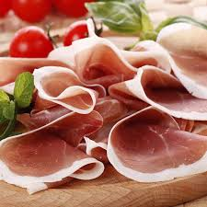
Parma raw ham:

Slide 2
AREA OF PRODUCTION:
The territories of the province of Parma.
CURING:
After being processed, the legs of ham are left to rest from 60 to 90 days. They are hung on some special supports for a period of 6-7 months, and cured for at least 12 more months.
PARTICULAR SIGNS:
No trotter, the hams are "rounded" and the brand is a five-pointed crown.

Slide 3
ORGANOLEPTIC PROPERTIES:
The aroma is fragrant, the color is pinkish in the lean part and white in the fat. Sweet and delicate on the palate, fruity but gentle.
PAIRINGS:
Perfect with melon, with fresh cheeses like mozzarella and burrata, and with breadsticks. It is the essential ingredient of the tortellini filling.

