Slide 1
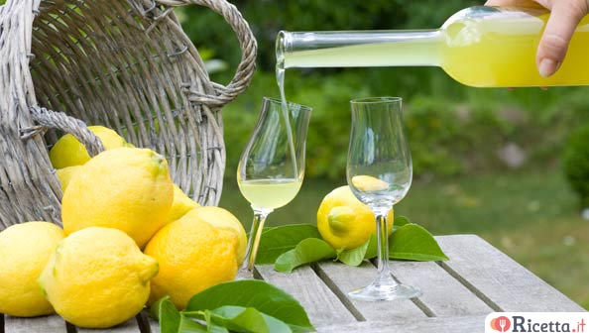
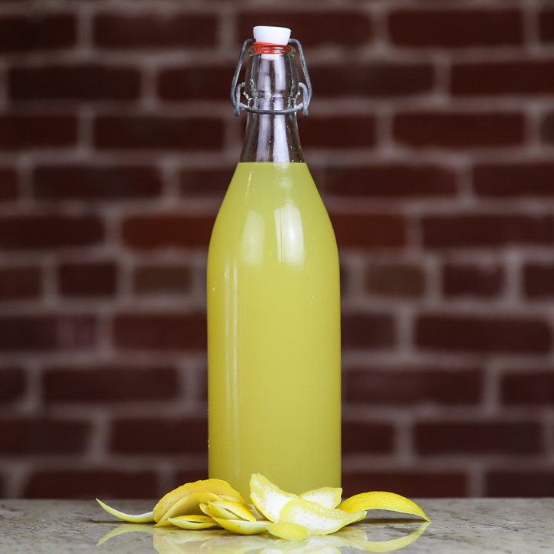
Lemon liqueur (limoncello)
Ingredients
5 organic lemons
750 ml of water
500 ml of alcohol
600 g of sugar
Preparation Method
Put the alcohol, the yellow part of the lemon zest into a big jar and after two weeks filter the content. Prepare a syrup with sugar and water, let it cool and then add the filtered alcohol.
Pour it into glass bottles and wait at least two months before drinking it.

