Slide 1
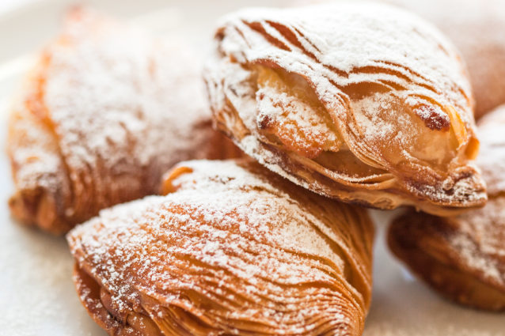
Sfogliatelle

Slide 2
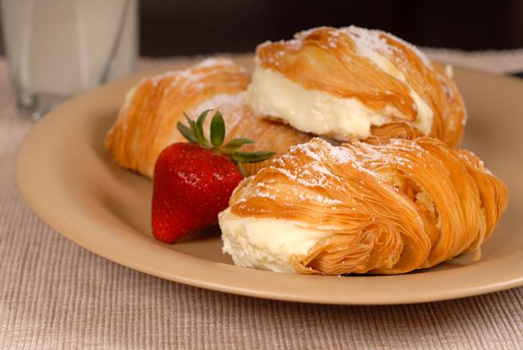
Ingredients for about 15 sfogliatelle
For the dough
500 g of flour
200 ml of water
100 g of lard
A coffee spoon of fine salt
Half a coffee spoon of honey
For the filling
150 g semolina
400 ml of milk
300 g of ricotta
1 egg
250 g of sugar
A knob of butter
Half a coffee spoon of cinnamon (powdered)
Vanilla extract, a coffee spoon
Millefiori aroma, a small phial
100 g of candied fruit
A pinch of salt

Slide 3
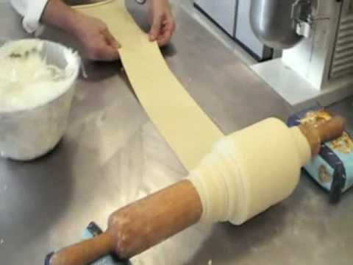
How to prepare them
1- Add flour, water, honey and salt in a bowl and knead for several minutes until a compact mixture is obtained. If you do not have the kneading machine, put the same ingredients in a glass container and mix with electric whips.
2- When you see that the mixture will be almost elastic, transfer it to a pastry board.
3- Knead a little with your hands, roll it out with a rolling pin, make a ball, grease it with lard and let rest in the fridge for a couple of hours.
4- Roll the dough with the appropriate machine until it is very thin, then wrap it around a rolling pin, greasing with lard. Keep it in the fridge for a couple of hours.
5- Unroll flaky pastry from the rolling pin and while doing it, get another rolling by pressing the dough down, wrapping it with your greasy hands. Continue like this until the end of the dough.
6- Once finished, sprinkle with lard again and let it rest in the fridge overnight, wrapped in food foil.
7- While the mixture rests, make the semolina you will introduce into the filling: in a saucepan, boil the milk with the butter and stir slowly adding the semolina, making sure that there are no lumps. Cook over medium heat for about 20 minutes and then keep it in the fridge until next morning.

Slide 4
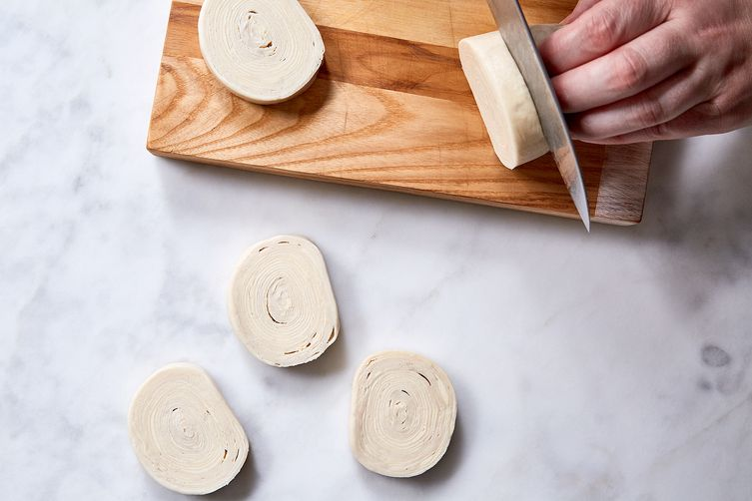
9- In a bowl, mix the egg, semolina (prepared the night before), ricotta and sugar and when it is compact, add the candied fruit and the aromas: cinnamon, vanilla.
10- Take a cone at a time and insert the filling inside each cap using a spoon. Be generous with the filling and do not seal the shells!
11 - Place them on a tray lined with parchment paper.
12- Bake for about 20 minutes at 180 ° and sprinkle with powdered sugar.

