Slide 1
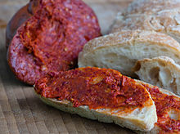
'Nduja
First name
The name 'nduja is linked to two other particular types of sausages made of meat and spices, the Piedmontese salam dla doja and the French andouille, from which the 'nduja takes its name. All these terms derive from the Latin "inductilia" ("things ready to be introduced", to "induce"), Less common variants are the Italian form anduglia and other dialectal forms such as anduja, 'ndugghia,' nduda.

Slide 2
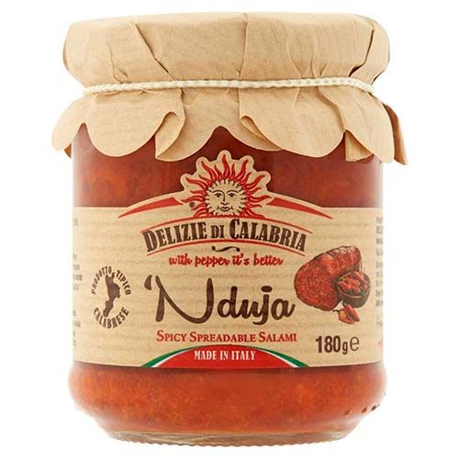
Features
It is typical of the areas of the Poro plateau: Spilinga (in the province of Vibo Valentia) is the commune of choice, but the area of ​​production is extended to many municipalities, especially those of the Tyrrhenian side, to such an extent that making 'nduja a food typically associated with the whole of Calabria. Prepared with the fat parts of the pork, with the addition of Calabrian hot pepper, it is stuffed into the blind casing (orba), then smoked.

Slide 3
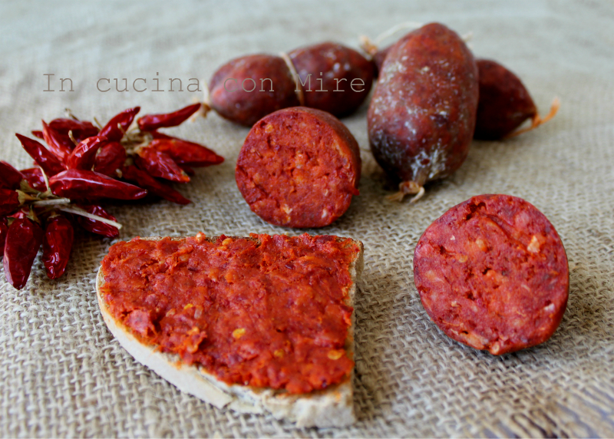
Historically
'nduja is a poor dish, born to use the waste of pork meat: spleen, stomach, intestines, lungs, esophagus, heart, trachea, soft parts of the back and pharynx, fleshy portions of the head, muscles fur, lymph nodes, fat from various regions, etc. Commercial success is at the origin of current changes in the various compositions.
The abundant content of chili, with its antiseptic properties, means that the 'nduja does not need preservatives.

Slide 4
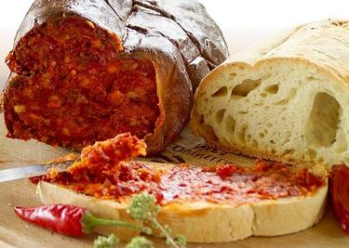
Consumption
'Nduja and bread
It is consumed by spreading it on slices of toasted bread, better if still hot, or used as a sauce for the base of a sauce or a tomato sauce, with garlic; it can be used to garnish the pizza, before the other condiments if raw, or freshly baked; it can be eaten on semi-matured cheese slices or it can be used to make omelettes.
Festival of the 'nduja
From 1975 to today, on the 8th of August of every year in Spilinga the festival of the 'nduja is held. Similar events are held in many other Calabrian municipalities

