Slide 1
Alessia AND EGY’S Favourite dishes

Slide 2
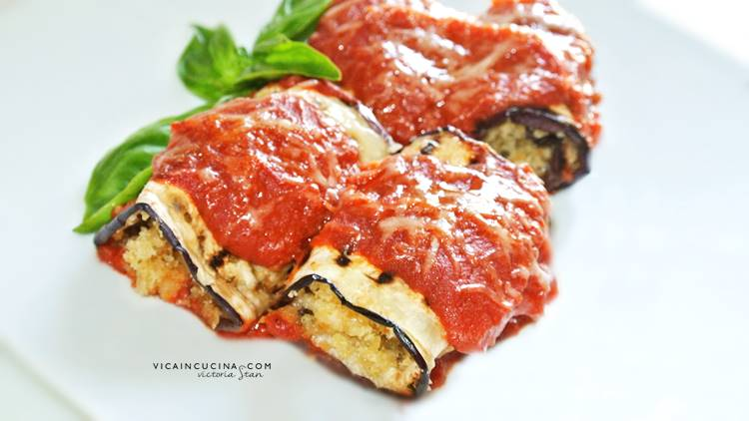
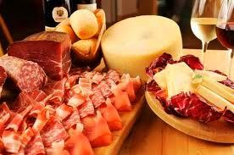
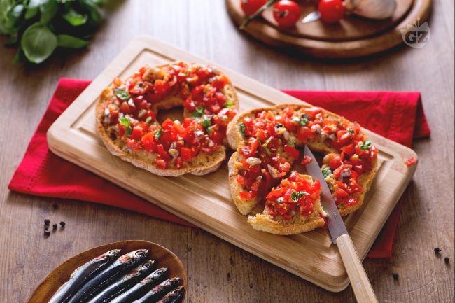
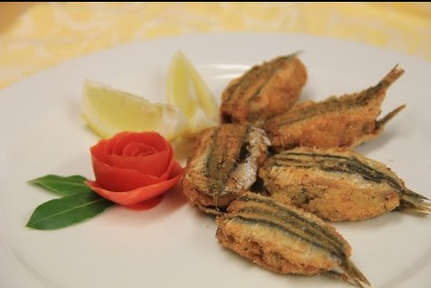
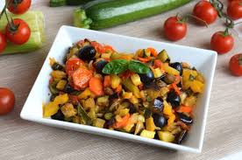
OUR STARTERS…
cured meats and cheese
aubergine rolls
Toasted bread topped with garlic, origano, chilli pepper, oil
Caponata
Stuffed anchovies

Slide 3
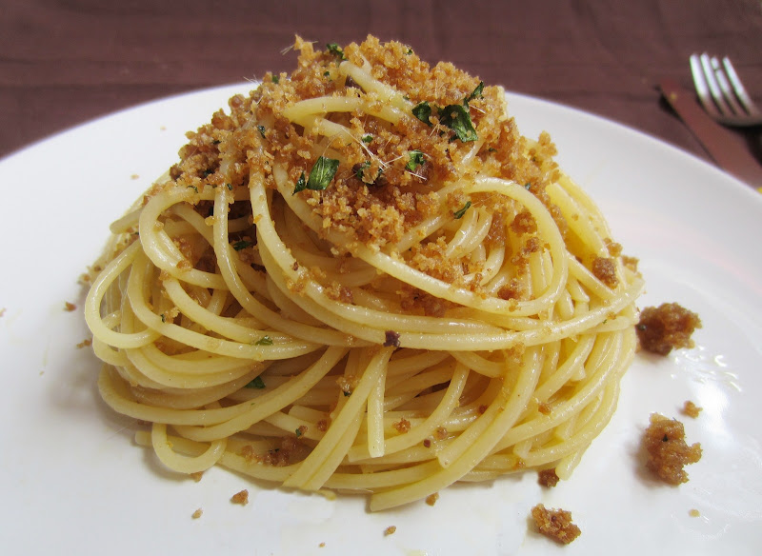
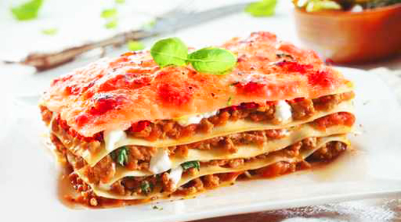
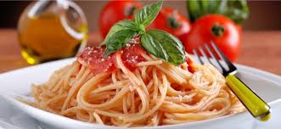
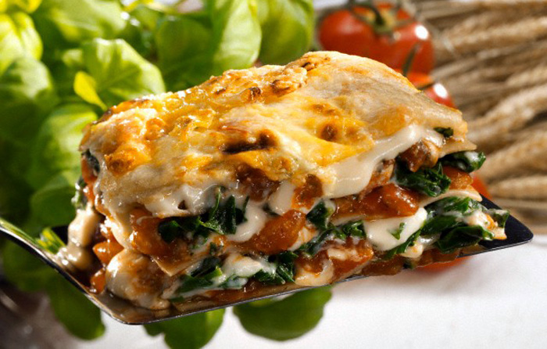
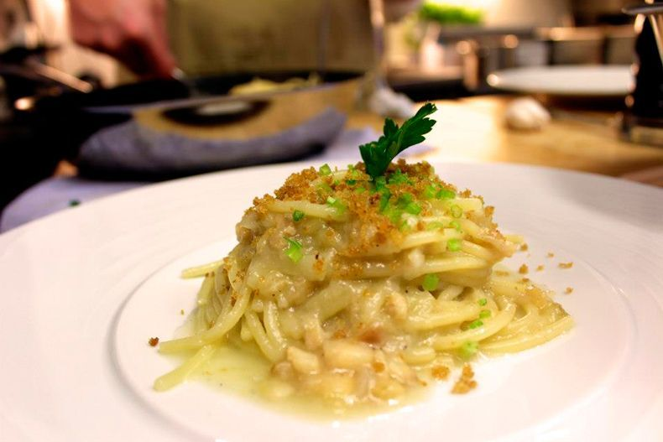
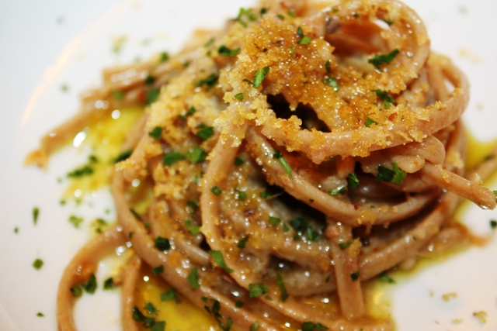
OUR 2nd courses…
Tomato sauce pasta
pasta with crumbs
Calabrian lasagne
Bergamot flavoured pasta
lasagne with spinach
Struncatura

Slide 4
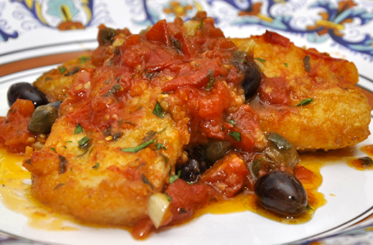
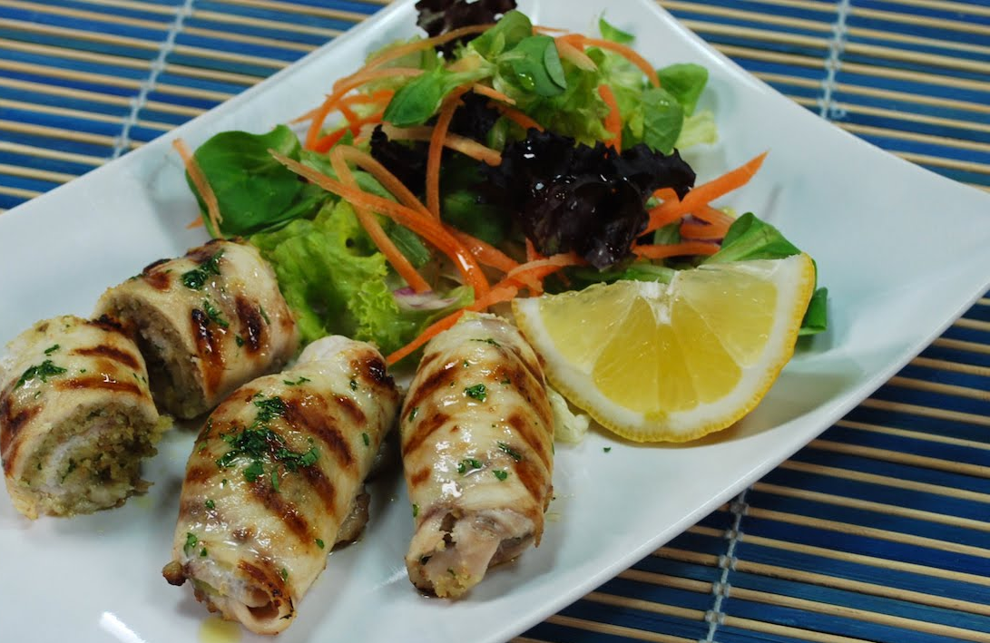
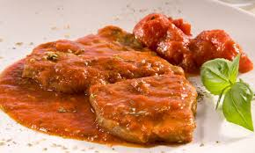
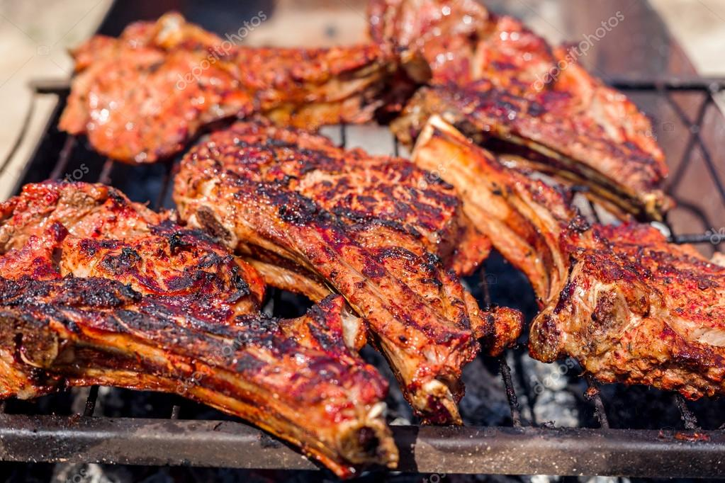
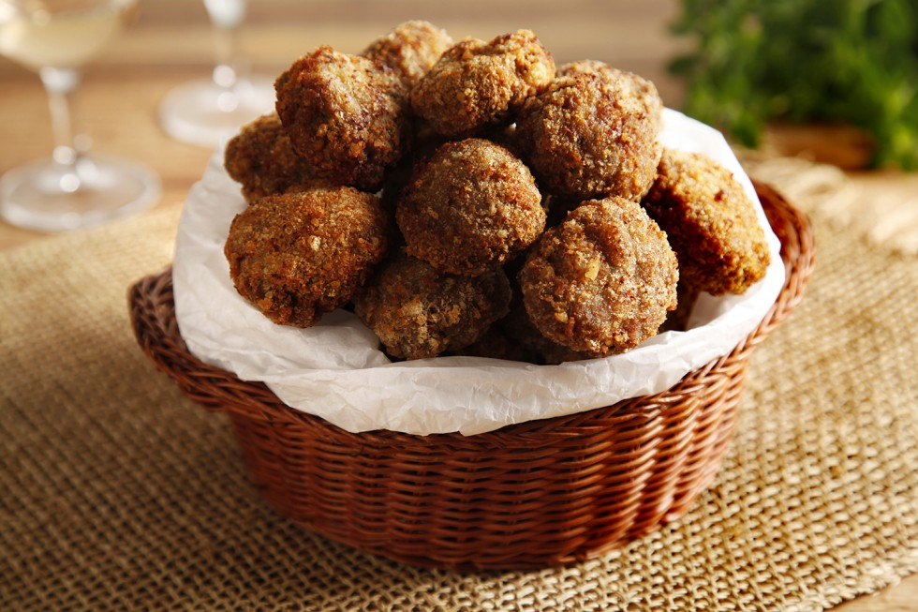
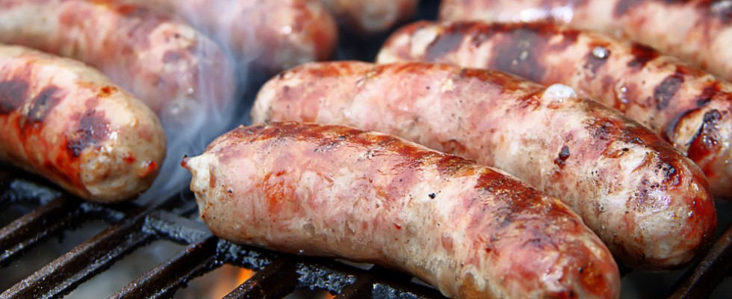
Dried codfish with potatoes and olives
(pesce stocco a ghiotta or Messinese)
Pizzaiola Meat
SwordFish rolls/wraps
(Involtini di pesce)
Grilled Pork Steaks
Meatballs
Grilled pork sausages

Slide 5
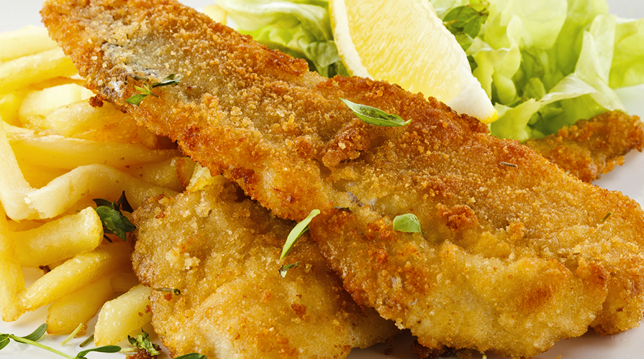
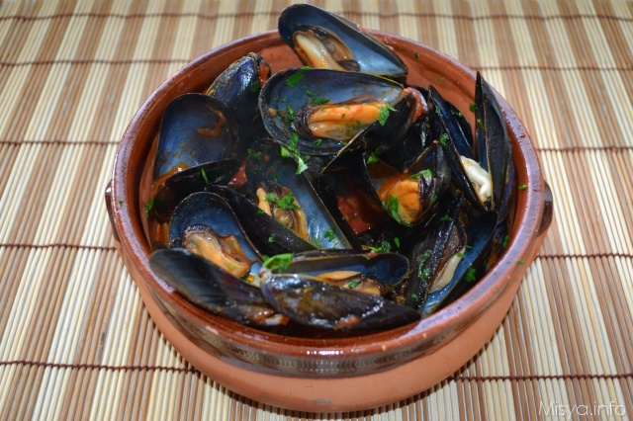
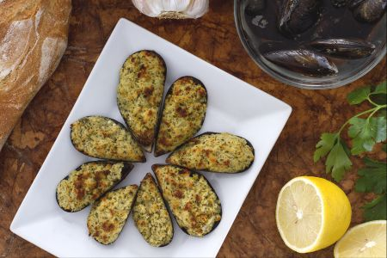
Fried salted codfish
(baccalà fritto)
Mussels pepata
Au gratin mussels

Slide 6
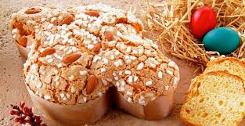
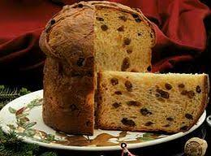
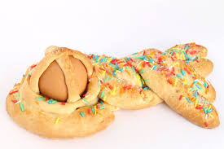
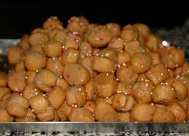
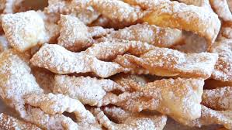
Desserts
Easter Dove
(Colomba)
Cudduraci
Christmas Panettone
Castagnole
Susamelle
Carnival Chiacchiere

Slide 7
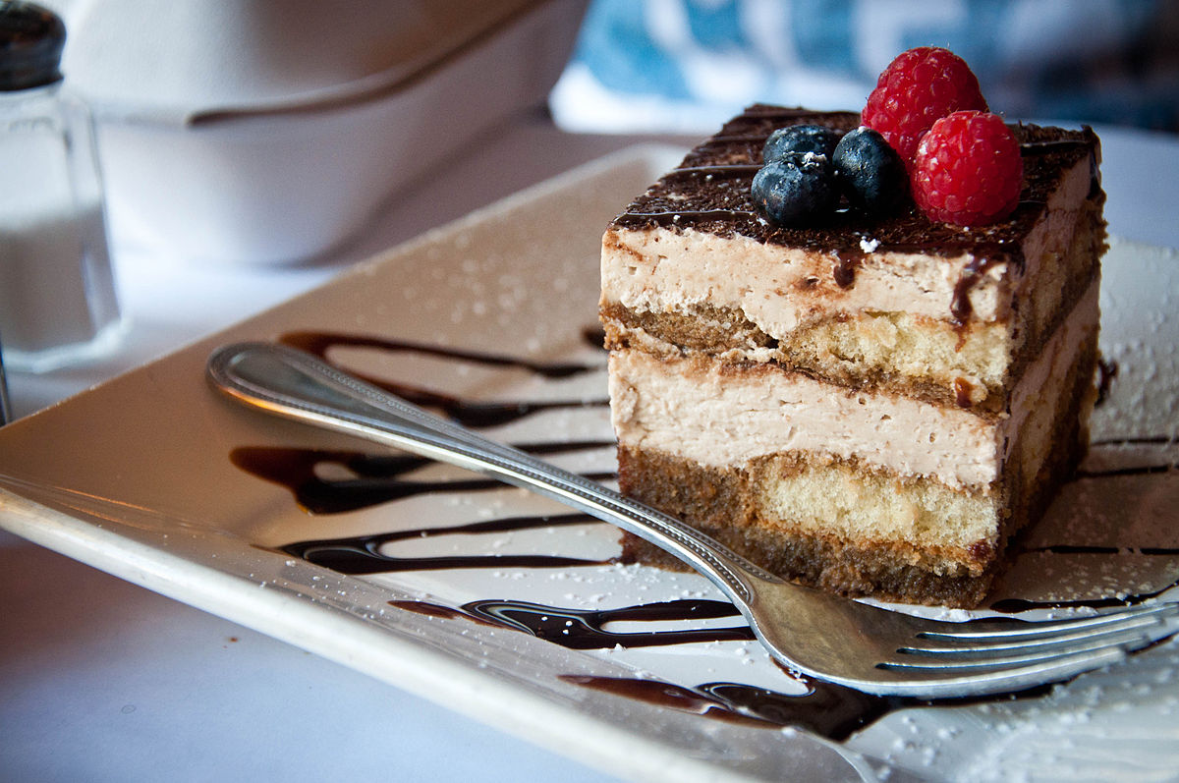
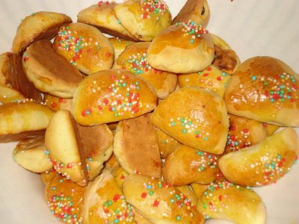
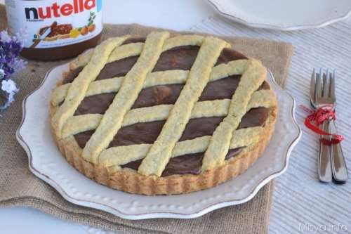
Tiramisù
Petrali
Chocolate cake

Slide 8
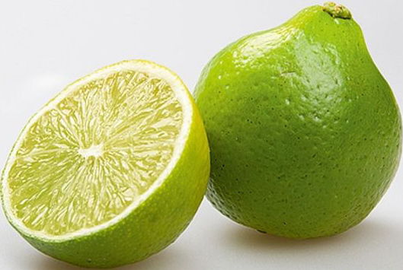
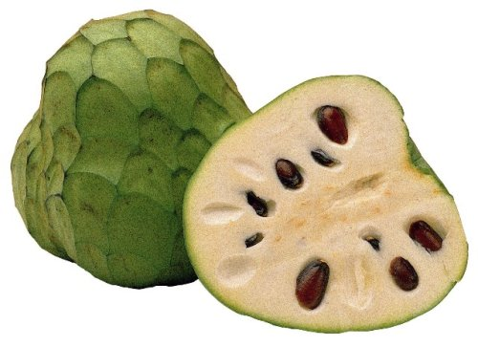
FRUIT
Apple
Grapefruit
Bergamot
Anone
Cherries

Slide 9
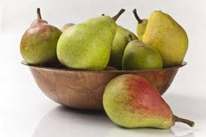
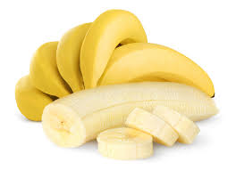
Pears
Banana
Fruit salad
Strawberries
Orange

