Slide 1
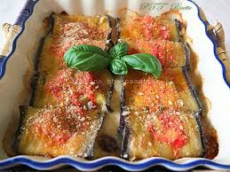
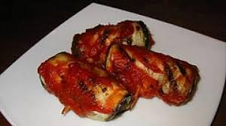
Aubergines rolls /wraps
-200g of aubergines
-200g of tomatoe sauce
-Black pepper
-100g of ham
-10g of extra vergin olive oil
-100g of Caciocavallo cheese (provola or other cheese)
-salt
A different version is without sauce

Slide 2
Cooking method
First wash and dry the aubergines, then remove the petiole and cut them to obtain 12 slices about 2 mm thick . If you wish, you can dab the aubergine slices with the absorbent paper to remove excess vegetation liquid ; this step is optional. Place the aubergine slices on a baking tray lined with parchment paper and bake in a preheated oven at 180 ° for 10 - 15 minutes.
Meanwhile, heat the oil in a saucepan, add the tomato sauce; cook over medium heat for 10 minutes, stirring occasionally, then season with salt and pepper. Using the mandolin, reduce the caciocavallo to slices of the same thickness as those of the aubergines .
Now you can assemble the rolls: place a slice of aubergine on the cutting board, add a slice of cooked ham and finish with a couple of slices of caciocavallo , then roll each slice of aubergine. Continue until the ingredients are finished.
Place the rolls in a pan with the closure facing down. After placing them all next to each other in the pan, sprinkle the rolls with the tomato sauce previously prepared. Finally, cut the remaining caciocavallo with the knife and distribute it over the rolls .
Cook in a static oven preheated to 180 degrees for 7 minutes, then operate the grill at 240 ° and cook for another 3 minutes . Your eggplant rolls are ready to be served , practically adding a few leaves of fresh basil!

