Slide 1
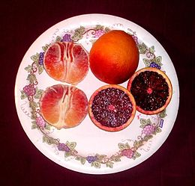
Bloody orange from Sicily
The definition Red Orange of Sicily (PGI) is used to identify some varieties of oranges with Protected Geographical Indication (PGI) grown in many centers in the provinces of Catania, Enna and Syracuse.
Oranges have a bright orange peel with red hues that vary depending on the variety and time of harvest and sweet taste
The name PGI recognizes the following varieties as “Bloody oranges from Sicily”:
The Tarocco variety
The Moro variety
The Sanguinello variety

Slide 2
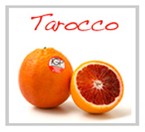
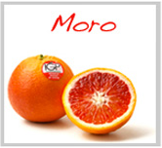
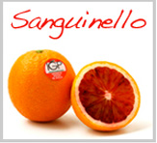
Characteristics of the variety of Bloody orange from Sicily
Tarocco
Shape: obovate or globose, with more or less prominent base
color of the peel: orange with parts colored in more or less intense garnet red;
pulp color: orange with more or less intense red mottling in relation to the harvesting period.
Moro
Shape: globose or ovoid;
color of the peel: orange with more intense nuances on one side of the fruit;
color of the pulp: vinous red when ripe.
Sanguinello
Shape: globose or obovata;
skin color: orange with red shades;
pulp color: orange with red streaks;

Slide 3
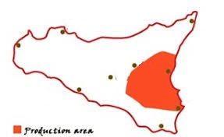
Production area
The production area of ​​the Red Orange of Sicily includes the municipalities of eastern Sicily suitable for cultivation and are thus identified
Province of Catania - Territory in the following municipalities:
Province of Syracuse - Territory in the following
Province of Ragusa - Territory in the following municipalities:
Messina
Palermo
Trapani
Enna
Catania
Caltanissetta
Agrigento
Syracuse
Ragusa

