Slide 1
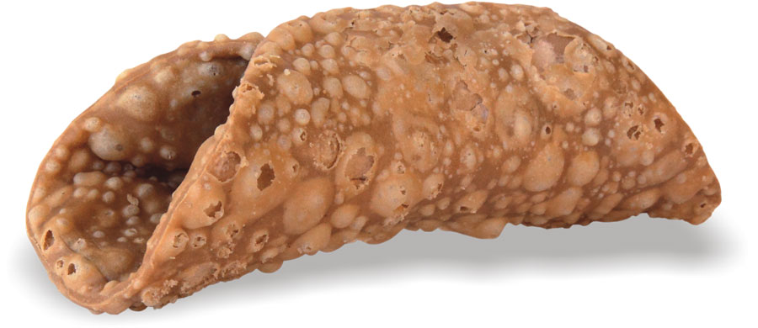
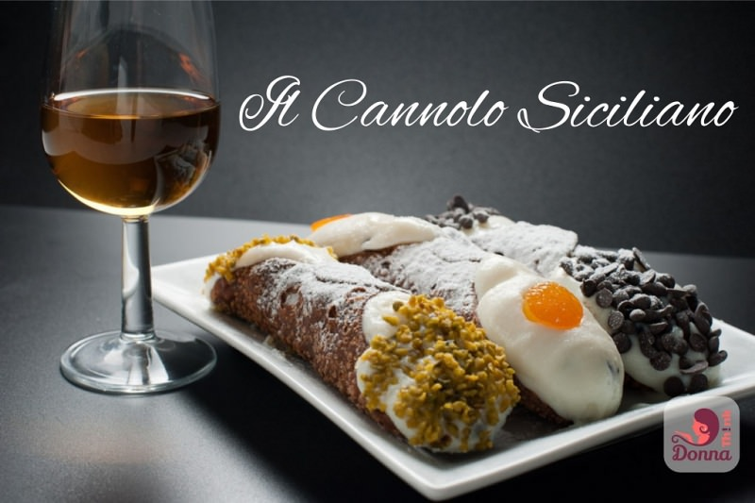
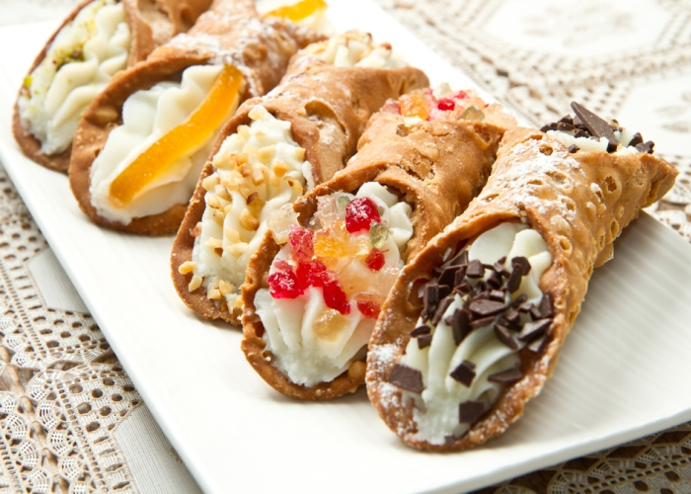
cannoli alla siciliana
Ingredients
For the DOUGH
(cannoli cialda)
400 g of flour 75 g of lard 40 g of caster sugar 2 eggs 1 egg white a pinch of salt 15 g unsweetened cocoa powder 60 ml of dry Marsala 60 ml of white vinegar metal rod shapes to make cannoli Peanut oil for frying

Slide 2
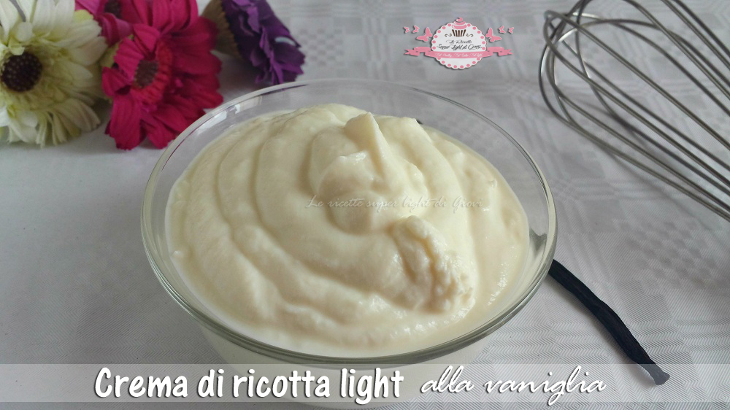
INGREDIENTS for the filling
1 kg of fresh sheep ricotta 600 g of sugar A pinch of cinnamon powder 150 g of dark chocolate drops Candied cherries (2 per cannolo) Candied orange peel (1) per cannolo
DIRECTIONS FOR the RICOTTA CREAM
If ricotta is too moist, make it drip in order to remove most of the serum. Mix ricotta and sugar well , leave it stand for an hour and sift it. Finally add cinnamon and dark chocolate.

Slide 3
If you have the opportunity, use a planetery mixer with the leaf tool, mix flour, sugar, cocoa, salt, lard well and then add the eggs, letting them combine well. Keep on working, add Marsal and vinegar until the mixture is not soft but firm. Make a ball, wrap it with parchment paper and put it into refrigerator for at least an hour.
Flatten the dough and make it thin with a rolling pin gradually sprinkling with flour both the worktop and the dough. When it reaches the desired thickness, make some disks which have a 10 cm diameter, wrap them around the metal rods greased with oil, joining the edjes, brushing them with beaten egg white.
Fry in plenty of hot oil, two to three at a time. As soon as the rind is dark gold, place them on absorbing paper towels to cool. Twist and remove gently the rods.
LET’S PREPARE CANNOLI
Fill in the rinds with the ricotta cream and smooth the ends helping yourself with a knife. Place a candied cherry on the ends, put them on a tray and sprinkle with powdered sugar.
Finally lay the candied orange peel on the top to decorate.

