Slide 1
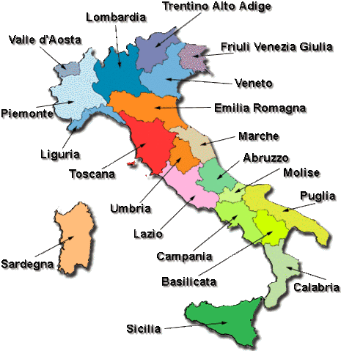
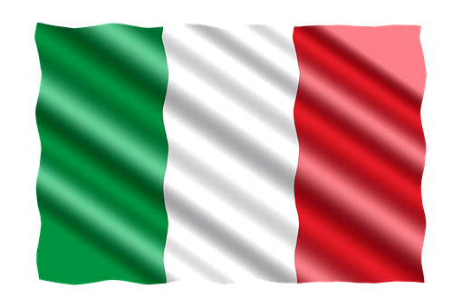
Italy and its regions
Italy is a peninsula of Europe.
It consists in 20 regions included Sardinia and Sicily that is the largest island in Europe.
The capital of Italy is Rome, it is known all over the world for its ancient monuments and history.
It was the capital of the Roman Empire.

Slide 2
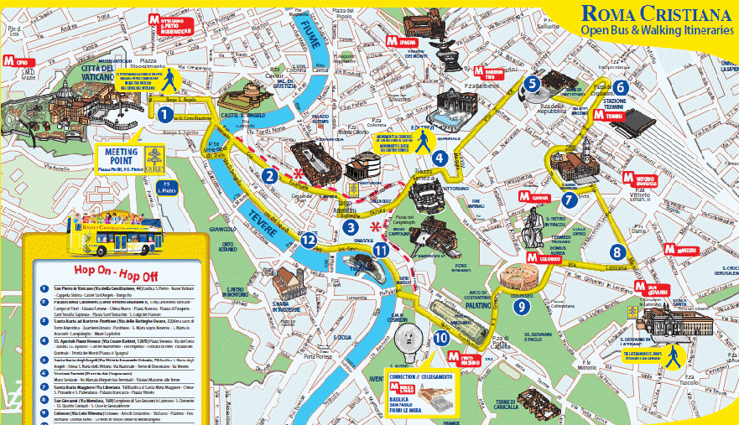
Rome and its monuments
Founded according to tradition on April 21, 753 B.C. , during its three millennia of history, it was the first great metropolis of humanity, the beating heart of one of the most important ancient civilizations, which influenced society, culture, language, literature, art, architecture , philosophy, religion, law and customs of the following centuries

Slide 3
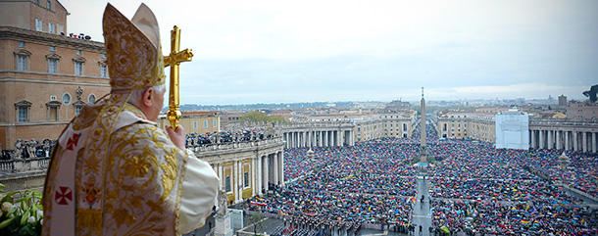
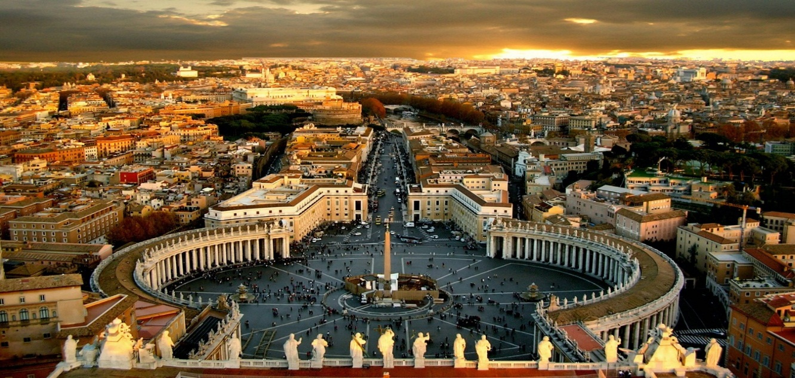
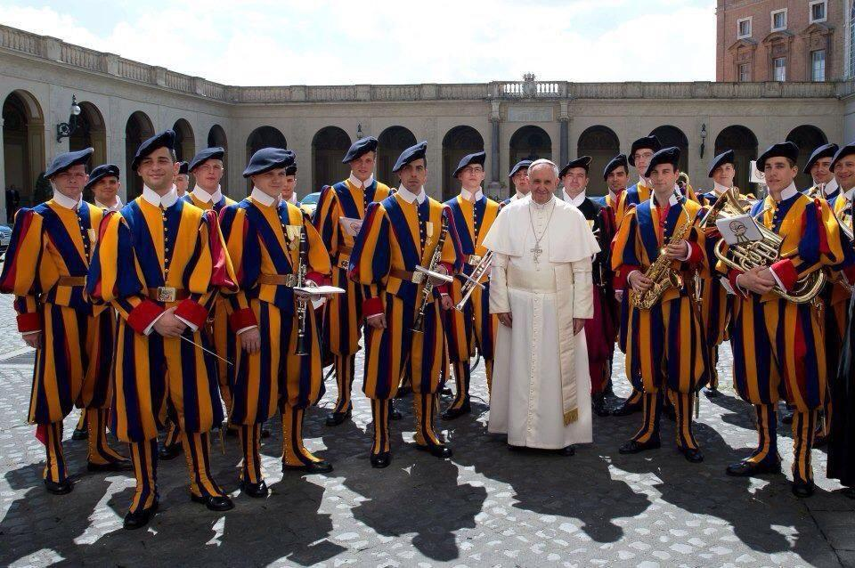
The Vatican
The Vatican is the smallest city in the world. It was admitted in 1870 to the Kingdom of Italy. It has a population of 605 inhabitants and has a width of about 0.44 kmq. The suiss guards live there to protect the Pape and the Vatican.

Slide 4
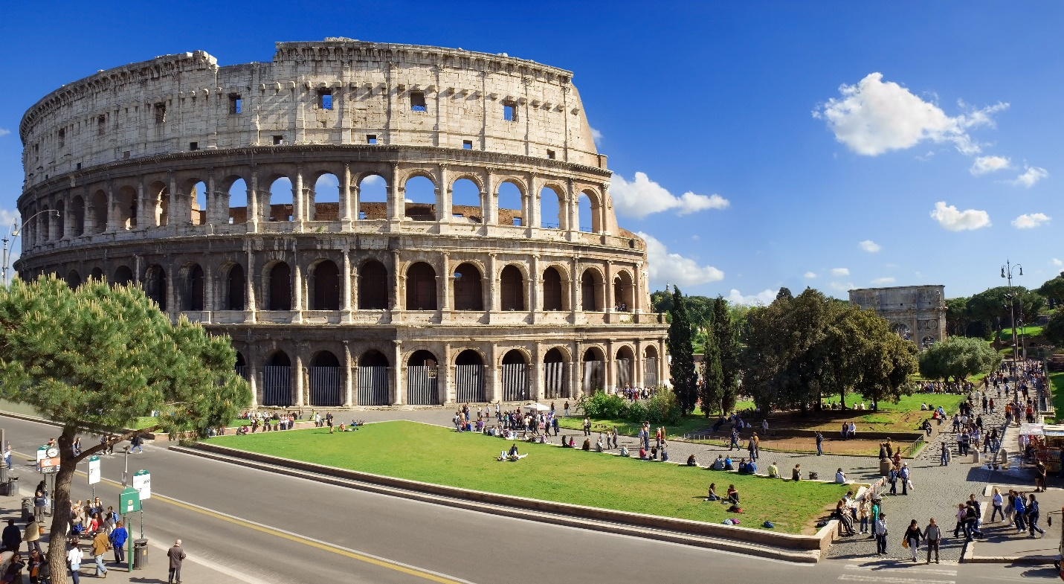
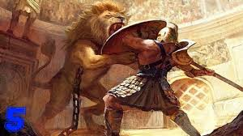
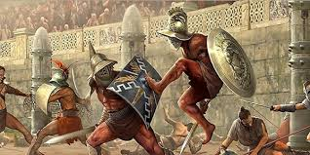
The Colosseum
In the Colosseum were held the gladiators’ fights.
It is one of the most important monuments in Italy.
It is located in Rome.

Slide 5
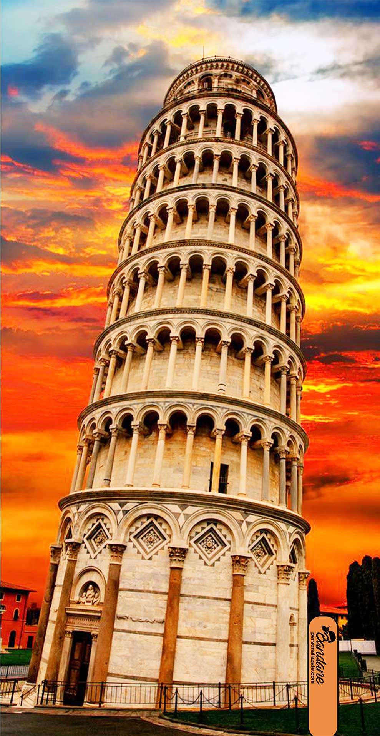
Pisa’s Tower
This is the Tower of Pisa.
It is situated in Tuscany, one of the 20 Italian regions.
The building was begun on 9th April 1173 by Bonanno Pisano.

Slide 6
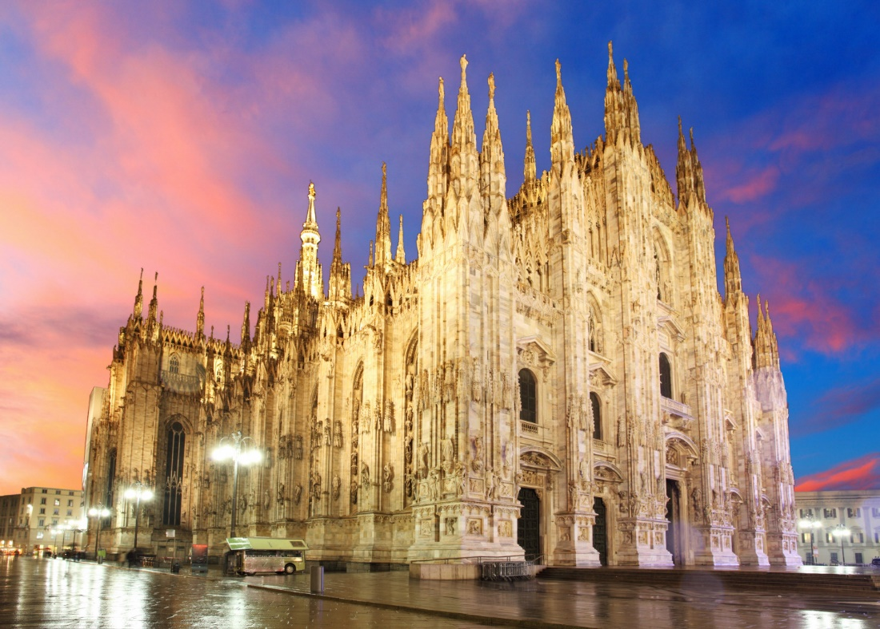
Duomo of Milan
The Basilica Metropolitan Cathedral of the Nativity of the Blessed Virgin Mary, better known as Milan Cathedral, is the cathedral of the Archdiocese of Milan. Symbol of the Lombard capital, and located in the homonymous square in the center of the metropolis, it is dedicated to Santa Maria Nascente. By surface it is the sixth Christian church in the world. It is home to the parish of Santa Tecla in the Duomo of Milan

Slide 7
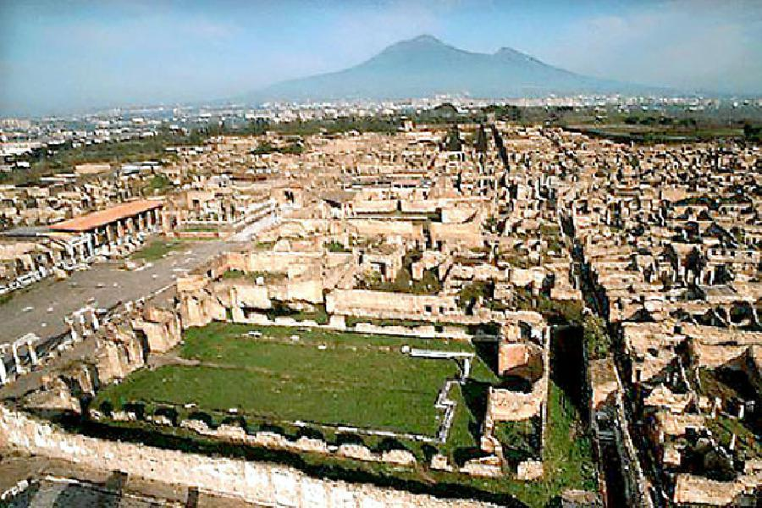
Pompeii was destroyed by Vesuvio that is a volcano in the centre of Italy
Pompeii is a very old city built near Vesuvius, the architect of its destruction in 79 A.D.

Slide 8
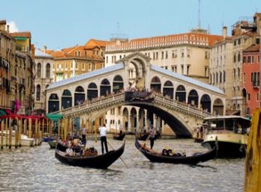
Venice
The city of Venice has been for over a millennium the capital of the Republic of Venice. Venice is universally considered one of the most beautiful cities in the world and is listed, together with its lagoon, among the UNESCO World Heritage sites: this factor has a turnover to make it the third Italian city (after Rome and Milan) with the highest tourist flow, mostly coming from outside Italy.

