Slide 1
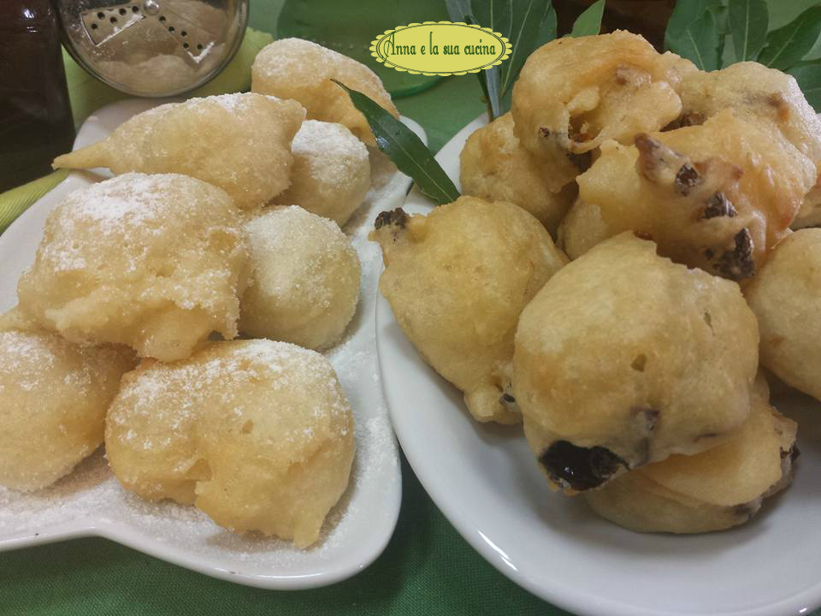
CRISPELLE

Slide 2
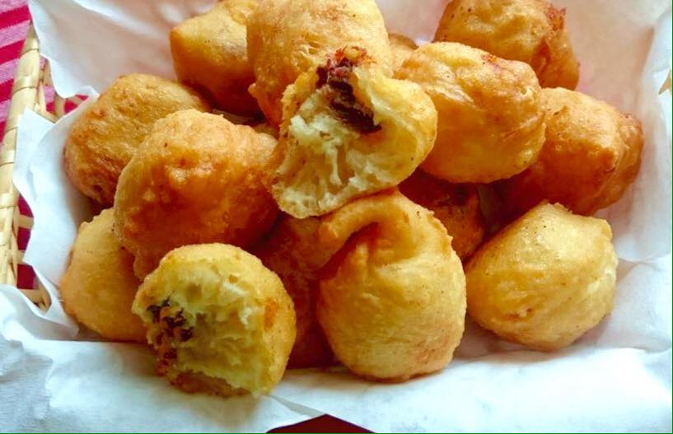
Ingredients
500 gr. flour
370 ml of water
10 gr. of brewer's yeast
2 teaspoons of salt
1 pinch of sugar
peanut oil
anchovies
dried tomatoes
granulated and icing sugar
nutella

Slide 3
How to prepare them
1°
Dissolve the yeast in warm water, NEVER hot, then add half flour, a pinch of sugar, salt and the remaining flour. Knead the dough vigorously, better with a planetary with the whisk K, for at least 10 minutes, start gradually with speed 3, then increase slowly.
It is necessary that the dough is kneaded thoroughly, gets warm and makes bubbles. Add more water or flour if needed, it usually depends on the humidity and the different flour used.

Slide 4
2°
The dough should be soft, elastic and sticky, keep in mind that after the rising you will take the dough with two spoons or with your hands.
Cover and let it rest until it doubles in volume (about 2 hours)
Prepare the salted, cleaned, washed and dried anchovies and put aside, cut the dried tomatoes into small pieces, you can also use soaked cod, cauliflower…
Put plenty of oil in a large frying pan, as soon as the oil is hot, first fry the dough to make sweet crispelle. Use two tablespoons or pull the dough, which is elastic, with your hands.

Slide 5
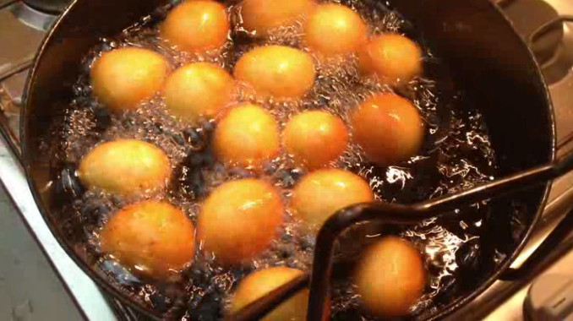
3°
As soon as they start to swell, turn them to brown all sides. When they are well cooked, let them drain on paper towels and sprinkle with granulated sugar and icing.
You can also fill them with nutella, ricotta or other cream.
Continue frying the remaining dough to make salty crispelle by adding anchovies, dried tomatoes into small pieces, olives or other flavours, and spoon them when they are golden brown.
Serve hot and crispy.

