Slide 1
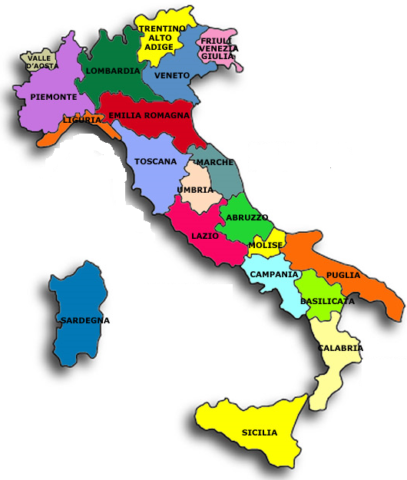
ITALY : our beautiful peninsula
Italy is a country in the south of Europe , It seems like a boot.
It has got twenty regions. Sicily and Sardinia are isles.
Italy has a beautiful culture and lots of ancient monuments.

Slide 2
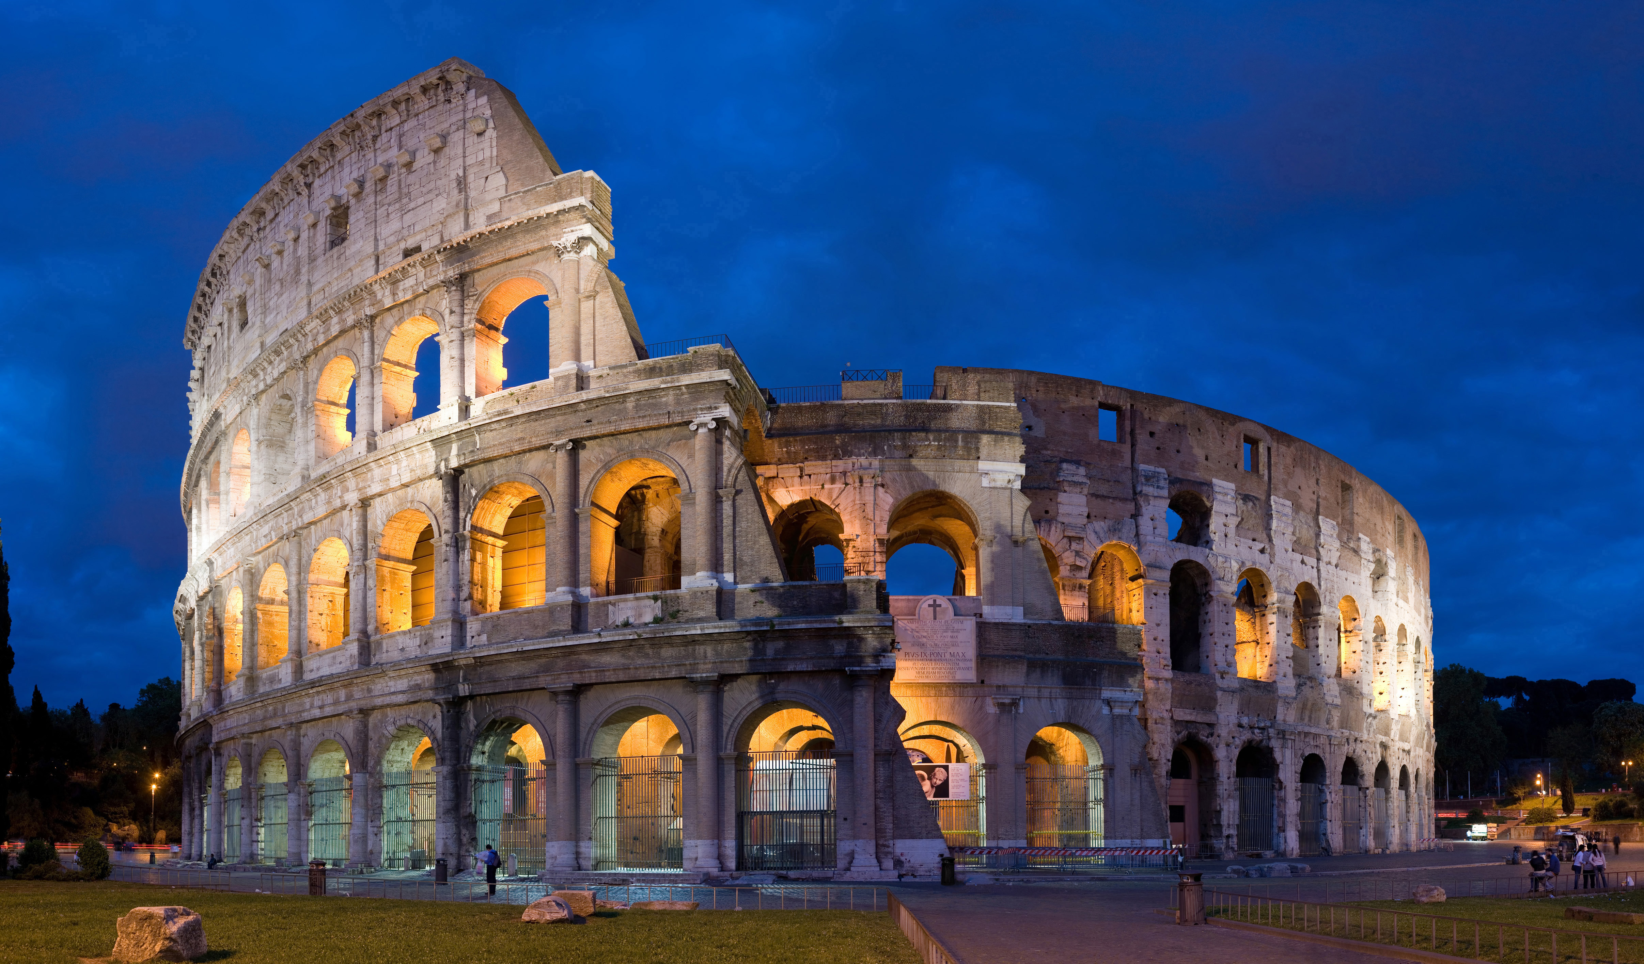
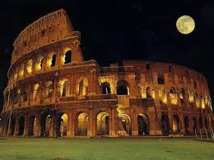
THE MONUMENT OF ITALY:
Italy has a lot of beatiful monuments like: The ‘Colosseo’ ; The Tower of Pisa and the ‘Fontana di Trevi’
The ‘Colosseo’
The ‘Colosseo’ (Anfiteatro Flavio) is one of the most important monuments in Italy and the biggest amphitheater in the world .
It was built under the empire of Tito Flavio Vespasiano in 70 A.D.

Slide 3
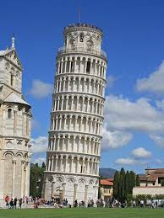
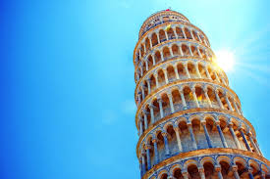
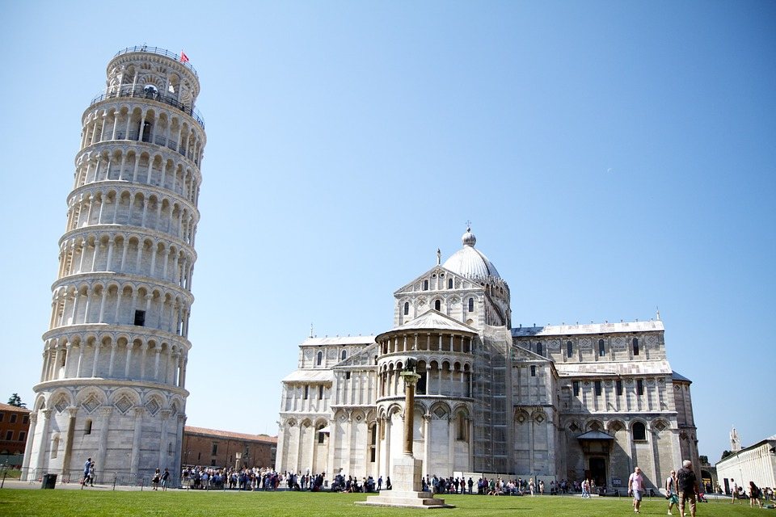
THE TOWER OF PISA
The Tower of Pisa is a belltower in the Duomo’s square.
It was built over two centuries by Diotisalvi , between the XII and the XIV.

Slide 4
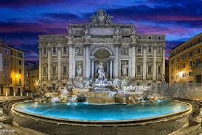
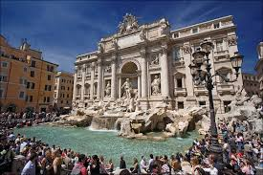
FONTANA DI TREVI
The ‘Fontana di Trevi’ is the biggest fountain in Rome and one of the most beautiful in the world.
This fountain was made by Nicola Salvi , but it was completed by Giuseppe Pannini . It belongs to the late Baroque.

