Slide 1
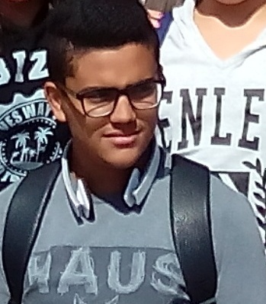
Hello , my name is Osama.
I live in Reggio Calabria I attend a hotel and catering vocational school.
I'm in the second class.
I love eating what I prepare.

