Slide 1
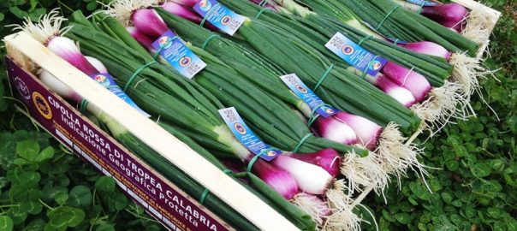
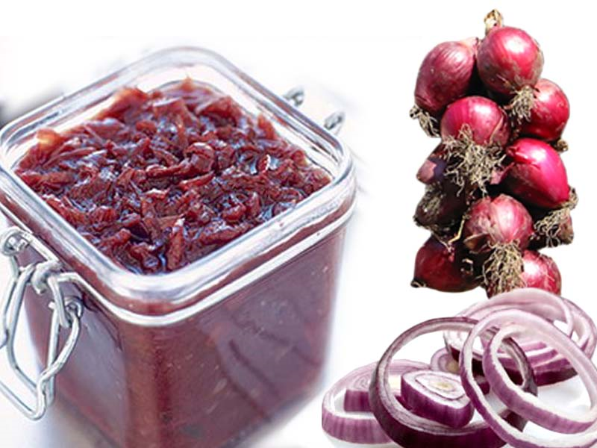
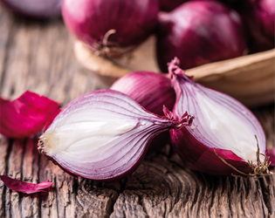
Tropea onion (cipolla di tropea)
Italy boasts many varieties of onion, but perhaps due to its unique sweetness, the most famous and appreciated, even abroad, is onion from Tropea.
Grown by hand on the clay cliffs that descend from the pore mountain towards the sea between Capo Vaticano, Zambrone, Tropea and Briatico, in the provinces of Cosenza and Vibo Valentia, the onion of Tropea was brought to Calabria by the Greeks, who had discovered it thanks to Assyrians and Babylonians. However, the Arabs perfected his cultivation in Tropea, where they settled for some time, and contributed to its spread through the region.
The shape of its bulbs, of an intense violet color, vary from round to oval to elongated. The extraordinary sweetness of the onion, the delicate scent, the lightness and the pleasant taste, which derive from the morphological peculiarities of the soil and of the microclimate in which it is cultivated, make it a very sought after ingredient by the gourmets and the Cooks.
As if its wonderful taste was not enough, the onion of Tropea has shown health benefits, known since antiquity. Pliny the Elder, in his "Naturalis Historia", lists 30 disorders that can be treated with the onion, and medical science has confirmed its healing powers. Recent studies have shown that the onion of Tropea, because of its high quality, seem to provide better therapeutic functions than other varieties, particularly diuretic, hypoglycemic, and anticancer functions. In addition, it has antiseptic properties, can alleviate both the symptoms of cold and flu, strengthens the cells and tone the arteries, lowers blood pressure, and is also used in dermatology.
In addition to being consumed raw in salads, the TROPEA onion can be prepared in different ways: cooked, boiled, as stuffed for omelet. In Tropea, it is also used to produce a delicious onion jam, to be consumed on croutons, as an appetizer and as accompaniment to roasts. Another delicacy made in Tropea is an onion jam and roasted peppers, a perfect accompaniment.

