Slide 1
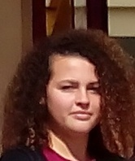
ALESSIA’S PRESENTATION

Slide 2
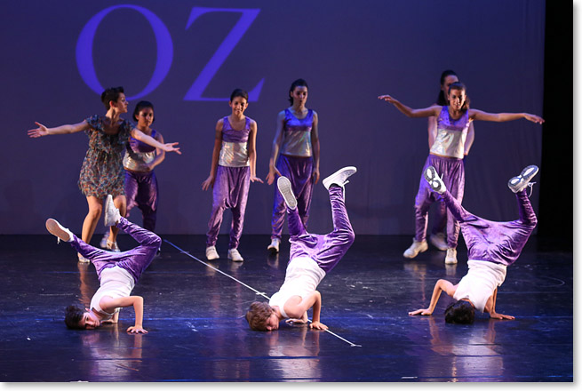
Hello, my name is Alessia Caracciolo. I'm 15 years old. I'm from Cannavò in province Reggio Calabria. I attend a Hotel and Catering vocational school, I'm in the second class. I love play volleyball and dance. I have one brothers his name is Antonio . I have one dog i love him!!

