Slide 1
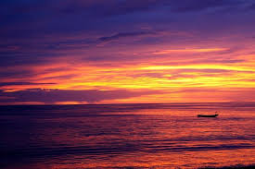
Hello,
my name is Carmen De Leo.
I'm 15 years old and, i live in Bagnara Calabra in province of Reggio Calabria.
I attend A Hotel and Catering vocational school, I'm in the second class.
I love staying with my friends, eating pizza and drinking Coke
Carmen De leo

