Slide 1
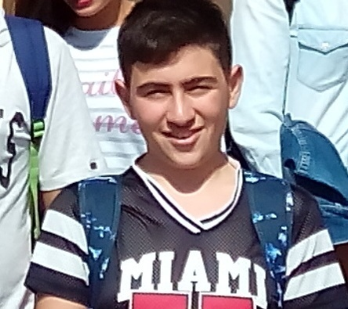
Hello , I'm Antonino . I'm 15 years old , I live in Campo Calabro in province of Reggio Calabria . I attend a Hotel and Catering vocational school . I'm in the 2nd class . I love swimming and eating pizza , and I like playing computer games and looking Anime .

