Slide 1
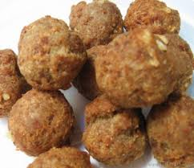
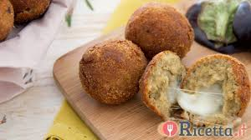
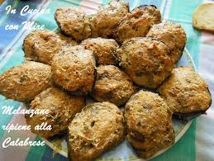
Meatballs
Ingredients for 44 meatballs
Beef meat 500g - Stale bread 130g - Grated Parmesan cheese - 2 medium eggs - A pinch of salt - Black pepper- Provola 70 gr - 50g of Parsley - 50 g of thyme – a little breadcrumbs - Seed oil

Slide 2
To prepare meatballs, start slicing the stale bread. Remove the crust and cut the breadcrumbs into cubes, then place it in a mixer together with minced parsley and thyme leaves: mix all together until you obtain a smooth and homogeneous mixture. Slice and chop coarsely the provola. In a large pan place the meat, chopped bread and provola, add the grated Parmesan and finally the eggs slightly beaten. Season with salt and pepper then start kneading with your hands until obtain a compact dough, which must be left in the refrigerator for 30 minutes covered with plastic wrap. After the necessary time, remove the dough from the refrigerator, moisten your hands and start dividing the dough into portions of about 20 g: model each one on the palm of the hand to obtain 44 meatballs of the same size. Put in a large bowl breadcrumbs and pass each meatball in, turning well for a uniform breading. Let them rest on the tray, trying to distance them slightly from each other. Meanwhile, bring the oil to fry at a temperature that does not exceed 170-180 °. When it will be hot at the right point, dip 2-3 meatballs at a time to prevent lower the temperature too much, cook a few minutes (2-3 minutes will be enough) until you get a nice browning, then transfer the cooked meatballs on paper towels just long enough to eliminate the excess oil. Meatballs are ready, serve them hot!

