Slide 1
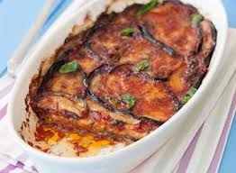
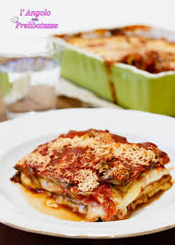
Ingredients
Aubergine parmigiana (Light version)
Extra-virgin olive oil
1kg of large aubergines
700 g of tomato sauce
1 bunch of fresh basil
300 g of mozzarella or provola (Italian melting cheese)
80 g of grated Parmesan
Some breadcrumbs
Extra-virgin olive oil
A garlic clove
Salt and pepper

Slide 2
Cooking method
Preheat the oven to 200° C to grill the aubergines.
Get about 6 slices from each aubergine, about 0,5 cm thick. Put them on a parchment sheet so that they do not stick and brush all the rows lightly with extra – vergin olive oil. Bake them at 200° C until they turn golden brown on top, about 12-15 minutes. Remove the aubergines from the oven and place them on a plate to cool.
Prepare the sauce.
In a saucepan heat the olive oil over medium heat with the garlic, add the tomato sauce, basil, salt and pepper, lower the heat and simmer for 30 minutes until it becomes quite thick.
Now it’s time to layer the aubergines in a large baking dish.
To assemble them, put some tomato sauce at the bottom of a baking dish. Top with a layer of grilled aubergines, some more tomato sauce, grated Parmesan, sliced mozzarella or other melting cheese, some breadcrumbs and pepper. Repeat the layers until you run out of aubergines. Finish the top layer with the tomato sauce and grated Parmesan.
Bake at 200° C for 20–25 minutes or until it gets golden brown. Serve warm.
It tastes good at room temperature even the next day.

