Slide 1
THE BERGAMOT

Slide 2
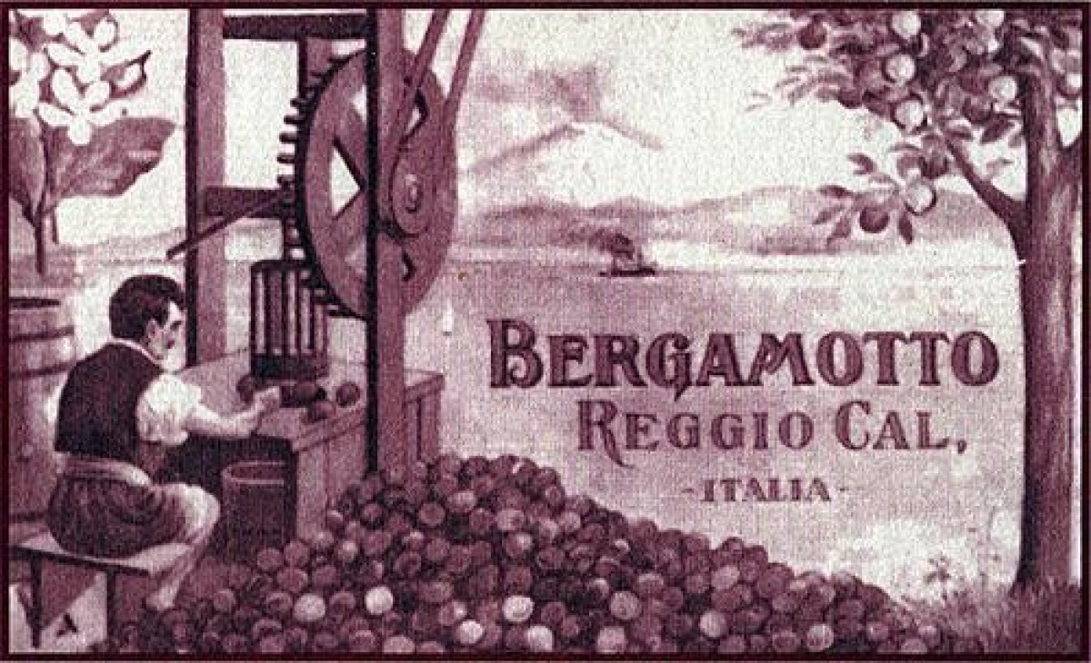
THE ORIGINS OF BERGAMOT
Early sources refer to a "bergamot grove" in Calabria as far back as 1750, but even earlier, in 1500, candied bergamot fruits were offered to Emperor Charles V who was passing through Rome. It is a generous plant: a rare essential oil is extracted from the skin of its fruit and an essence used for the production of perfumes, sweets and liqueurs is also obtained. It grows along the flat coastline protected by the hills from the wind blowing in from the Messina Strait. The Bergamot is produced along the coastal strip from Villa S. Giovanni to Gioiosa Jonica, between the Ionian Sea and the Tyrrhenian Sea. Calabria is the world's largest producer of bergamot, with 90% of total production The calcareous clay soil creates an ideal combination of various factors that enables some unique products to thrive. This is a “humid and temperate tropical” microclimate with an average of 300 days of sunshine in a year. All of this contributes to the growth of an extraordinary fruit which, together with the typical lemons of this coast, embody the true spirit of the South.

Slide 3
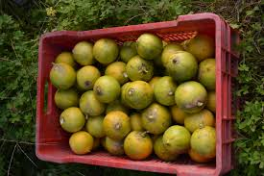
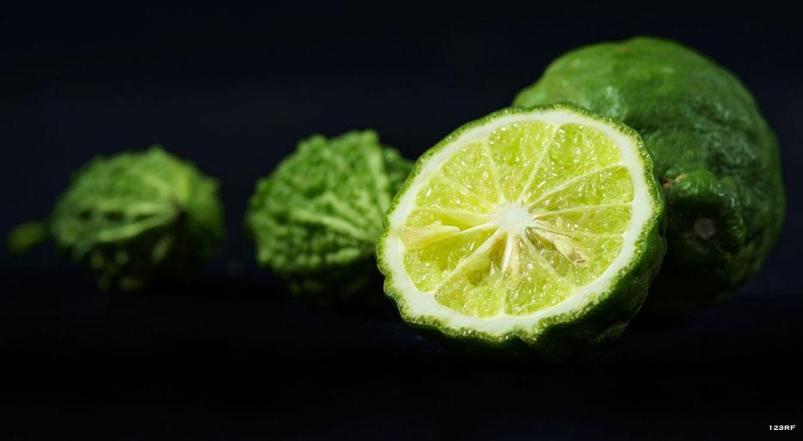
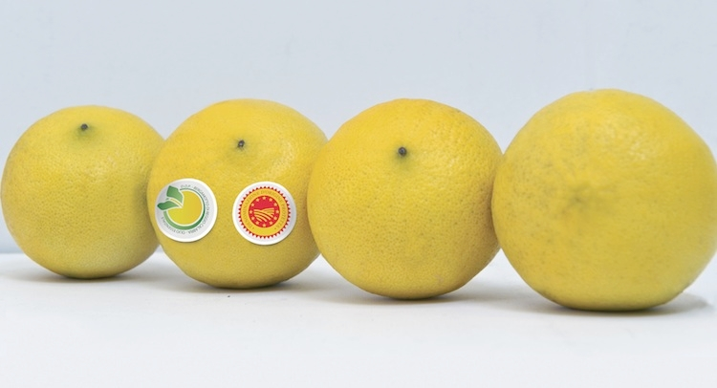
THE USES AND PROPERTIES OF BERGAMOT
As well as being a basic ingredient for most eau de toilettes, it is also used as a fixative in perfumery. However, owing to its traditional use in this industry, for a long time it was considered to be toxic. No one had ever thought of it as being an edible substance. In the last decade it has been introduced in cooking and its health-giving property as a powerful ally against cholesterol has been rediscovered. Scientists have found that the Calabrian citrus bergamot reduces “bad” cholesterol ,LDL (the fat-like substance that furs up the arteries, triggering heart attacks and strokes), and improves the good one, HDL, thanks to its unique high concentration of polyphenols.

Slide 4
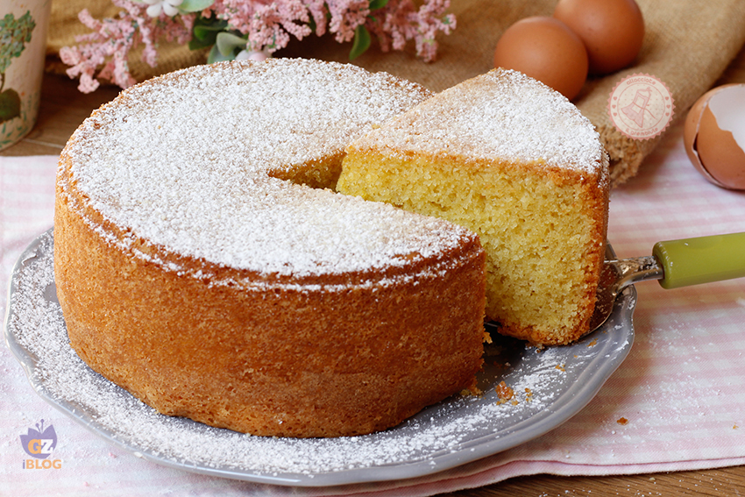
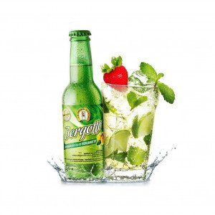
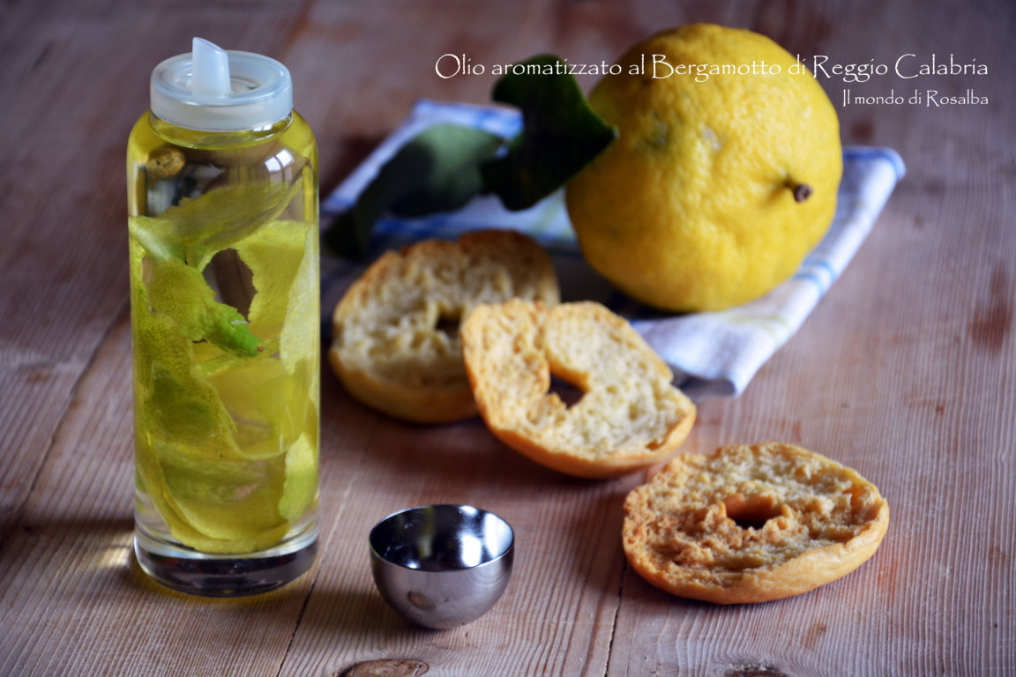
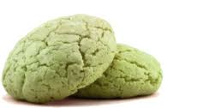
USE IN COOKING
Bergamot is widely used, especially in pastry making, where it confers a Mediterranean touch when used to aromatize doughnuts, cakes, sponges and creamy desserts. Moreover, it gives an interesting twist to salads and, when grated on fillets of fish, can completely transform an otherwise banal recipe. Another way to employ bergamot is in the preparation of a liquor which, in its turn, can be used to sprinkle on pan-fried fish or meat to give a touch of bitter sweetness to savoury recipes.
The quickest recipe of all? Marmalade.
Recipe - Remove peel and pith from 1 Kg of organic bergamots and blend them for 15 seconds. Add 700 g of sugar and boil for around 30 minutes. Pour the marmalade, still hot, into jars and seal them hermetically.

