Slide 1
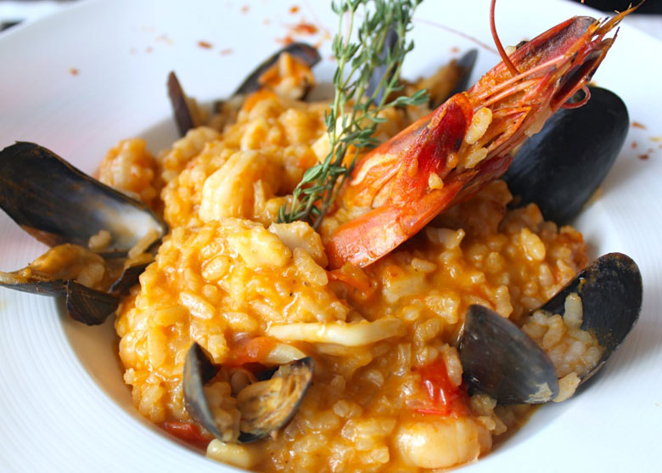
seafood risotto
Ingredients 1 tablespoon of butter 1 tablespoon of olive oil 350 g arborio rice 3 large shallots, finely diced 1/2 glass of dry white wine 2 glasses of fish stock 1/2 teaspoon of salt A pinch of saffron 12 prawns, shelled and halved lengthways (keeping the heads) 12 mussels, debearded 200 g white fish cut into small pieces 100 g of sliced scallops 4 tablespoons of freshly grated parmesan cheese 2 tablespoons of chopped fresh parsley 2 tablespoons of fresh chopped dill 2 tablespoons of chopped thyme Some diced butter, kept in the fridge

Slide 2
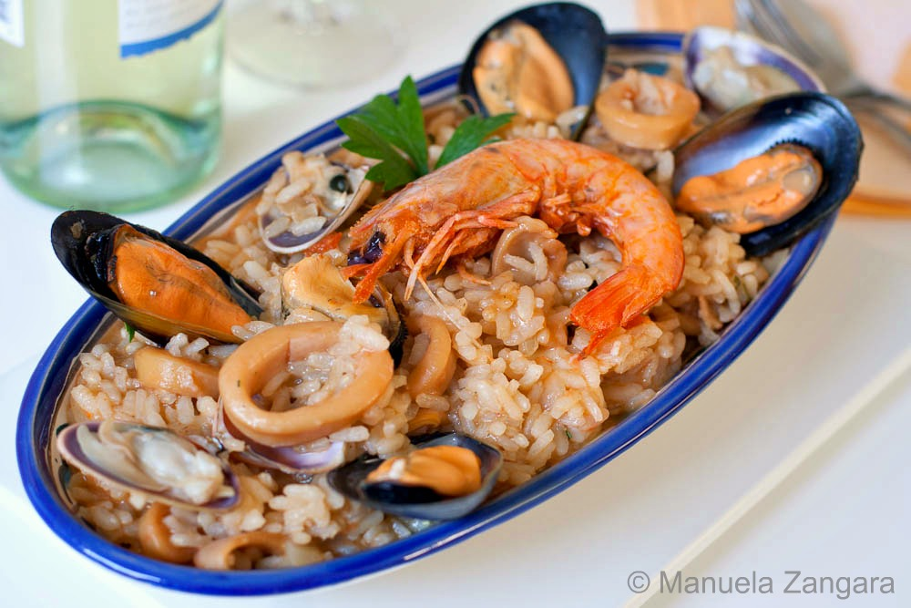
preparation Method Prepare all the seafood and keep aside. In a small saucepan, heat the stock until simmering. In a separate, heavy based saucepan, heat the olive oil, butter and the shallots over a medium heat and let sauté for 3 minutes. Add in the prawn heads and let cook for further few minutes. Add in the aborio rice and toast over a low heat for 2 minutes, stirring every frequently. Don’t let it stick!. Add wine and saffron and cook until almost evaporated, keeping stirring, this will take at least 1 minute.
Mix in hot stock and bring to the boil. Gently simmer the rice for around 12 minutes, adding in some more stock if it gets too dry. It should always resemble a porridge so keep it moist.
Add in the prawns and mussels and continue simmering for 2 minutes.
Add in the remaining seafood and simmer for a further minute. The rice should be tender but still firm to bite or ‘al dente’.
Remove from the heat and vigorously stir in the cheeses and the cold diced butter. Stir continuously until all the butter has melted. Mix in the thyme, dill and parsley. Season risotto with pepper and garnish with the mussels and prawn heads placed on the top.

