Slide 1
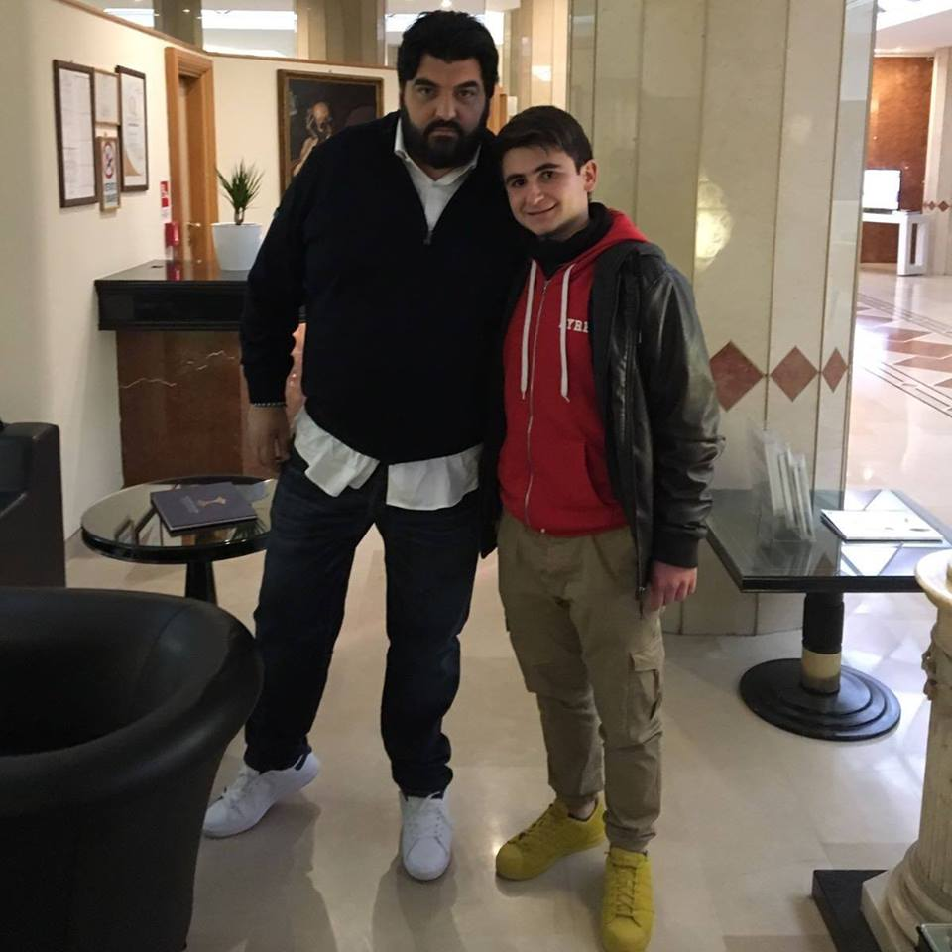
Hello everyone!
My name is Antonino , I'm fifteen, I live in Reggio Calabria(in the south of Italy).
I attend a Hotel and Catering vocational school , I'm in the 2nd class .I love cooking and eating what I prepare. I love travelling.

