Slide 1
MATTEO AND CARMEN ‘S FAVORITE DISHES AND DRINK

Slide 2
Enjoy our food!

Slide 3
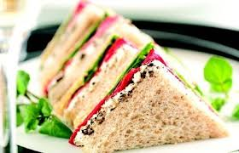
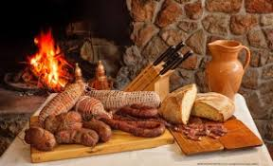
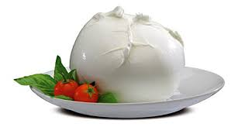
OUR STARTERS
Sandwich
Calabrian cured meats
Mozzarella

Slide 4
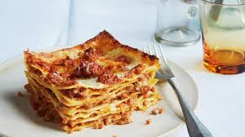
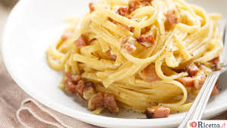
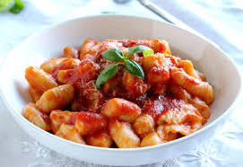
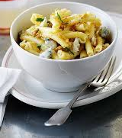
Ist CORSES
Lasagna
Carbonara
Gnocchi with mozzarella cheese
Strozzapreti with nuts and gorgonzola cheese

Slide 5
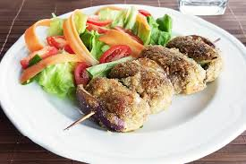
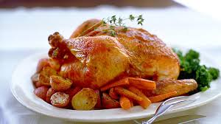
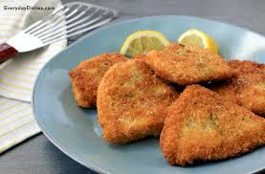
II nd CURSES
Meat rolls/wraps
Roast Chicken
Chicken cutlets

Slide 6
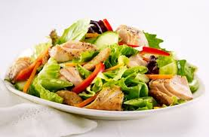
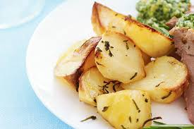
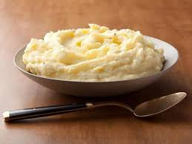
SIDE DISHES
Baked potatoes
Mixed salad
Mashed potatoes

Slide 7
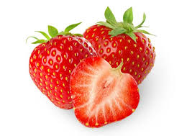
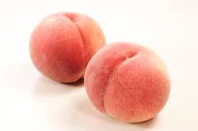
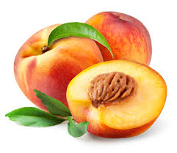
FRUITS
Strawberries
berries
Walnuts peaches
Peaches

Slide 8
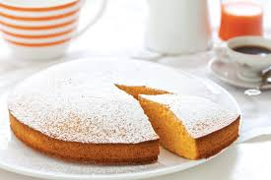
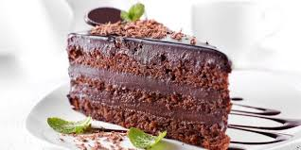
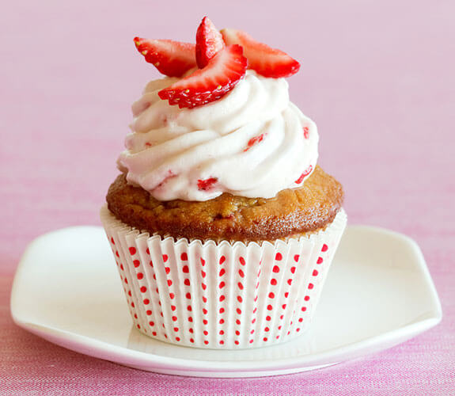
DESSERT
Carrots cake
Chocolate cake
Cupcake

Slide 9
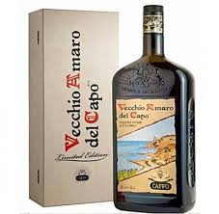
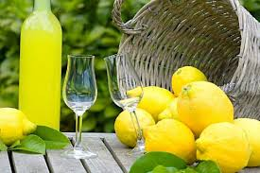
DRINKS
Herbs and spices based liqueur
Amaro del capo
Lemon based liqueur
Limoncello

