Slide 1
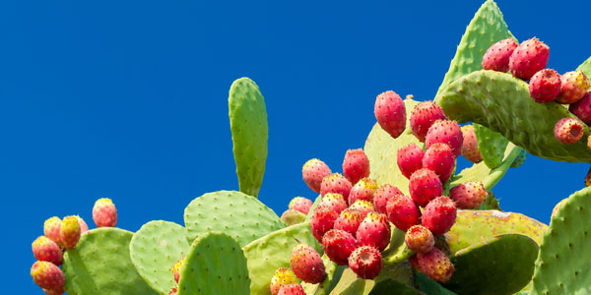
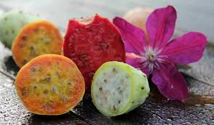
Fico d’ India

Slide 2
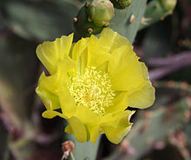
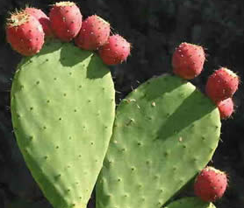
Origin:
The prickly pear is a succulent plant belonging to the family of cacti and to the genus opuntia , native of Mexico but
naturalized throughout the Mediterranean basin but now it has become a symbol of southern Italy. The prickly pear is a fat plant, which can exceed 3m in height and produces highly appreciated edible fruits. The flowers are an inferior and unilocular ovary. The pistil is surmounted by a multiple stigma. The stamens are very numerous. The sepals are not very visible while the petals are clearly visible and of a yellow-orange color.

Slide 3
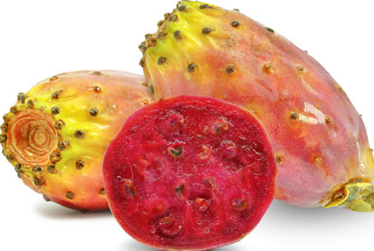
Nutrients and phytochemicals :
One benefit of Opuntia ficus-indica for human and animal consumption is its water content in an arid environment, containing about 85% water as an important source for wildlife.The seeds contain 3-10% of protein and 6-13% of fatty acids, mainly linoleic acid. As the fruit contains vitamin C (containing 25–30 mg per 100g), it was once used to mitigate scurvy.
There are high levels of selenium in Opuntia.
The red color of the juice is due to betalains, (betanin and indicaxanthin). The plant also contains flavonoids, such as quercetin, isorhamnetin and kaempferol.

Slide 4
HEALTH BENEFITS OF PRICKLY PEAR

Slide 5
