Slide 1
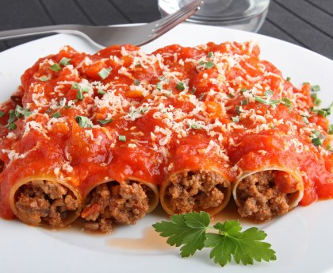
Cannelloni
for 6 people
-250 g of cannelloni (1 pack of 24 cannelloni)
-800 ml of tomato sauce
- 600 ml béchamel sauce
- 400 g of mozzarella
-500 g of minced meat
-1 egg
-30 g of cheese
- 1/2 of onion
-White wine
- extra virgin olive oil
-salt

Slide 2
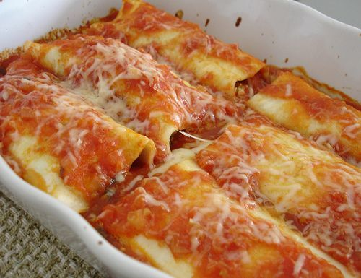
PREPARATION
Pour the tomato sauce into a saucepan with a little oil and salt, cooking for about twenty minutes.
Prepare the béchamel sauce and keep it aside.
In a pan brown the chopped onion in a little oil and add the minced meat; when it is ready, flavour with white wine.
Add a pinch of salt and a couple of ladles of tomato sauce, then cook until you get a a nice thick sauce.
Turn off the heat , add 2 eggs, Parmesan and diced mozzarella; mix the filling until it is smooth. With a teaspoon fill each cannellone with the stuffing of meat obtained.
Cover cannelloni with the remaining tomato sauce and sprinkle with grated Parmesan.
Then place them next to one another on a baking tray sprinkled with tomato sauce.
Bake cannelloni at 180°C and cook for about 30 minutes.

