Slide 1
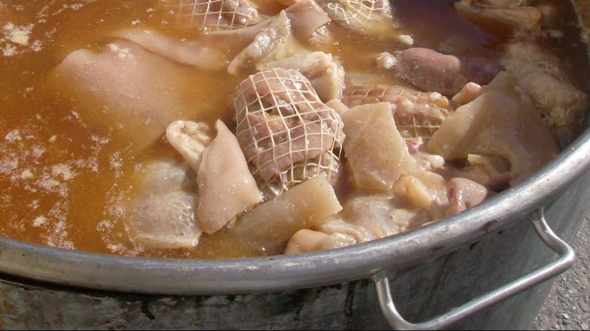
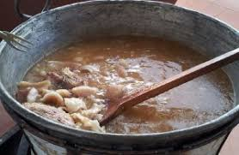
Frittole Ingredients
Lard - Rinds -Ribs- Shins - Neck -Tongue -Cheek - Muzzle - Ears - Tripe - Other less noble parts of the pig -Salt and Pepper

Slide 2
Cooking Method
Clean and scrape the pork scratching (cotenne). With a sharp knife, remove all the fat from the rind and place it in a bin with fresh water. Cut the lard into thin strips and place it in the bin with water. Clean the other parts thoroughly. In a large pot, put the lard, pork rinds and other fat parts on the bottom of the pot. Continue adding the rest of the pork pieces. Add a glass of salted water with a tablespoon of salt. Put the pot on a low temperature and constant fire so that the fat melts but does not fry. The fat must melt completely and cover all the meat. Add a little water if it is necessary (if it boils too much). Once the meat is cooked, add salt to it, dissolving no more than a tablespoon of salt in a glass of warm water. Check if the frittole are well cooked using a fork. Remove the pot from theheat and transfer the meat on a serving dish, sprinkle with plenty of black pepper and nutmeg, decorate with slices of oranges on the top and serve the them hot.
The frittole that remain can be stored in an earthenware jar or a glass jar like this: put them inside the jar, filter the melted fat with a strainer and pour it over the frittole until it covers them. When the lard has solidified, pour a pinch of salt over it, close and store the jar in a cool place.

