Slide 1
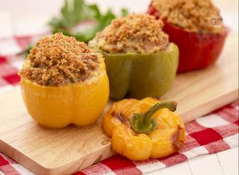
Stuffed Green / Red / Yellow Peppers
Ingredients
Big and coloured peppers
Extra virgin olive oil
Milk
Salt
Pitted black olives
About a tablespoon of breadcrumbs (for each pepper)
About a tablespoon of grated Parmesan (for each pepper)
About 90 g of minced meat (for each pepper)
About 20 g of mozzarella or provola cheese

Slide 2
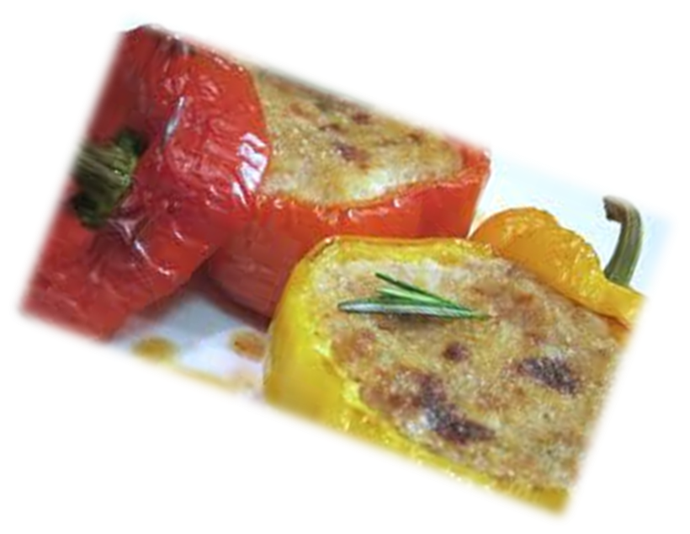
Cooking method
In a bowl put the minced meat, grated Parmesan, breadcrumbs, a pinch of salt, chopped olives, mozzarella and a little milk. Mix everything and immediately after, wash, dry and empty the peppers completely. Fill each one with the mixture made previously and place them all in a baking pan greased with oil or lined with parchment paper. Bake them for three quarters of an hour at 200 ° C in a preheated oven.

