Slide 1
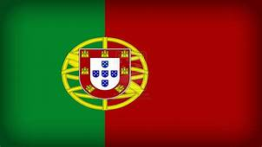
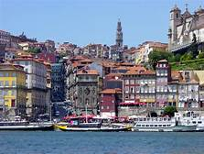
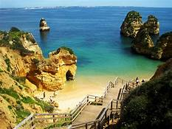
Portugal

Slide 2
Portugal

Slide 3
Geography
Portugal is a Southern European State, founded in 1143, which occupies a total area of ​​92,212 Km2.
The continental part is situated in the extreme south-west of the Iberian Peninsula, bordering the north and east with Spain, and west and south with the Atlantic Ocean.
The Portuguese territory also covers two autonomous regions: the Archipelagos of Madeira and the Azores, located in the Atlantic Ocean.

Slide 4
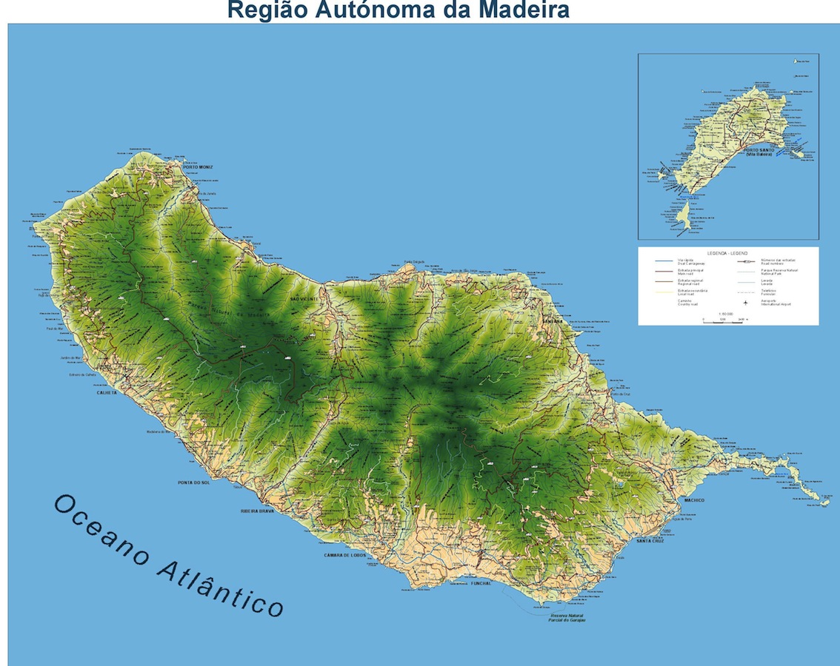
The Archipelago of Madeira is made up of the islands of Madeira, Porto Santo, Desertas and Selvagens.

Slide 5
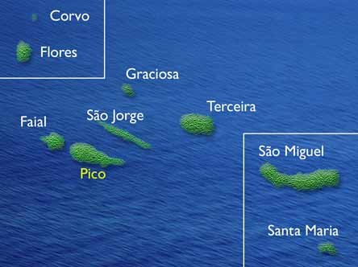
The the Azores islands are 9islands and some
islets: Santa Maria, São Miguel, Terceira,
Graciosa, São Jorge, Pico, Faial, Flores and Corvo.

Slide 6
Climate
The Portuguese climate is characterized by mild winters and mild summers, varying, however, from region to region.
South of the Tagus, the largest Portuguese river, the Mediterranean influences are felt, with very hot and prolonged summers, and short winters with little rainfall.
Madeira has a Mediterranean-type climate with mild and pleasant temperatures all year round, while the Azores have a temperate maritime climate with abundant rainfall.

Slide 7
Population
Portugal is a country with 10.6 million inhabitants (2011), with a greater population concentration along the coastline.

Slide 8
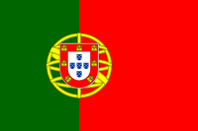
National symbols
The Portuguese Flag:
Red: The courage and blood of the Portuguese fell into battle.
Green: The hope.
Armillary Sphere: The world discovered by the navigators in the fifteenth and sixteenth centuries and the people with whom they exchanged ideas and trade.
7 Castles: The fortified localities, conquered to the Moors by D. Afonso Henriques.
5 Quins: The 5 Moorish kings defeated at the Battle of Ourique by D. Afonso Henriques.
5 white dots in each corner: The 5 wounds of Christ

Slide 9
National Anthem
Heróis do mar, nobre povo, Nação valente, imortal, Levantai hoje de novo O esplendor de Portugal! Entre as brumas da memória, Ó Pátria sente-se a voz Dos teus egrégios avós, Que há-de guiar-te à vitória! Às armas, às armas! Sobre a terra, sobre o mar, Às armas, às armas! Pela Pátria lutar Contra os canhões marchar, marchar! Desfralda a invicta Bandeira, À luz viva do teu céu! Brade a Europa à terra inteira: Portugal não pereceu Beija o solo teu jucundo O Oceano, a rugir d'amor, E teu braço vencedor Deu mundos novos ao Mundo!
Às armas, às armas! Sobre a terra, sobre o mar, Às armas, às armas! Pela Pátria lutar Contra os canhões marchar, marchar! Saudai o Sol que desponta Sobre um ridente porvir; Seja o eco de uma afronta O sinal do ressurgir. Raios dessa aurora forte São como beijos de mãe, Que nos guardam, nos sustêm, Contra as injúrias da sorte. Às armas, às armas! Sobre a terra, sobre o mar, Às armas, às armas! Pela Pátria lutar Contra os canhões marchar, marchar!

Slide 10
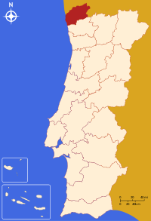
Viana do Castelo
Santa Luzia‘s Basilic

Slide 11
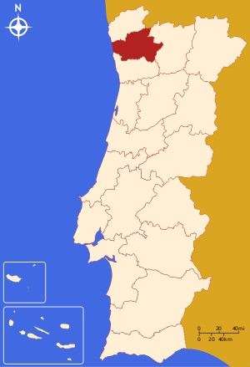
Braga
Peneda-Gerês National Park

Slide 12
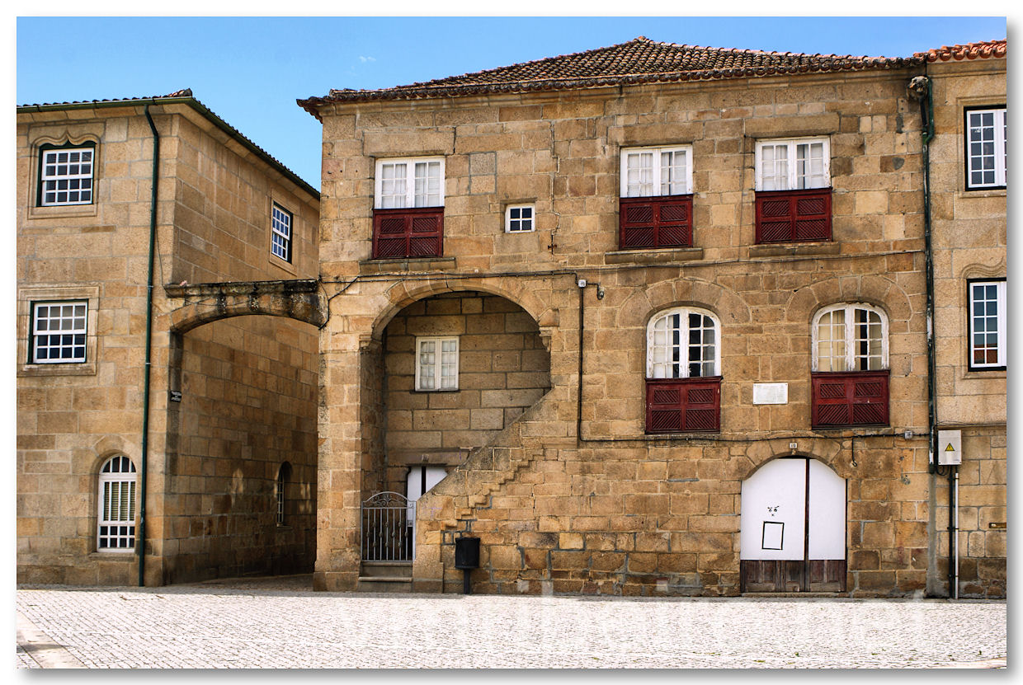
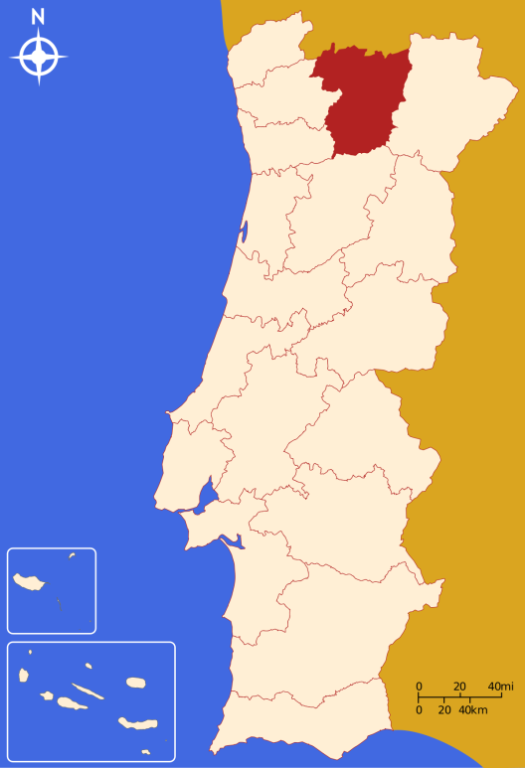
Vila Real
Home of Diogo Cão

Slide 13
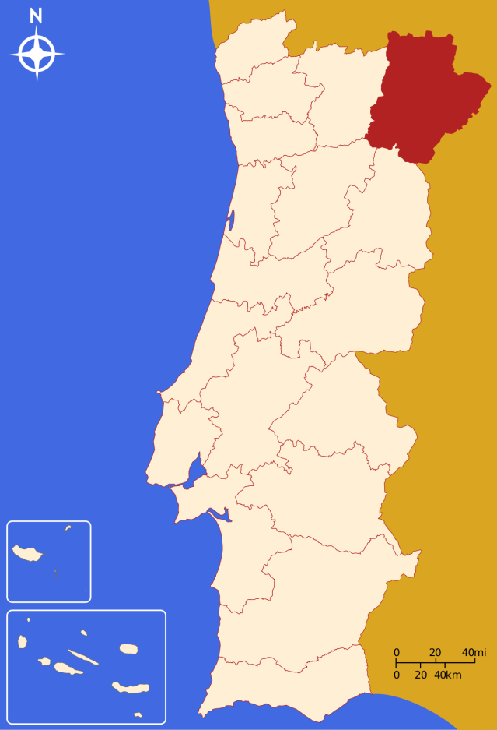
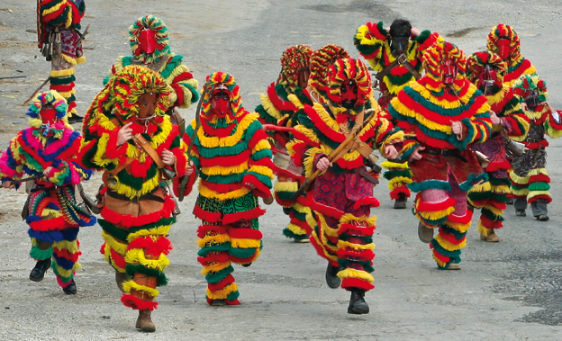
Bragança
Chocalhos

Slide 14
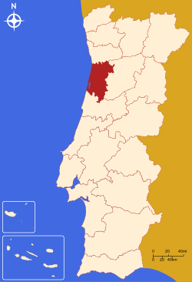
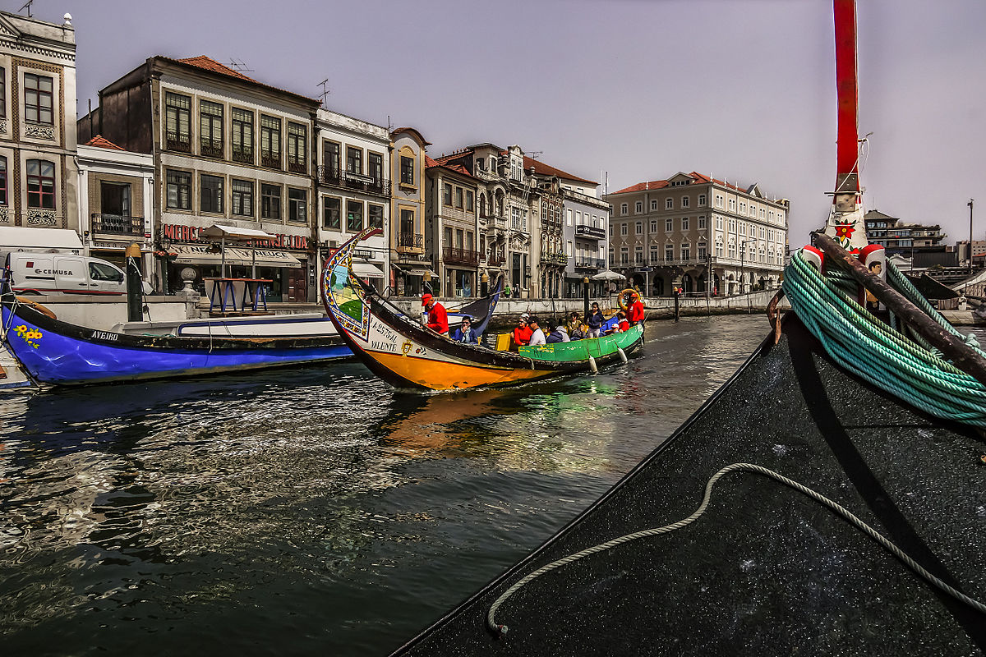
Aveiro
Known as the Portuguese “Venice” city

Slide 15
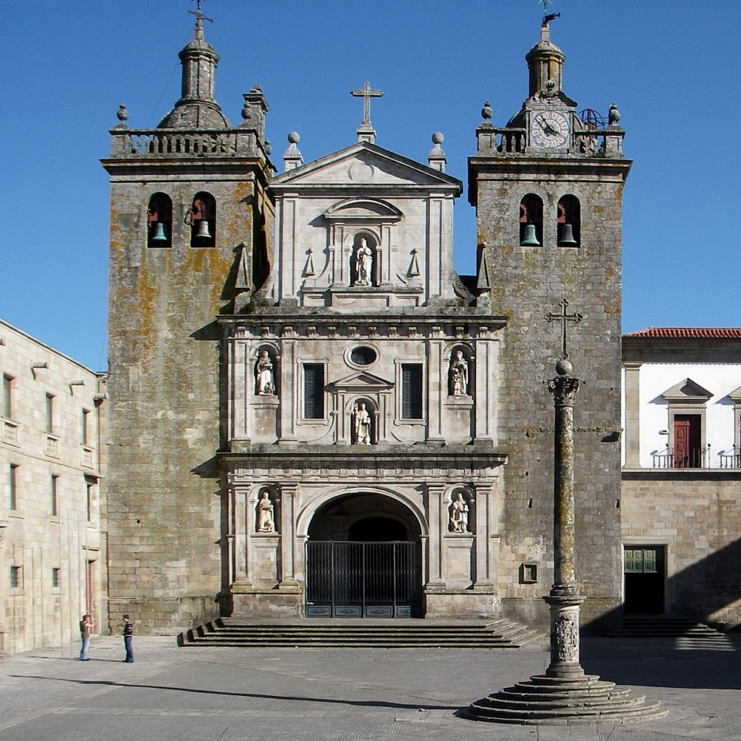
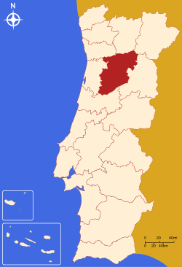
Viseu
Sé de Viseu

Slide 16
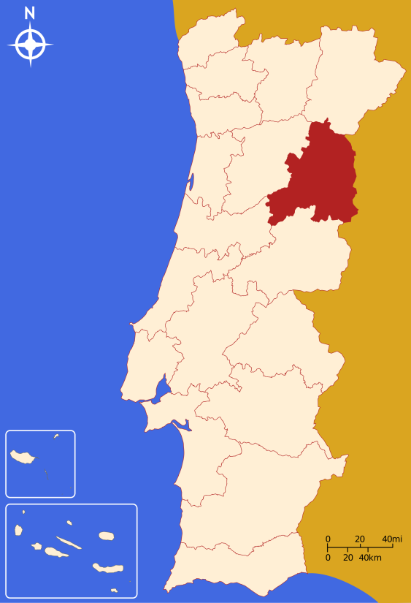
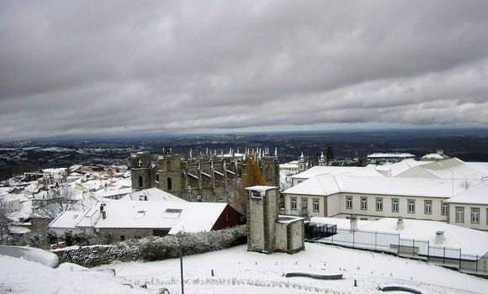
Guarda
Serra da Estrela

Slide 17
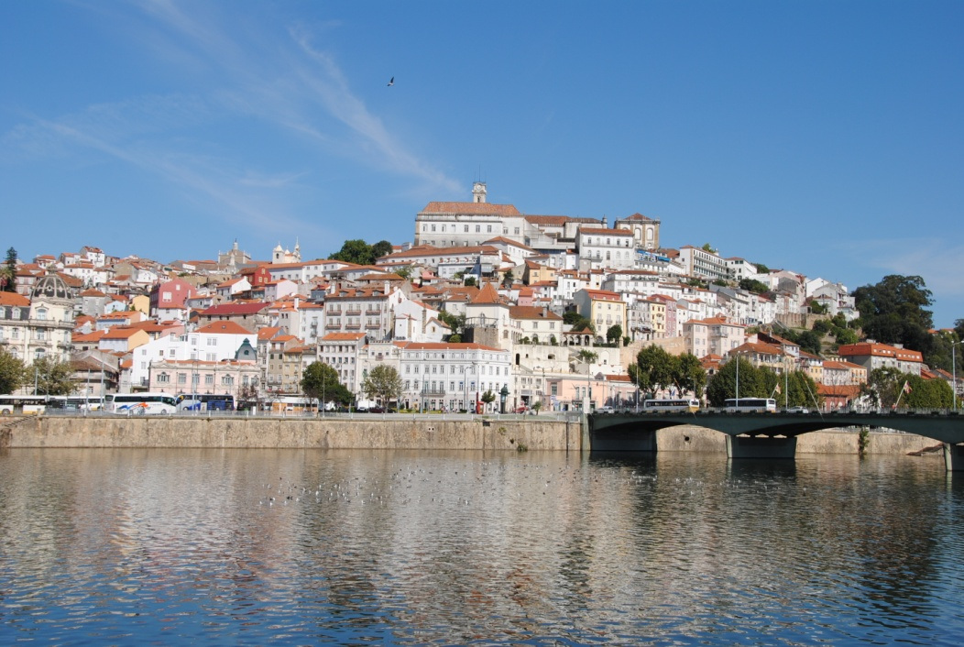
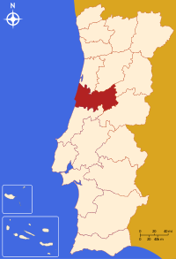
Coimbra
Mondego River

Slide 18
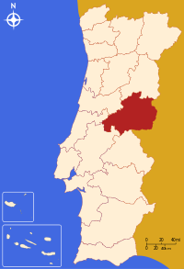
Castelo Branco
Garden of the Palace

Slide 19
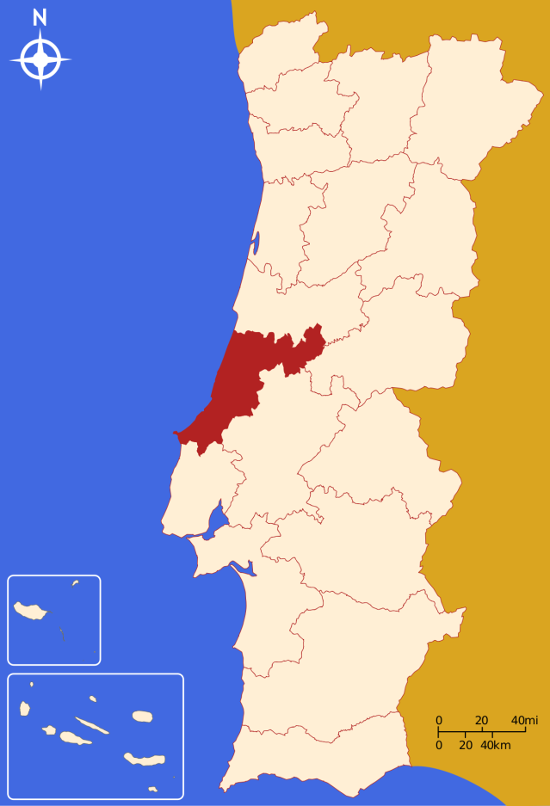
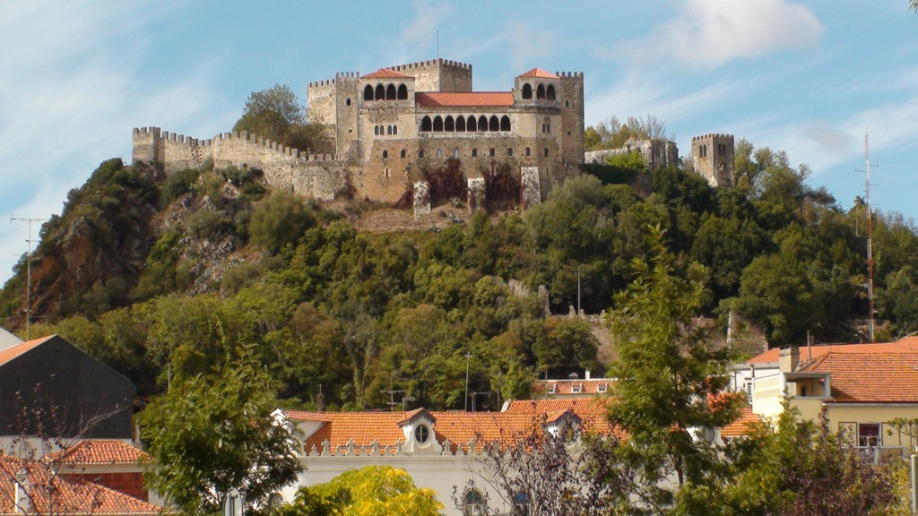
Leiria
Castle of Leiria

Slide 20
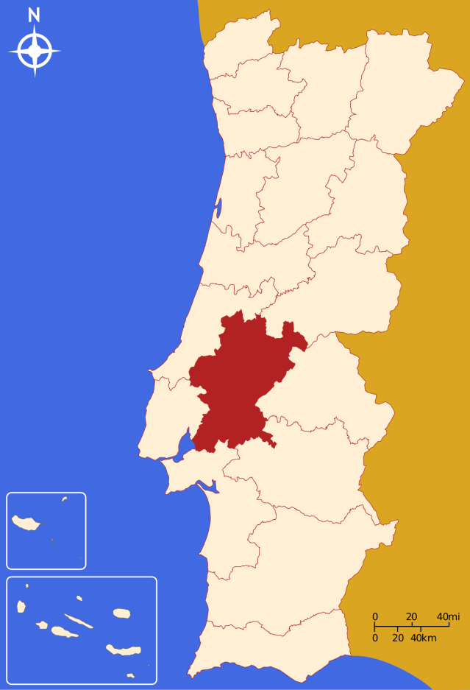
Santarém
Cathedral of Santarem

Slide 21
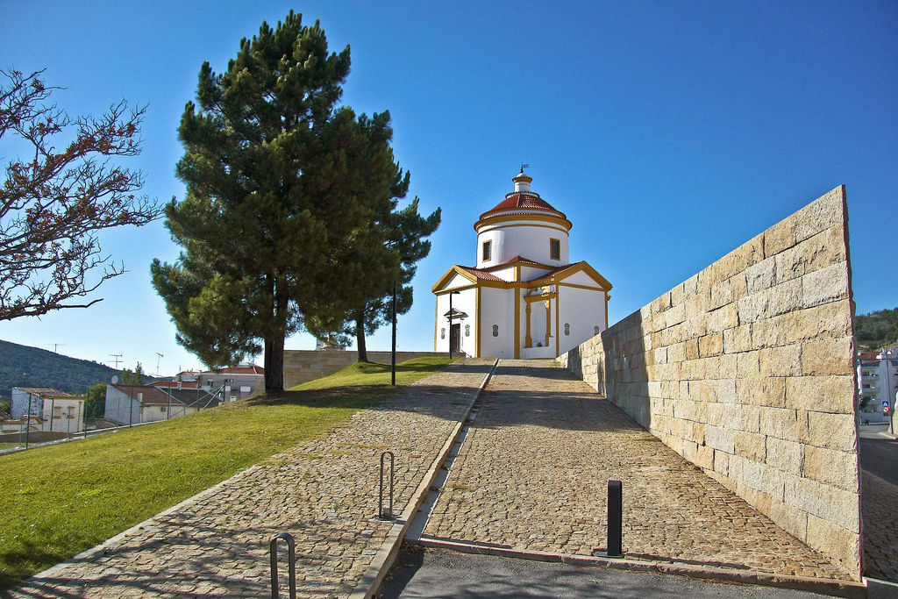
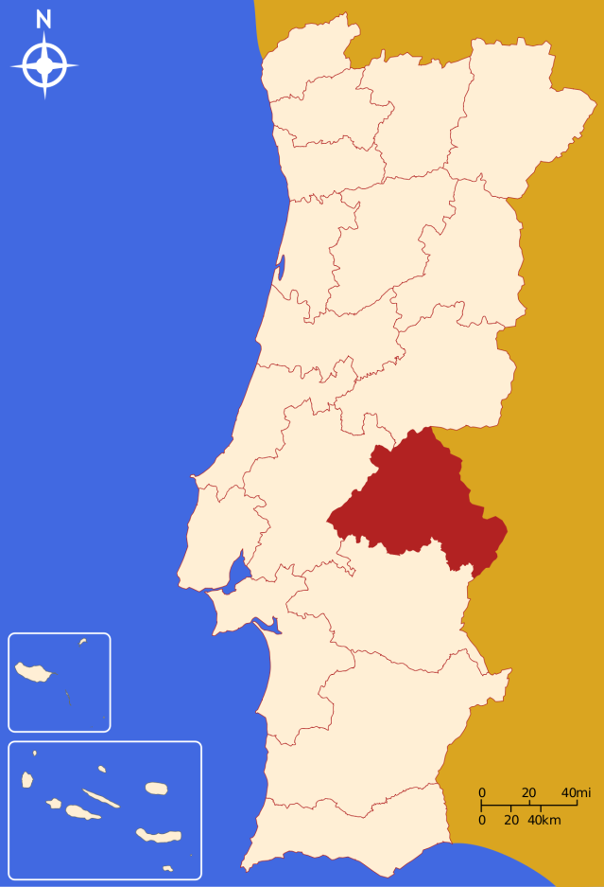
Portalegre
Chapel of Calvary

Slide 22
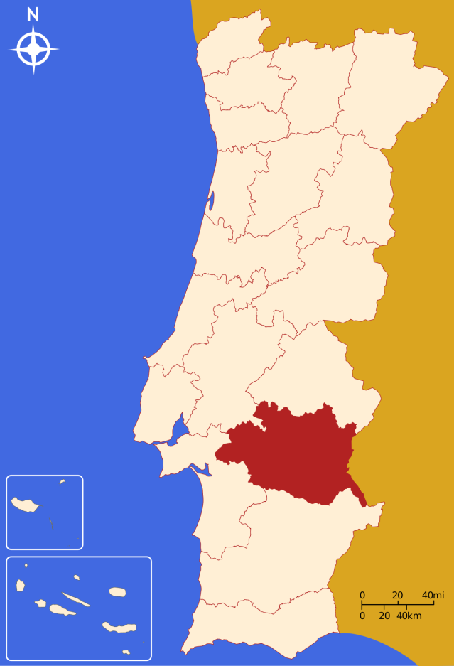
Évora
Roman Temple of Évora

Slide 23
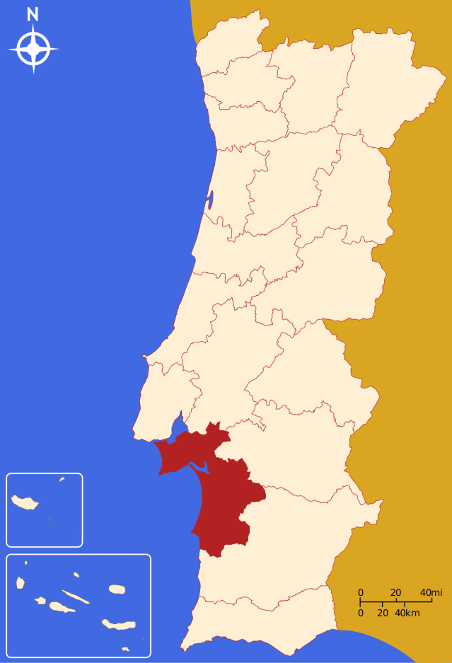
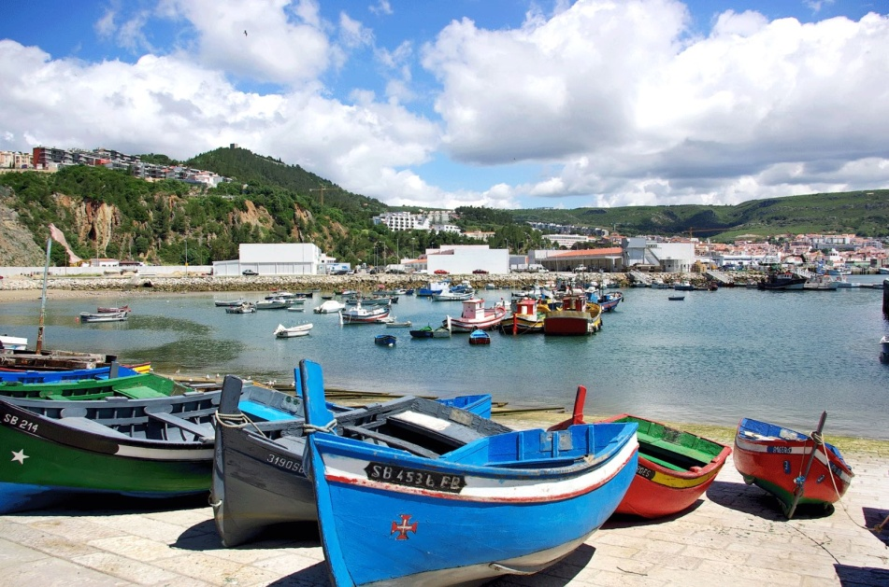
Setúbal
Port of Setúbal

Slide 24
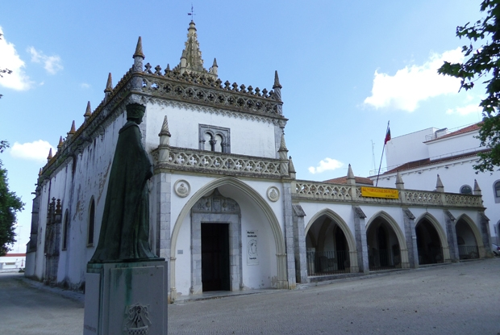
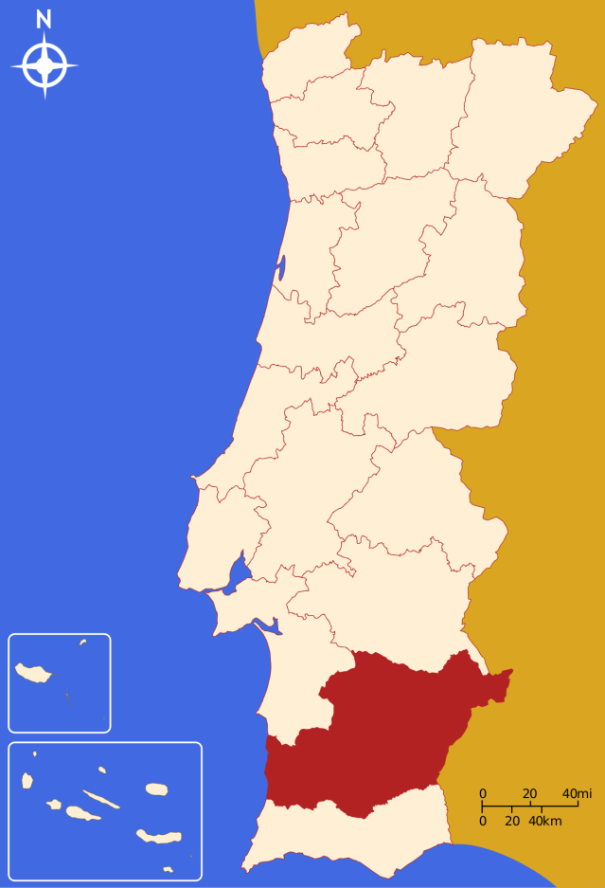
Beja
Museum Rainha D. Leonor

Slide 25
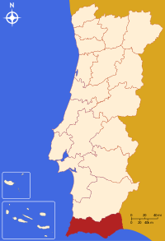
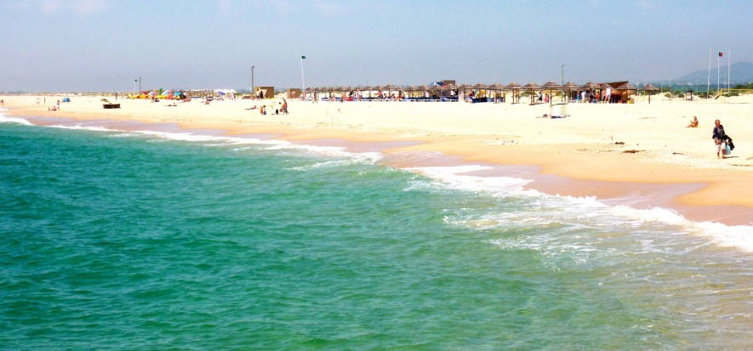
Faro
Island of Tavira

Slide 26
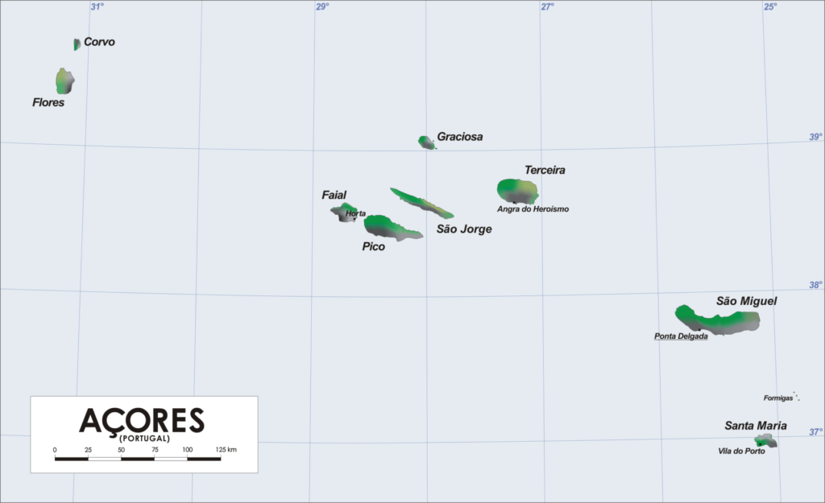
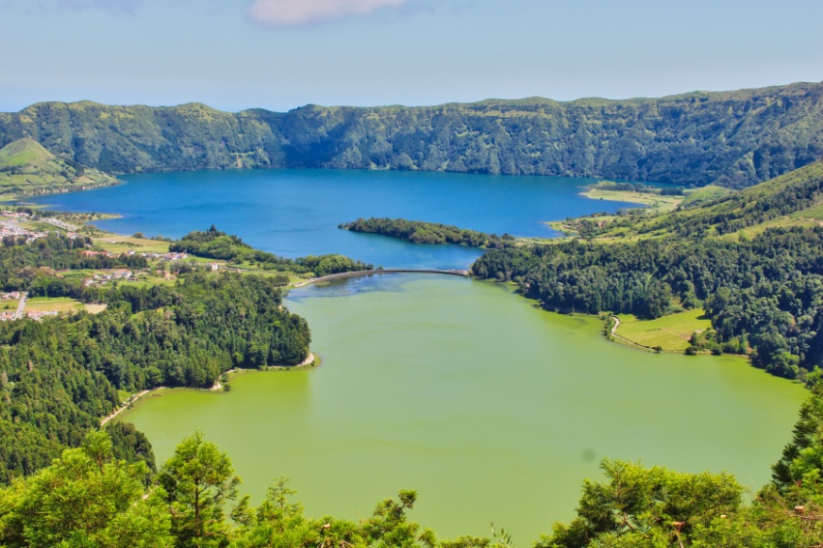
Arquipélago dos Açores
Lagoon of the 7 cities

Slide 27
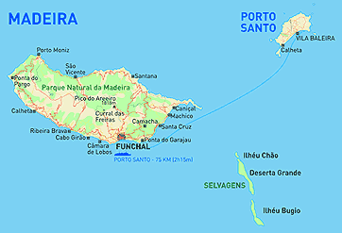
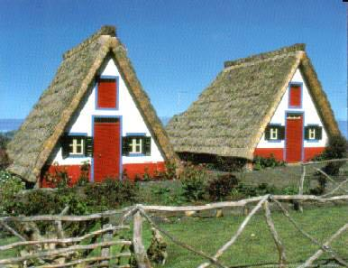
Arquipélago da Madeira
Typical Houses

Slide 28
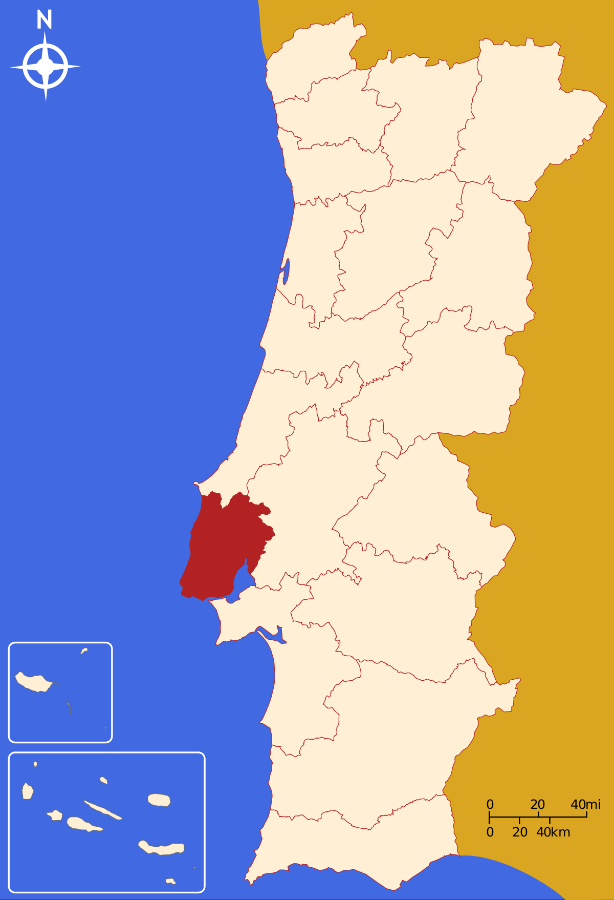
Lisbon
Lisbon is the capital and the largest city of Portugal
With an estimated population of 552,700
Lisbon is responsible for economic, commercial, media, artistic, educational and tourist affairs
Lisbon was almost completely destroyed on 1 November 1755 by a terrible earthquake. It was rebuilt according to plans drawn by the Marquis of Pombal. The reconstructed central part will be called Baixa Pombalina.

Slide 29
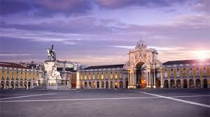
What can you visit in Lisbon?

Slide 30
Torre de Belém

Slide 31
Praça do Comércio

Slide 32
Praça do Rossio/Teatro Nacional

Slide 33
Museu do Fado

Slide 34
Palácio da Pena

Slide 35
O Bairro de Alfama

Slide 36
Mosteiro dos Jerónimos

Slide 37
Ponte 25 de Abril

Slide 38
Cristo Rei

Slide 39
Estádio Da luz

Slide 40
Estádio José Alvalade

Slide 41
Bairro Alto

Slide 42
Castelo de São Jorge

Slide 43
Elevador de Santa Justa

Slide 44
Mude (Museu do Design e da Moda)

Slide 45
Oceanário no Parque das Nações

Slide 46
Jardim da Fundação Calouste Gulbenkian

Slide 47
Convento do Carmo

Slide 48
Museu Nacional dos Azulejos e dos Coches

Slide 49
Chiado

Slide 50
Docas de Santo Amaro

Slide 51
Panteão Nacional

Slide 52
Parque Eduardo VII

Slide 53
Aqueduto das Águas Livres

Slide 54
Jardim da Estrela

Slide 55
Museu da Carris

Slide 56
Padrão dos Descobrimentos

Slide 57
Museu da Eletricidade

Slide 58
Palácio Nacional Da Ajuda

Slide 59
Jardim Botânico

