Slide 1
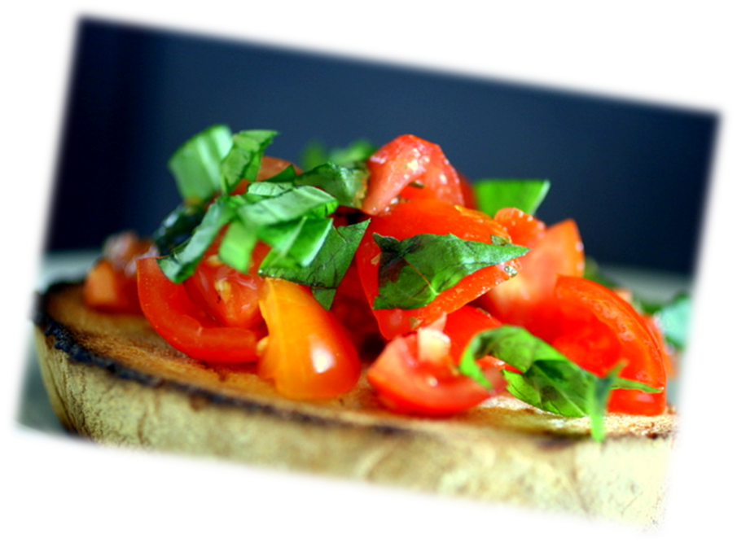
Bruschette
• 8 slices of homemade toasted bread
• ripe pachino tomatoes (cherry tomatoes)
• garlic
• oil
• basil
•oregano
• chilli pepper
• salt

Slide 2
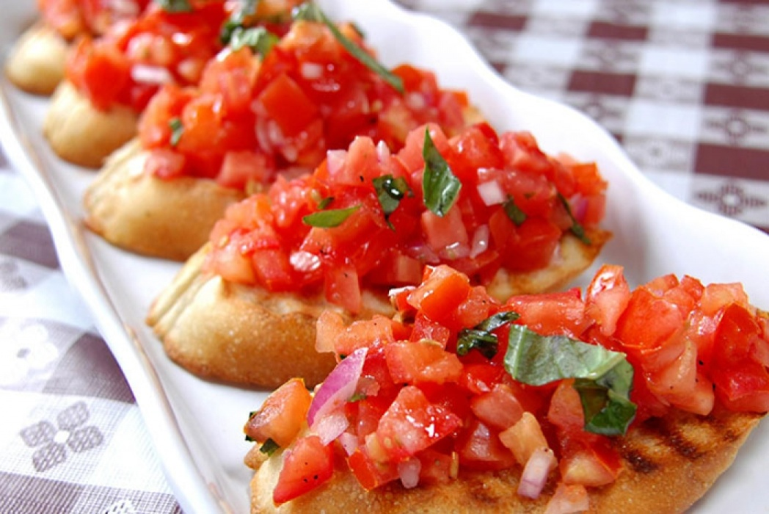
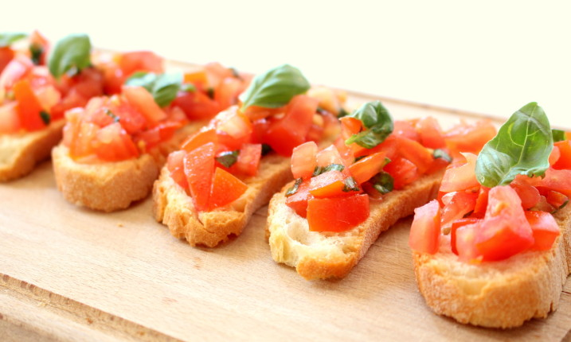
Preparation
Choose a loaf of brown bread, cut eight slices of medium thickness, slightly rub them with a peeled garlic clove and place in preheated oven at 180 ° C until golden. Withdraw them, spread the peeled tomatoes on the surface, without seeds and cut into cubes. Season with chilli pepper, oregano, a pinch of salt. Finish it off with extra virgin olive oil and a few basil leaves. Plate and serve.

