Slide 1
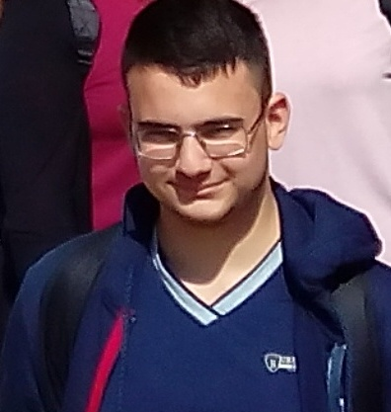
Hello everyone! My name is Matteo Lucisani , I'm fifteen , I live in Reggio Calabria (in the south of Italy). I attend a Hotel and Catering vocational school , I'm in the 2nd class. I love playing video games and watching anime (Japanese cartoon).My favorite anime is Bleach , my favourite videogame is Undertale . It’s a nice videogame. What do you thing about videogames? Do you like them or do you hate them? See you soon!!!

