Slide 1
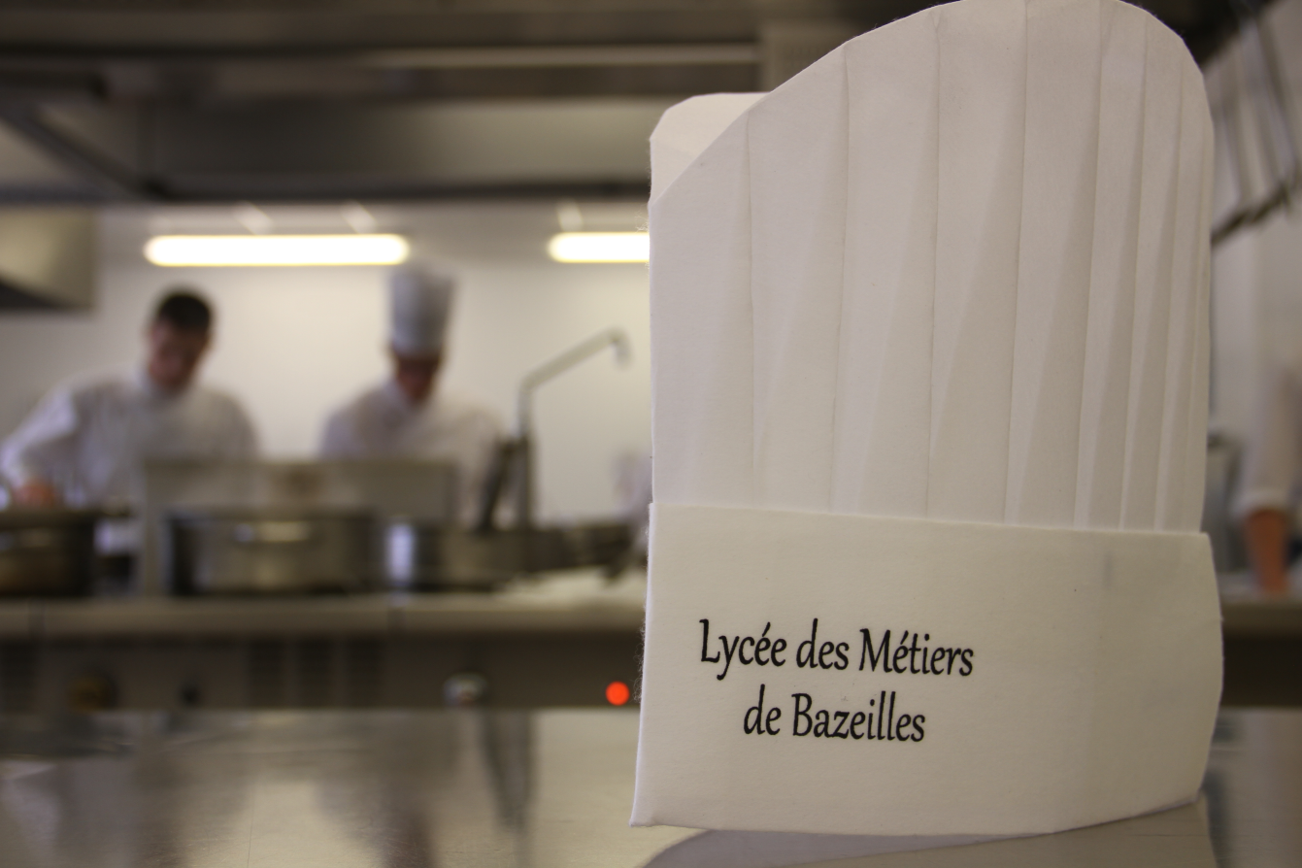
« L’excellence à la française »

Slide 2
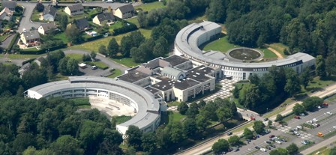
Bazeilles
We are here

Slide 3
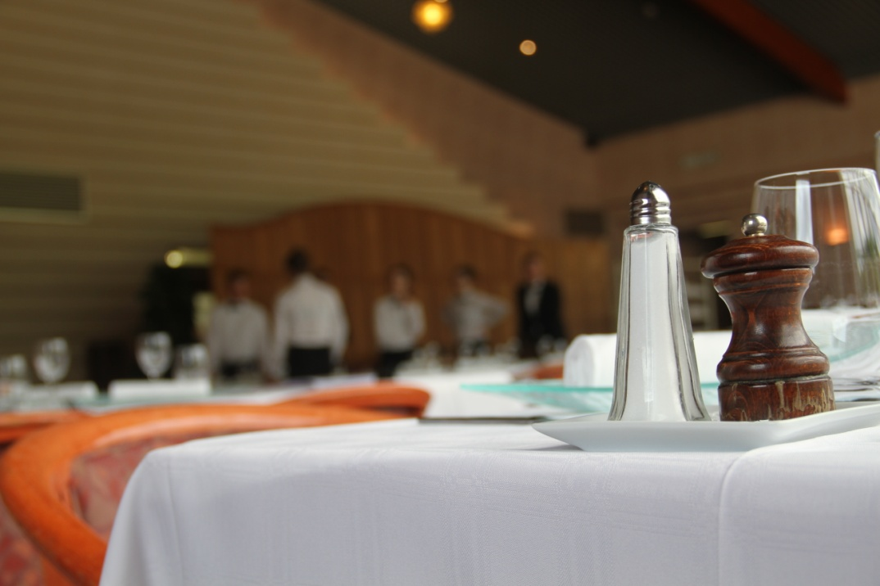
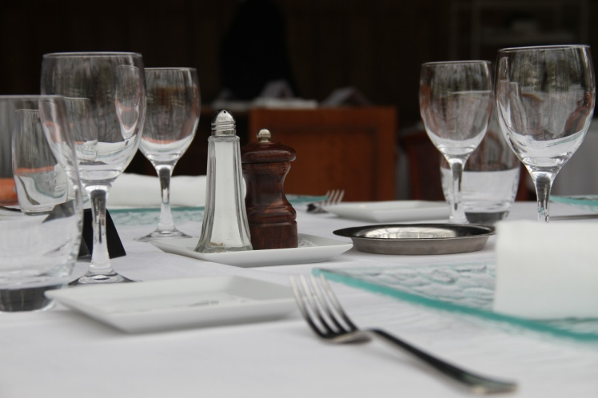
The restaurant

Slide 4
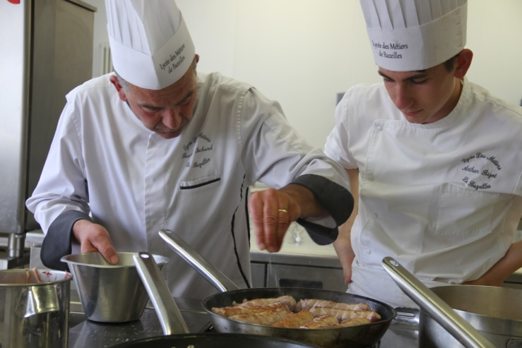
The kitchen

Slide 5
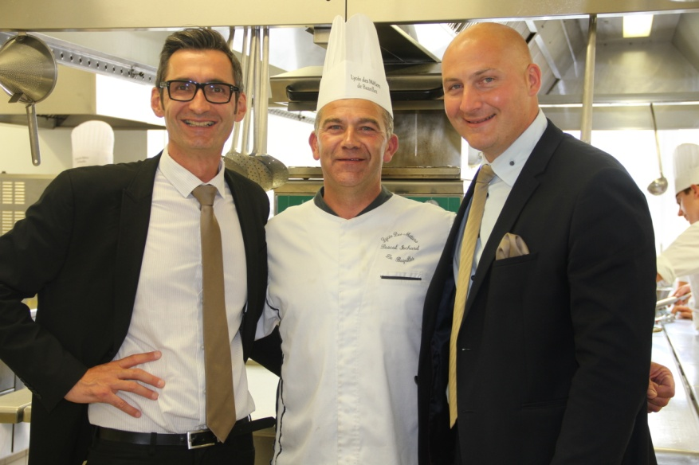
The teachers (cooking and service management)

Slide 6
French subjects

Slide 7
General subjects
English 2 hours per week
Maths 3 hours per week
Hotel management 5 hours per week
Physical education 2 hours per week
Civic and moral education 1 hour per week
Applied science 3 hours per week
French 3 hours per week
Spanish/german 2 hours per week
History and geography 2 hours per week
English management 1 hour per week
English/German european course 2 hours per week

Slide 8
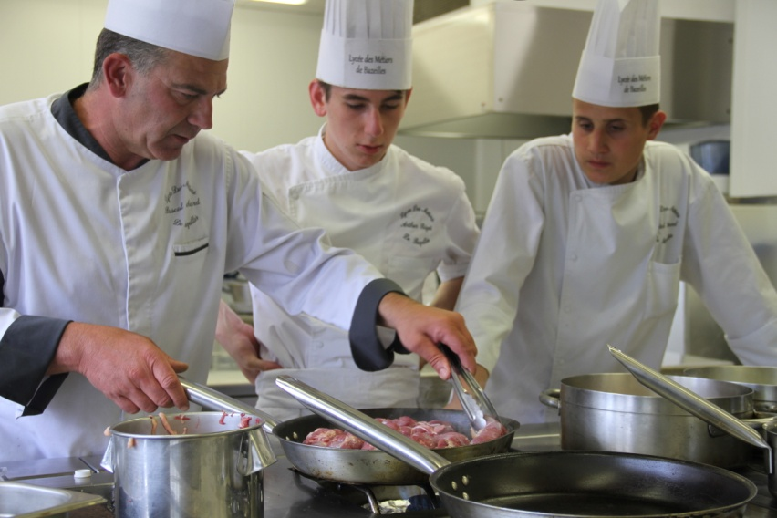
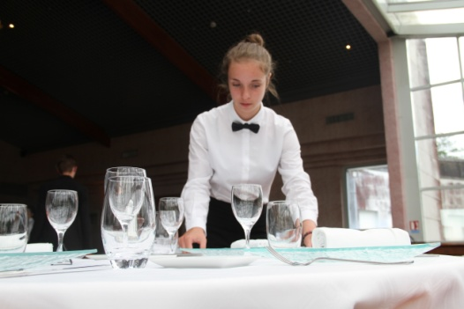
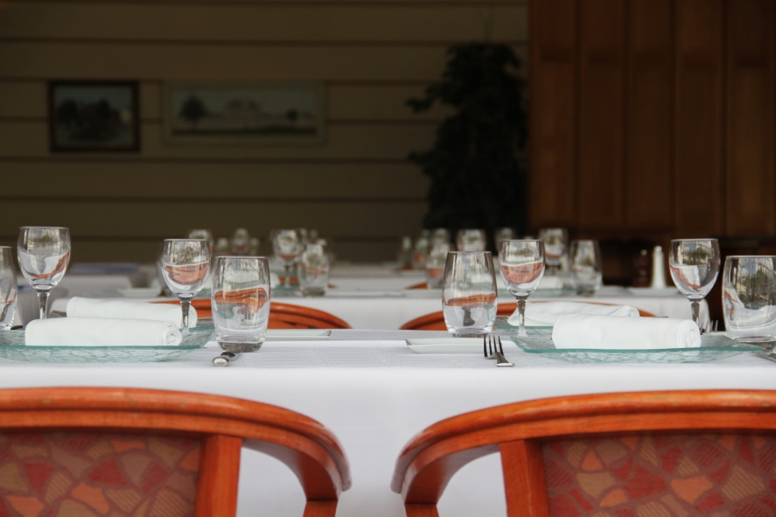
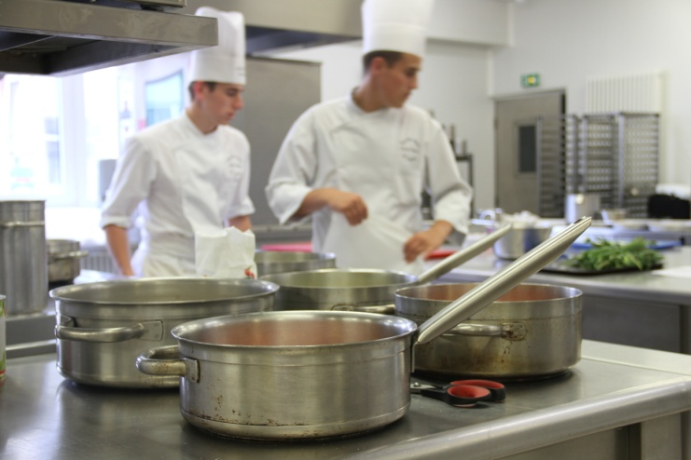
Practical work
We have 4 hours of cooking and 4 hours of service

Slide 9
English European course

Slide 10
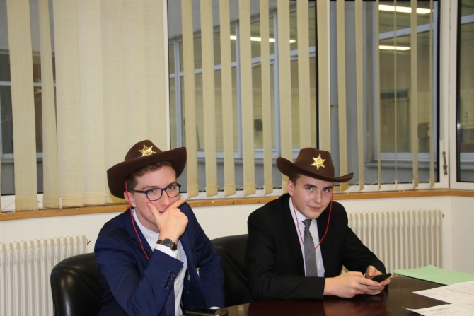
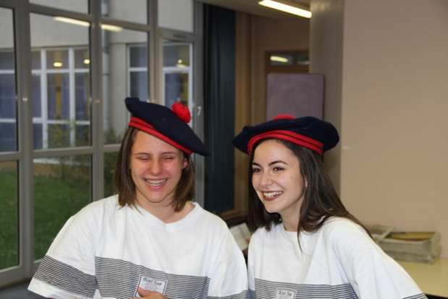
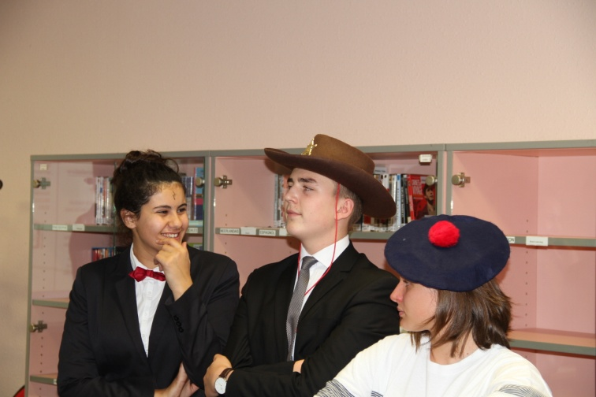
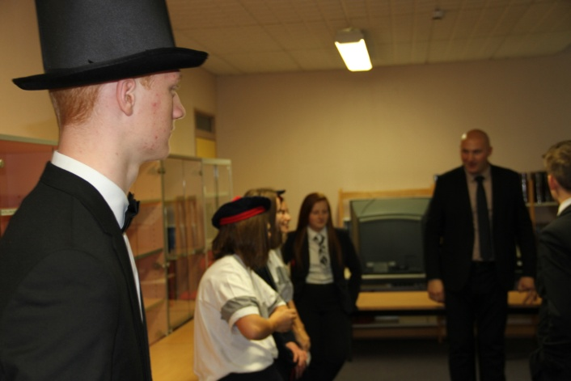
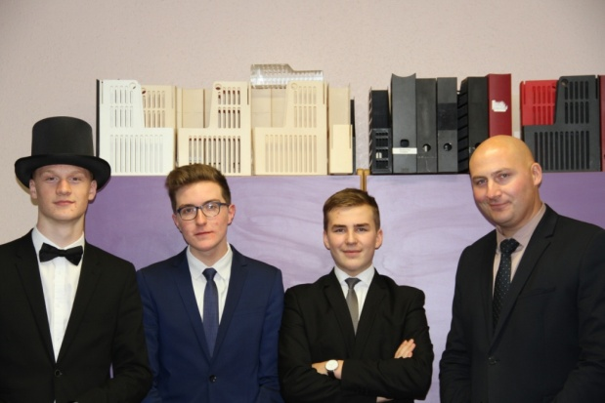
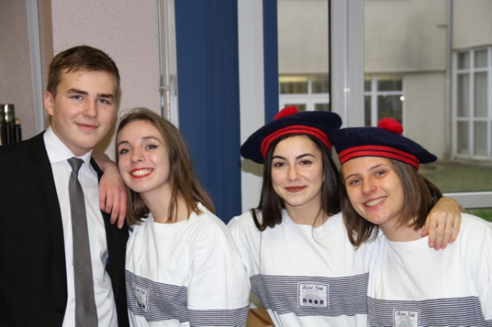
A few pictures

Slide 11
Each evening, many activies are organized:
On Mondays: Music
On Tuesdays: Fitness
On Wednesdays: BasketBall and FootBall
On Thursdays: Basketball and FootBall
Nothing on Fridays because the students go back home .
Often, before hollidays they organized parties.

Slide 12
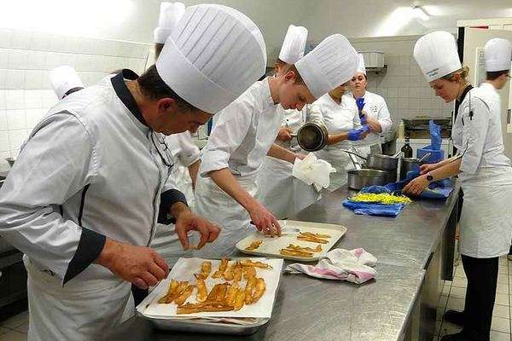
Every Wednesday for 4 hours, we learn how to cook and for 4 hours, we learn service management.

Slide 13
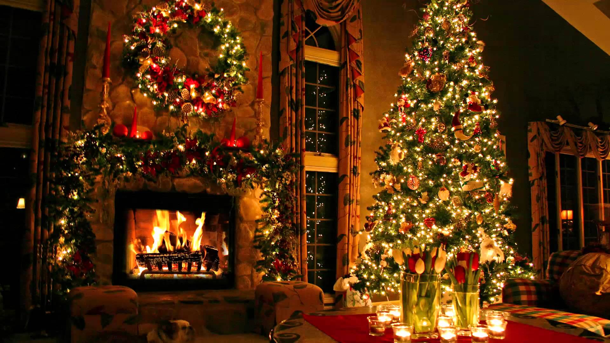
We have 11 bank holidays Like christmas

