Slide 1
Porto

Slide 2
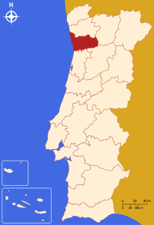
Location of Porto
This red point on the map is Porto.
It is located on the north of Portugal.

Slide 3
Porto Municipality
Porto is considered a district, so it is divided into 18 cities;
Porto is inhabited by 216 405 habitants, it was last checked in 2015.

Slide 4
Do you know that ...
Porto was the city that gave name to our country, Portugal;
It's known for its contemporary and ancient architecture, its wines , the gastronomy, and it’s considered world heritage by UNESCO;
It was once considered the most beautifull city in Europe;
Porto University , ranked 200 in the world and 100 in Europe;
It is where the Porto wine comes from.

Slide 5
What to visit
There is a lot to see in Porto:
churchs,
historic monuments,
gardens,
monasteries

Slide 6
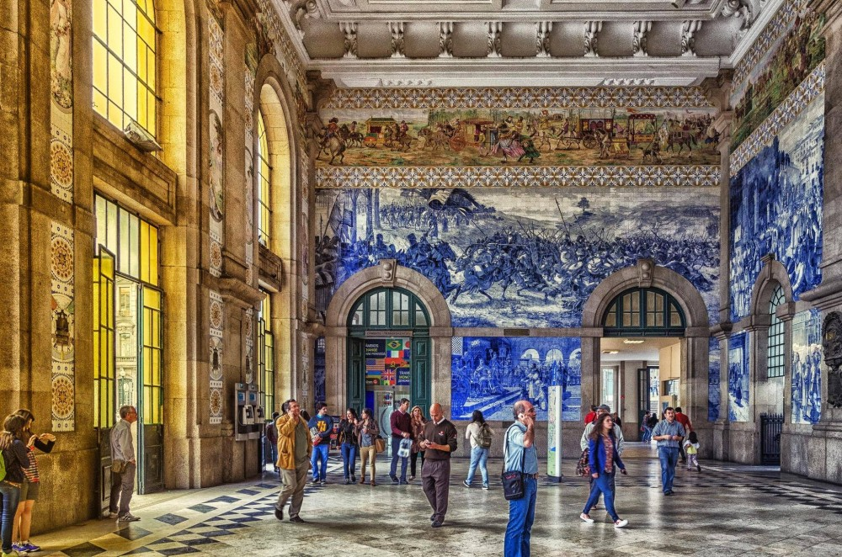
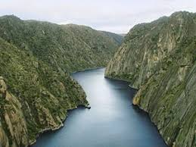
Places to visit
Douro River
Porto Train station

Slide 7
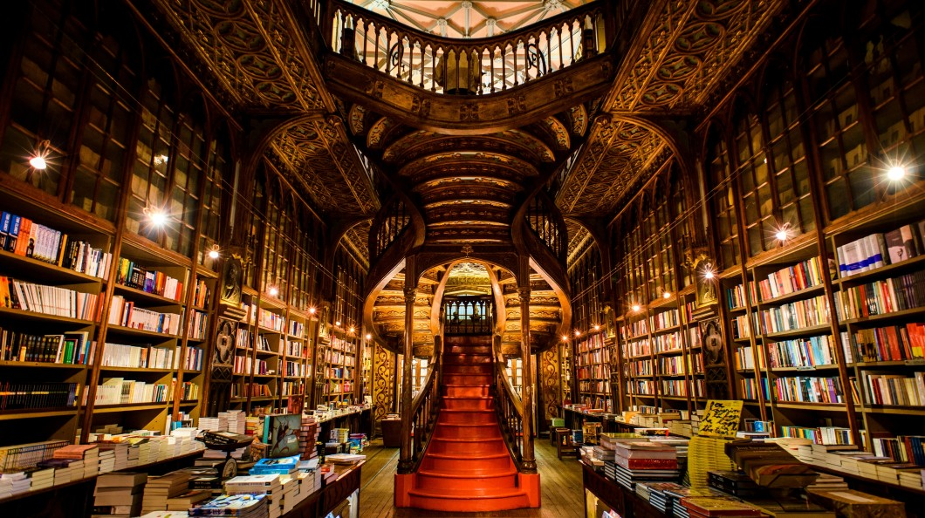
Lelo bookshop
Palácio da Bolsa

Slide 8
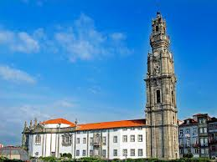
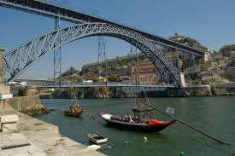
Torre dos Clérigos
D. Luis I Bridge

Slide 9
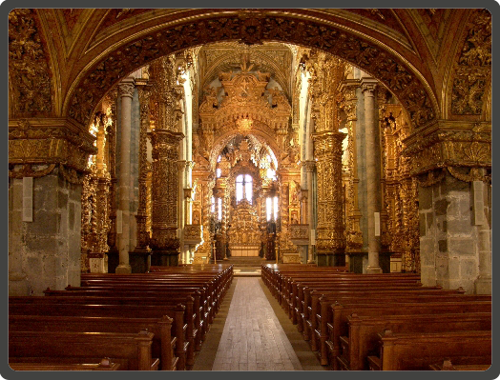
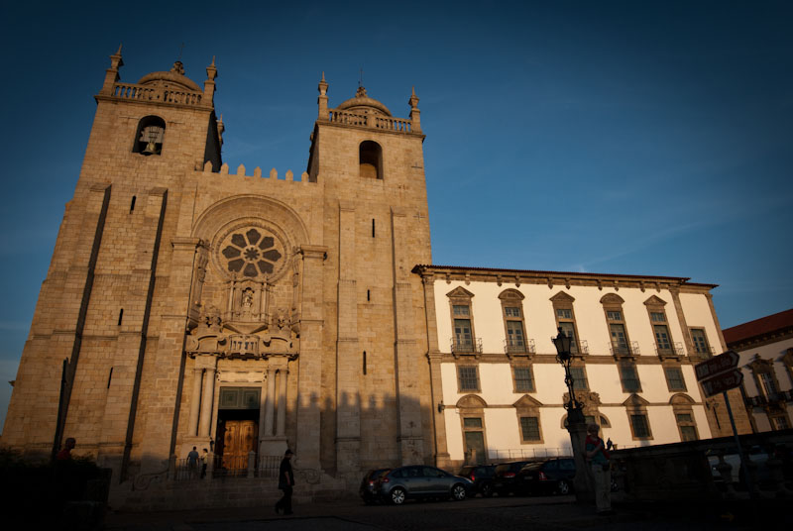
São Francisco Church
Sé do porto

Slide 10
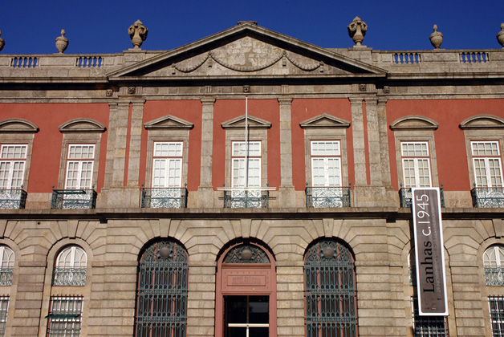
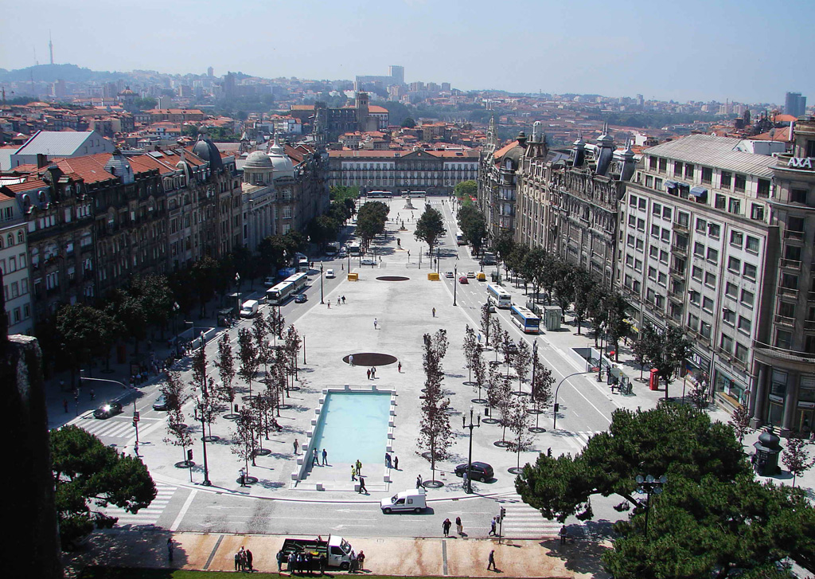
Soares dos Reis National museum
Avenida dos Aliados

Slide 11
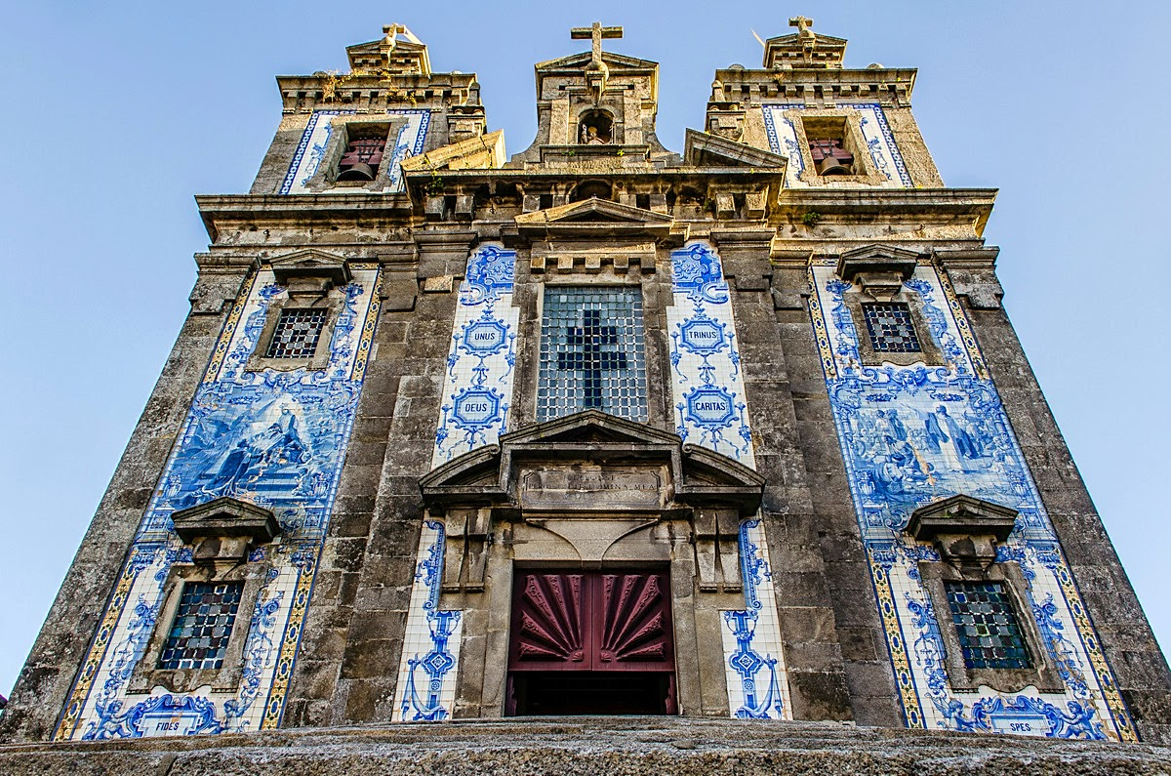
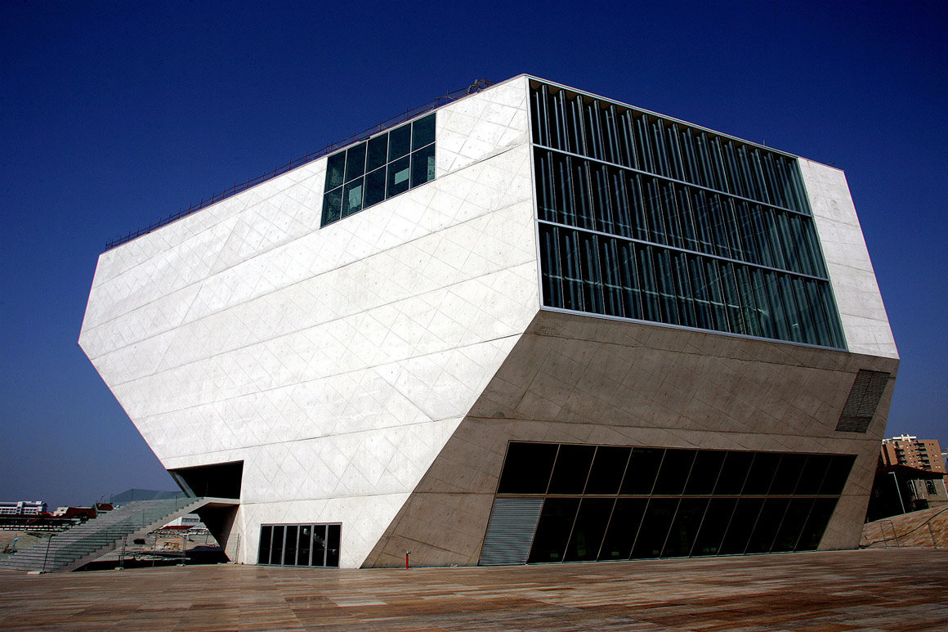
Santo Ildefonso Church
Casa da Musica

Slide 12
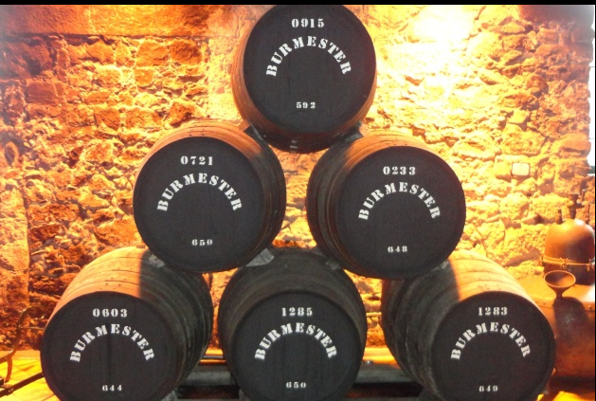
Wine cellars

Slide 13
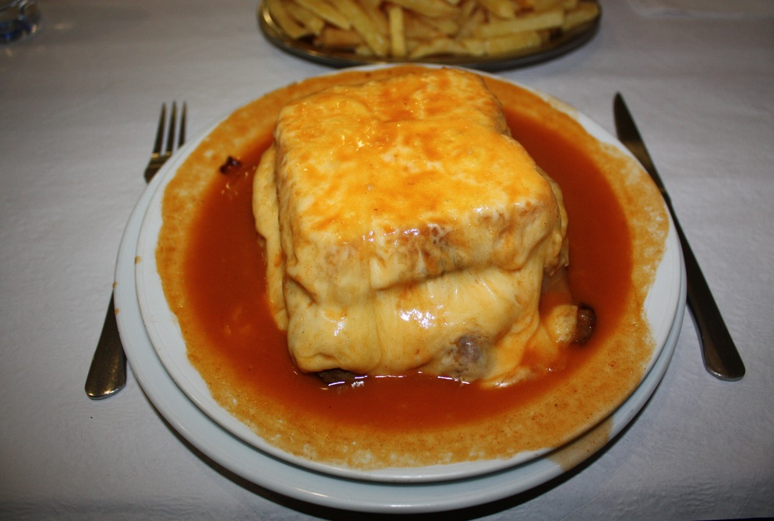
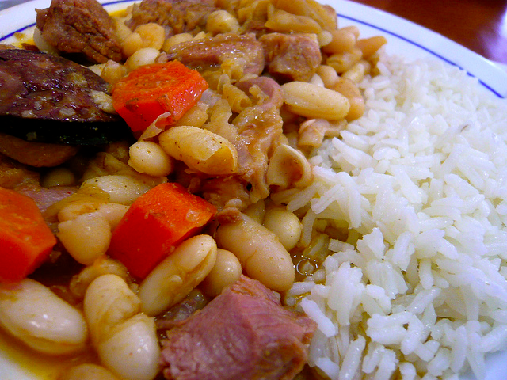
Some Typical Dishes
Francesinha
Tripas à moda do Porto

Slide 14
In 2017 Porto was considered European Best Destination

