Slide 1
Sesvete grammar school

Slide 2
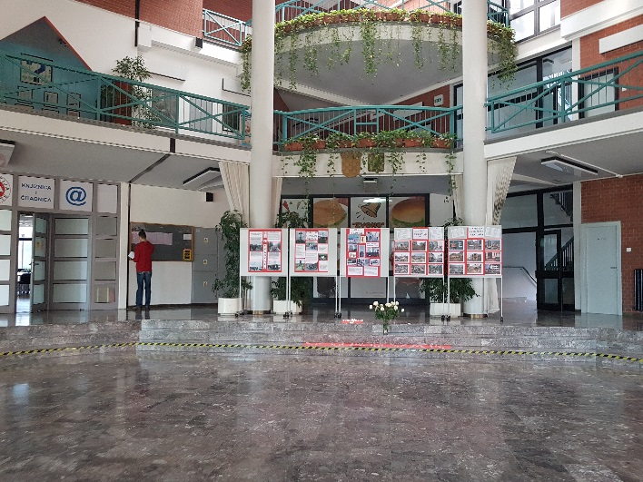
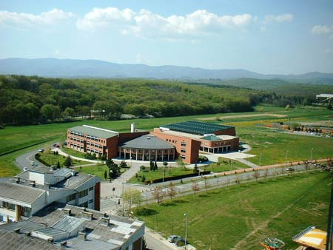

Slide 3
About
Our school is located in Sesvete,it’s a small city near the capital of Croatia-Zagreb.
In our school there are around 600 students.
Here, we have to attend a lot of different classes(15) so we can choose what college we want to enrol once we finish high school

Slide 4
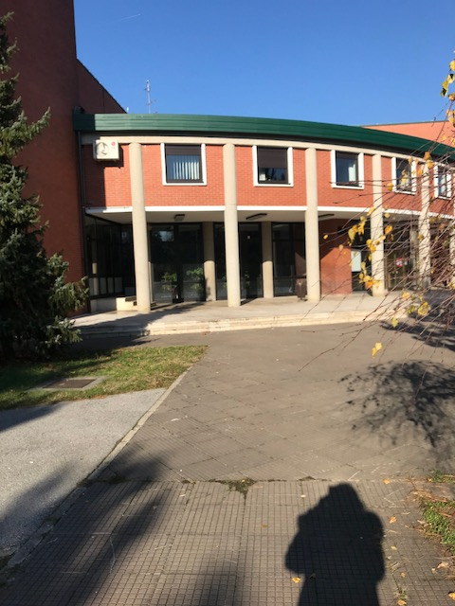
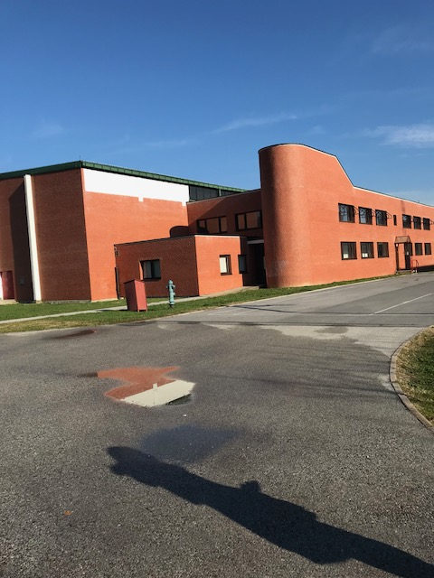
Slide Title
Sesvete is one of the best schools in Zagreb so it’s not easy to enrol.
But once you’re in you have to keep your grades up because if you don’t, you won’t go to college and you’ll have no future.

Slide 5
Subjects
Maths
Croatian
English
One more foreign language(Italian, French, German)
Biology
Chemistry
Physics
PE
Geography
History
IT
Arts
Music
Latin
Religion
Philosophy
Sociology
Psychology

Slide 6
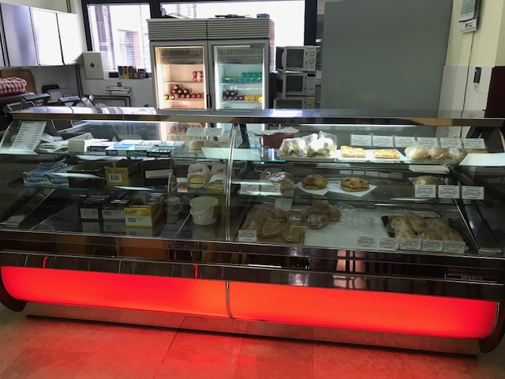
Timetable
Our school is always in the morning shift and it begins at 8 am and finishes at 2pm.
Every lesson lasts 45 minutes and after each lesson there is a 5-minute break.
After the second lesson there is a big break.
On big break we go to Kaufland which is right in front of the school or just eat in the school canteen.

Slide 7
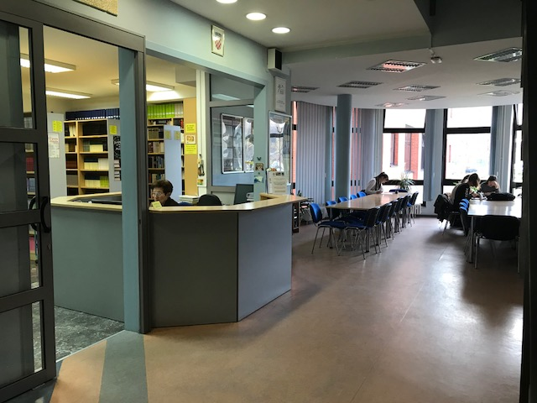
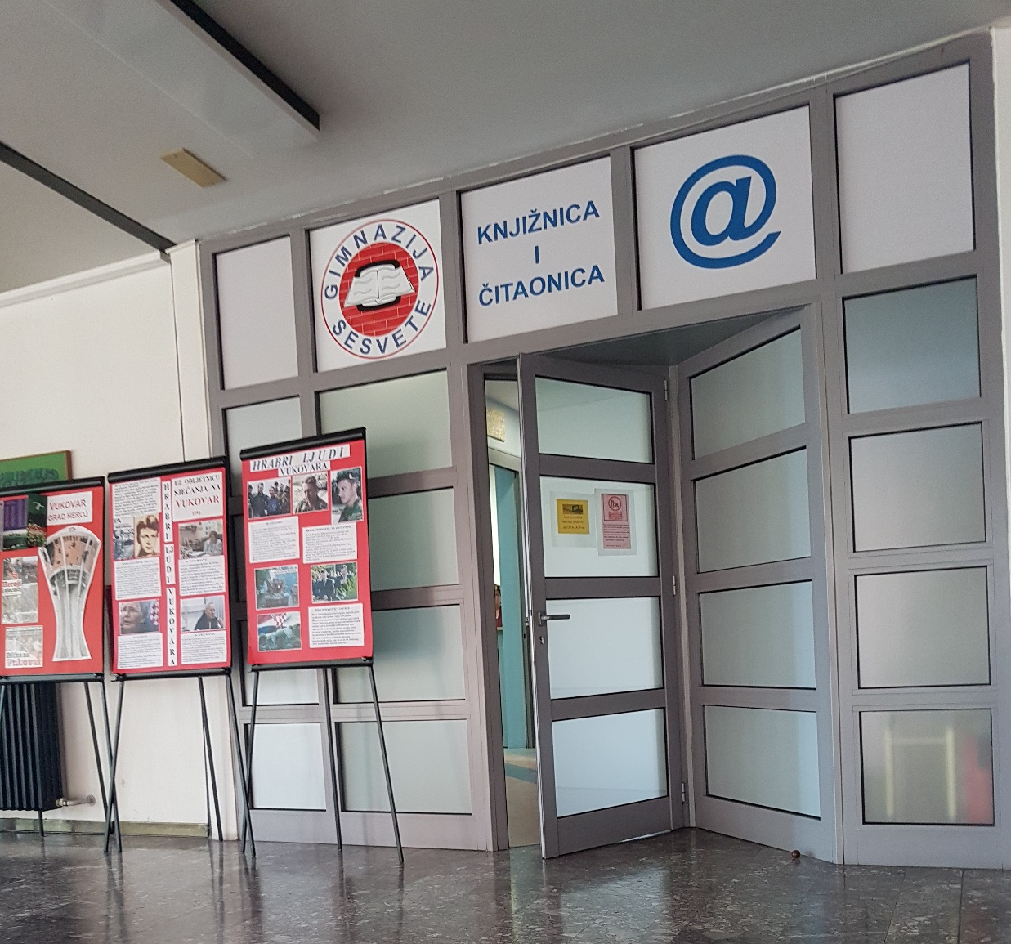
Library
If you don’t have enough time or peace at home to do your homework or study you can always go to the library.
In the library you can find everything, from magazines to encyclopedia.

Slide 8
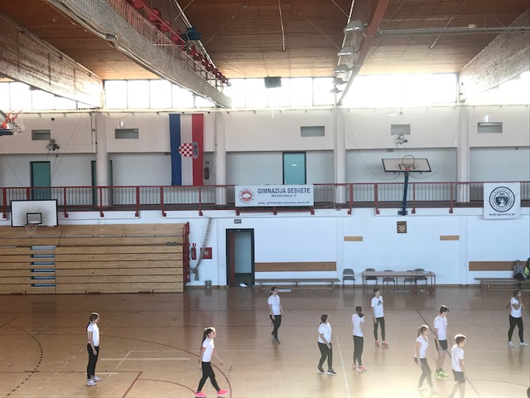
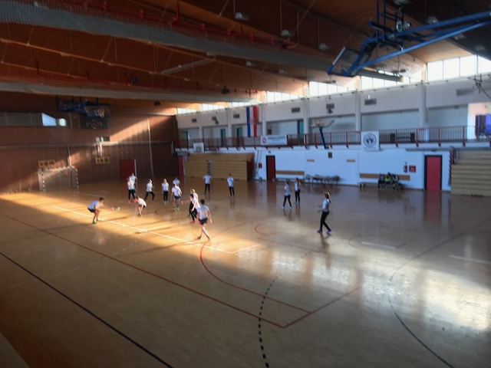
Our school also gives you the opportunity to play almost every sport you’d like and has great clubs you can join, such as handball, vollyball, athletics, tennis and football.

Slide 9
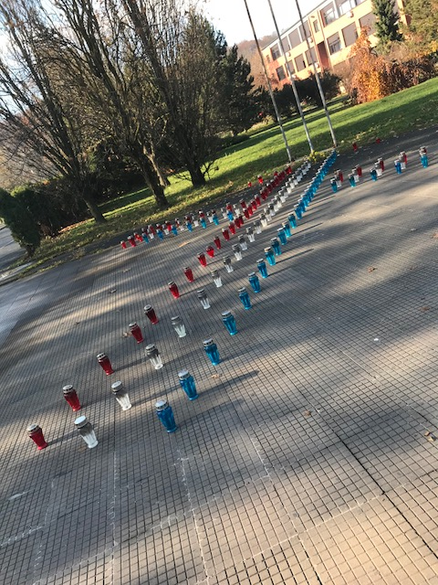
Holidays
In our country we have very long holidays.
3 months summer break, from June 15th to September 1st.
2 weeks winter break
1 week spring break

