Slide 1
REGGIO CALABRIA
Reggio Calabria is one of the five provinces of Calabria, in the south of Italy.
It is our main and closest big town.

Slide 2
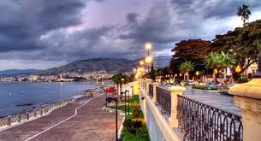
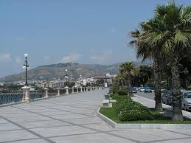
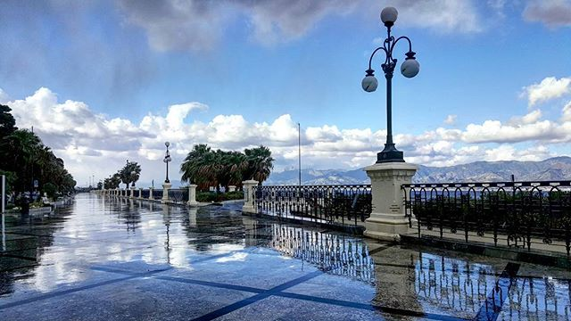
This is Reggio Calabria’s Seafront We call it “Via Marina”
It is known as the most beautiful kilometre in Italy.

Slide 3
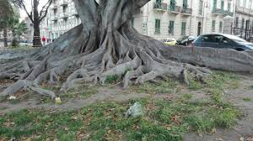
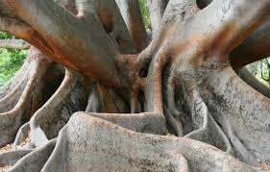
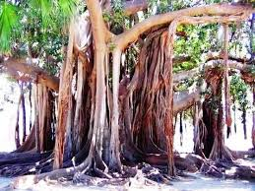
Its gigantic ancient trees are really characteristic.

Slide 4
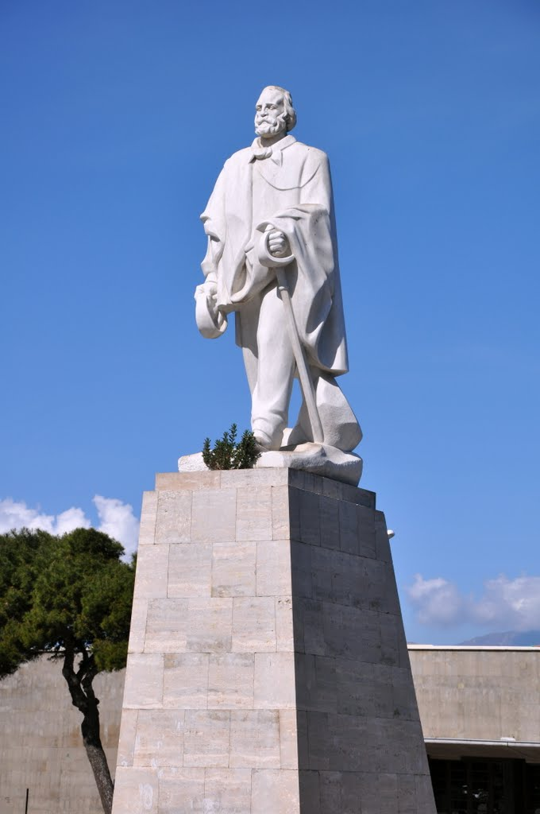
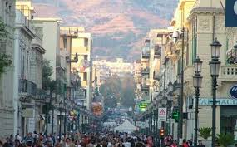
Here’s our CORSO GARIBALDI
It is our main street, where you go shopping, hang out and have fun.
It is named after G. Garibaldi, a famous hero.

Slide 5
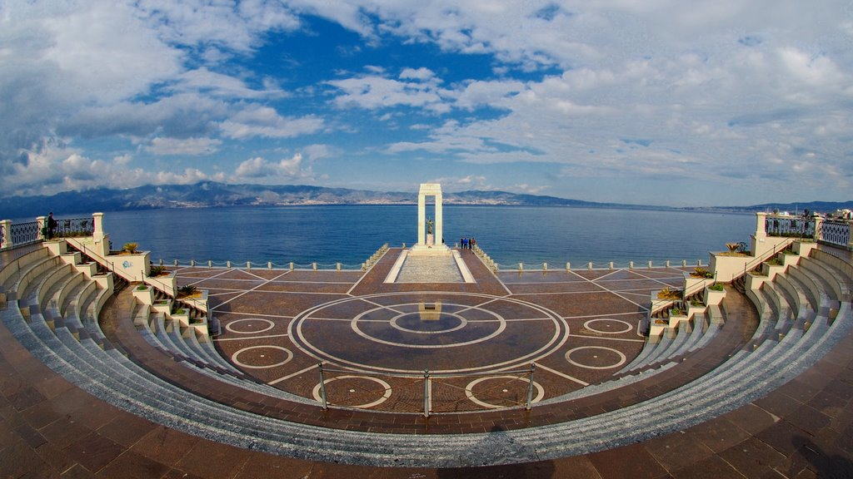
This is the ARENA DELLO STRETTO
It is the place where lots of shows take place, especially in summer.
It overlooks the Straight of Messina.

Slide 6
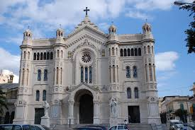
REGGIO CALABRIA’s Cathedral
It was built in 1928 by the architect Carmelo Angelini, soon after the 1908 terrible earthquake, which destroyed the town.

Slide 7
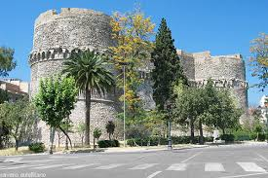
The ARAGONESE CASTLE
It was built in the Medieval Age and it is one of the most important monuments.

Slide 8
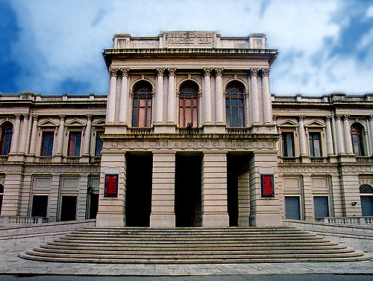
FRANCESCO CILEA’S THEATRE
F. Cilea was a famous musician and the theatre was named after him.

Slide 9
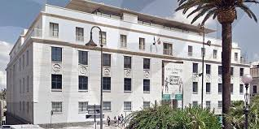
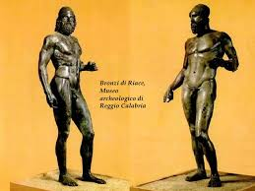
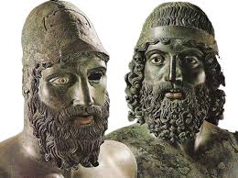
THE NATIONAL MUSEUM
The Bronzi di Riace are the
most important monument in the museum.
They were warriors and date back to the ancient Greek
age.
They lay on the sea bottom
for centuries and were found
in 1972.

