Slide 1
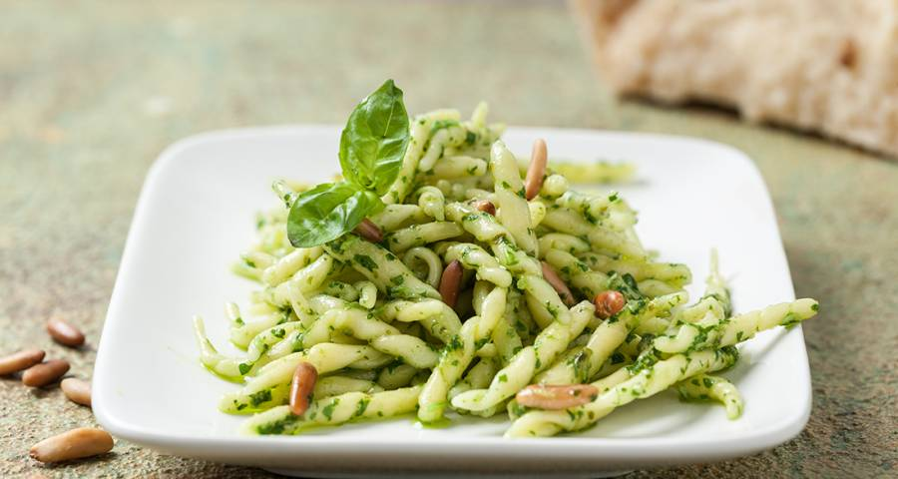
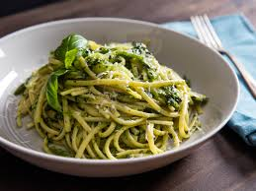
Trofie with pesto sauce
Ingredients for the sauce
30 medium leaves of basil
350 g of trofie (home made pasta
or spaghetti)
30 g of grated pecorino cheese
30 g of grated parmesan
30 g of pine nuts
A clove of garlic
6 spoons of Extra vergin olive oil, about 60 ml

Slide 2
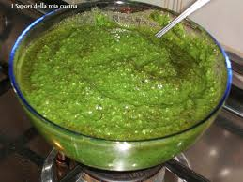
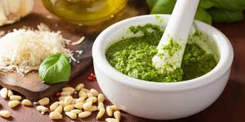
Preparation
Wash and dry the basil. Pound some leaves in the mortar, gradually adding the others. Add pine nuts, garlic into slices and a pinch of coarse salt. Reduce the ingredients to pulp. Add the cheese and mix well. Pour the oil into the mortar, working the pesto until it is homogeneous and compact.
Cook pasta in boiling salty water. Dilute the pesto sauce with a spoonful of cooking water to make it more creamy, then drain pasta and season with the pesto sauce, decorating with some basil leaves and freshly grated cheese. The perfect pesto would require basil leaves from Genoa, extra virgin olive oil from the Ligurian Riviera. The use of mortar and pestle is fundamental but if you are in a hurry, you can use the mixer.

