Slide 1
Fractals
Notes:
Maybe you’ve seen computer-drawn pictures that are repetitive and seem endless in the space. That is fractals.

Slide 2
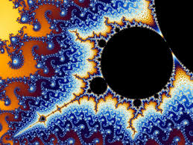
Fractals are patterns which are similar to one aother but in different sizes – when you break them into smaller and smaller pieces, the new pieces look exactly the same as the original.

Slide 3
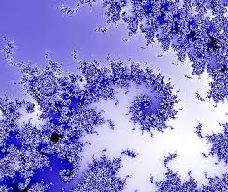
Fractals can be drawn with the help of computers. The computer draws points according to a special formula and repeats that very many times. The answer obtained by the formula is put back into the same formula again and again.

Slide 4
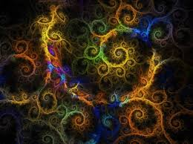

Slide 5
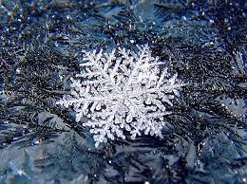
Many fractals can be found in the natural environment,too.

Slide 6
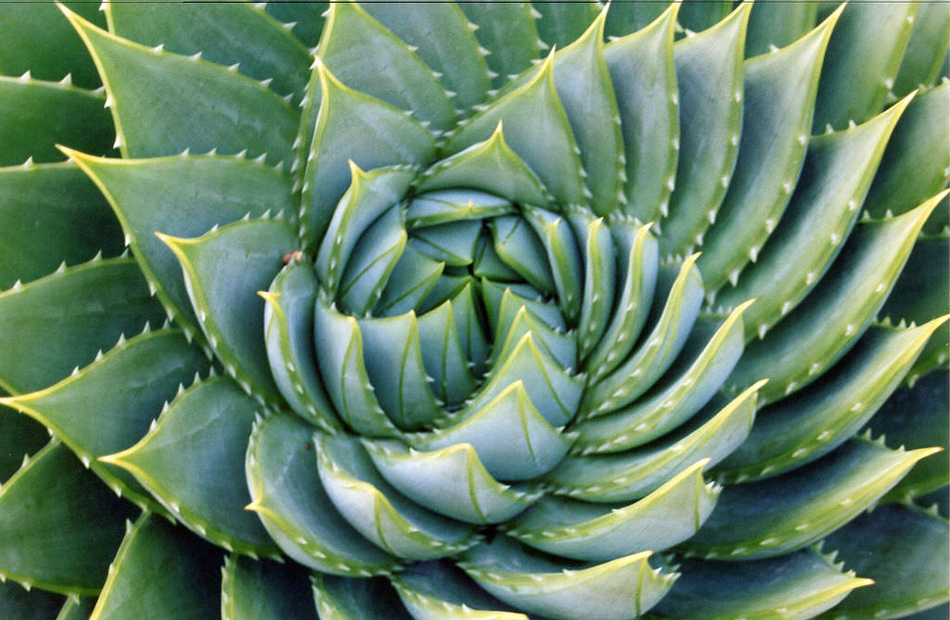

Slide 7
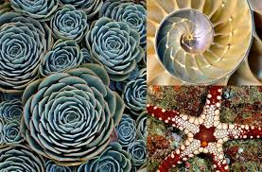

Slide 8
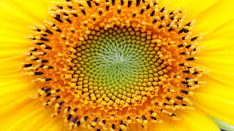

Slide 9
The leaf of the plant is made up of smaller parts that are the same shape as the large leaf. This is also a fractal.

Slide 10
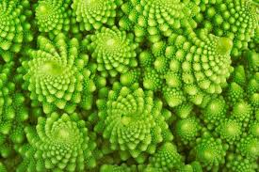

Slide 11
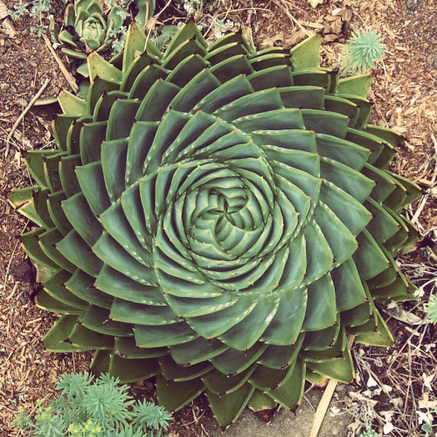

Slide 12
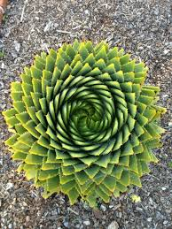

Slide 13
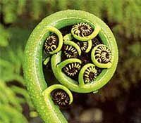

Slide 14
http://usefuljs.net/fractals/
Notes:
The usefuljs is a website to generete fractals very easily. You don‘t need any skils. You can try and download your fractals.

Slide 15
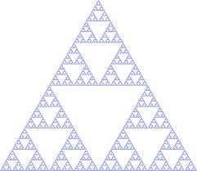
I will show some of the students‘ works done using Mc. Paint and my classmate Emilis will teach you how to do it.
Sierpinski Triangle
Author – Karolis, 6 grade

Slide 16
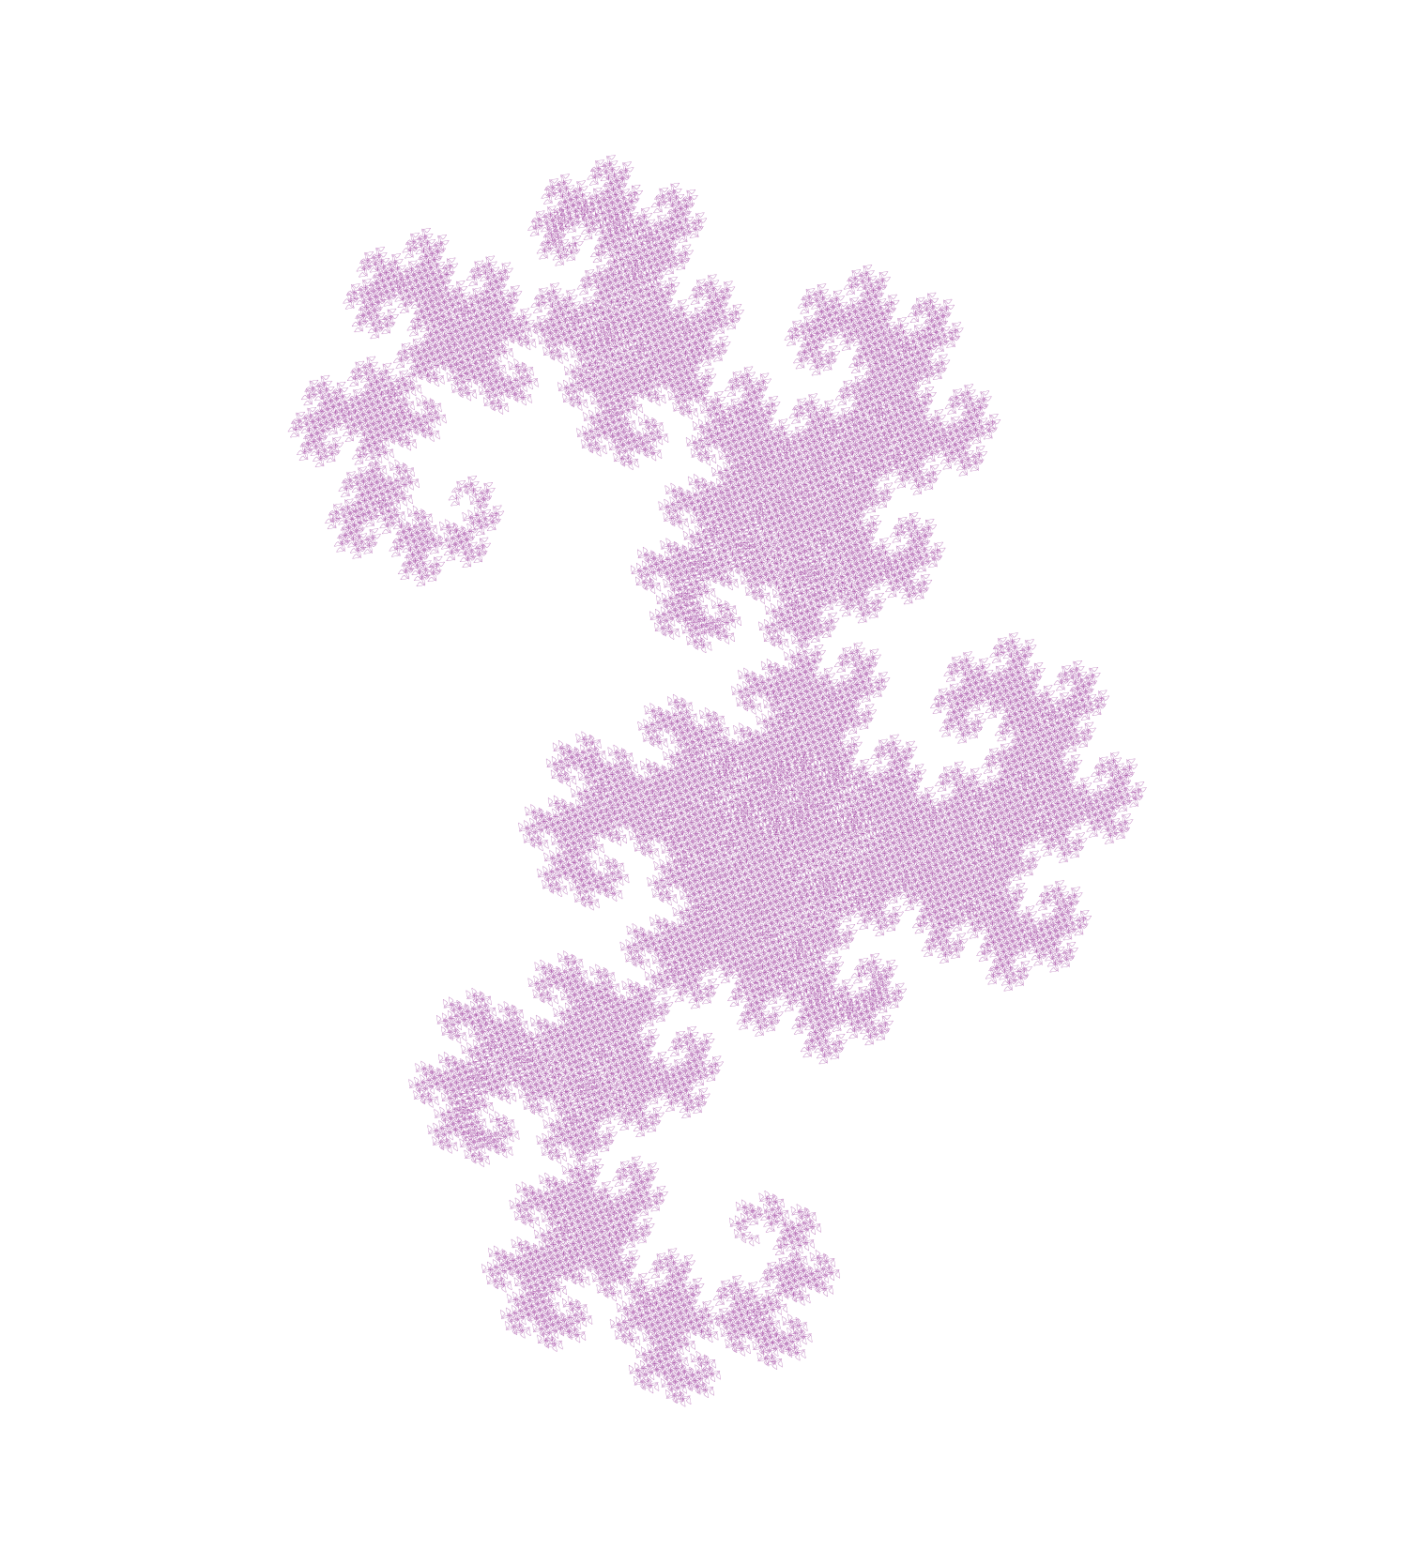
Author - Samanta

Slide 17
Author – Nojus, 6 grade

Slide 18
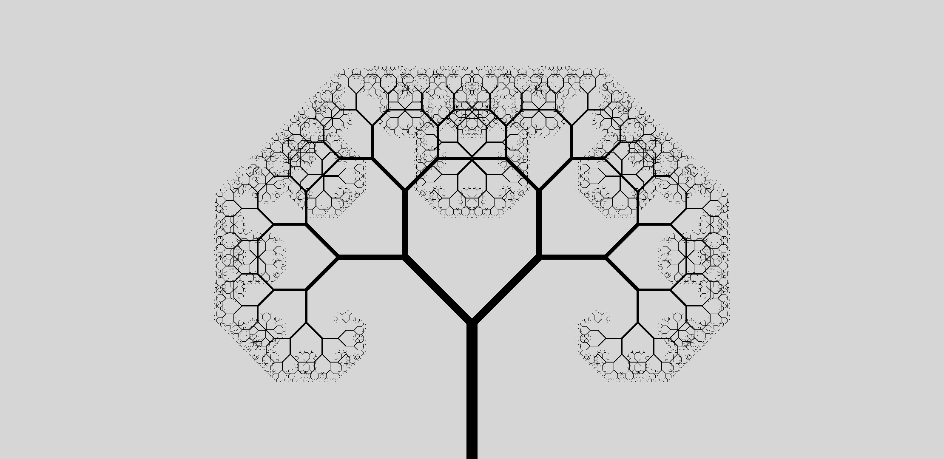
Author – Tomas, 5 grade

Slide 19
We hope you‘ll design some fractals and send them to us. We are planning to make a photo album of the fractals created by the project paricipants.
Thanks for your attention
Notes:
we will upload these slides to twinspace

