Slide 1
Build Your Own Fractal

Slide 2
These slides will explain how to use MS Windows' Paint application to create your own fractal-like image. There is any number of possible fractals you could create but they are all based on the idea of iteration; a repeated rule. I'll show you how to produce just one:

Slide 3
First, open MS Paint and repeatedly click the zoom out button under the view tab, until you can zoom out no further. Then, extend the drawing area to make it as big as possible:

Slide 4
Now, tick the box labelled gridlines and zoom in as far as possible. You should see a grid covering the drawing area; each square represents a single pixel. Scroll down to the bottom left of the drawing area and use the pencil tool (which colours one pixel when at a time) to create the following shape:

Slide 5
Now click on the rectangular select button, and select the 4x4 pixel square containing the above figure. Copy and paste the object. It will appear at the top left hand corner of your screen, and you'll be able to drag it around. Move the object so it sits adjacent to the one you originally drew. Paste and drag another copy so that it sits atop the other two. Your shape should now look like this:

Slide 6
Here's where the iterative fun begins. Select the 8x8 pixel square containing your drawing so far. Then repeat the above step; copying, pasting, and dragging to get the next three iterations:

Slide 7
For how many iterations can you continue? If you would like to colour the gaps in your fractal, it might be an idea to start sooner rather than later. If you leave it until the end, you will have a lot of gaps to fill. Can you calculate how many?

Slide 8
The fractal that the above iteration produces is an approximation of the Sierpinski Triangle. What other fractals can you produce by starting with different shapes, or changing the iteration rules? Here are a couple of suggestions to get you started:

Slide 9
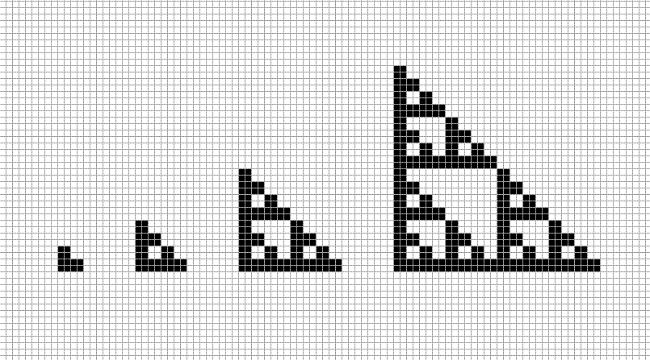

Slide 10
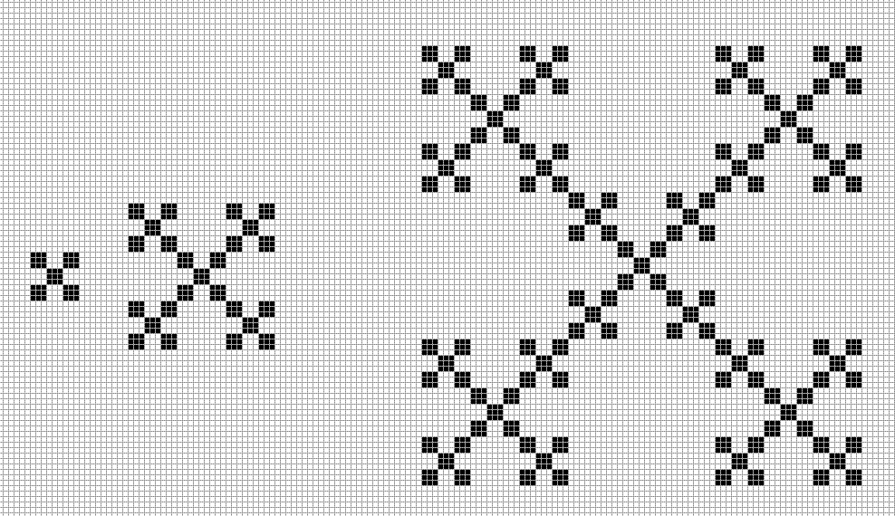

Slide 11
Thanks for watching and have a good day
The slides were made by Emilis Žemaitaitis

