Slide 1
FAVOURITE STORIES OF TURKEY

Slide 2
“Funded by the Erasmus+ Program of the European Union. However, European Commission and Turkish National Agency cannot be held responsi­ble for any use which may be made of the information contained therein”
TUNNEL OF TIME
Project No: 2017-1-FI01-KA219-034707_3

Slide 3
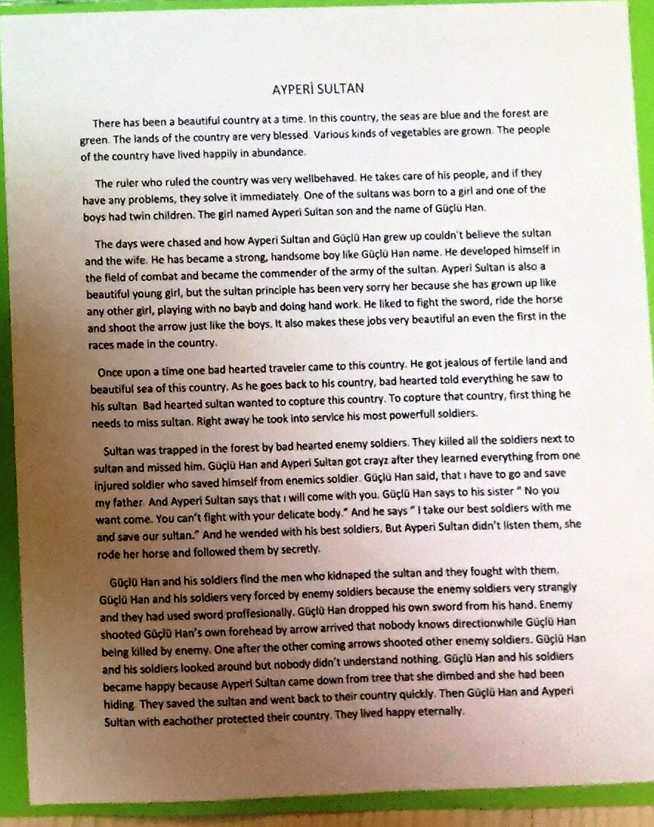

Slide 4
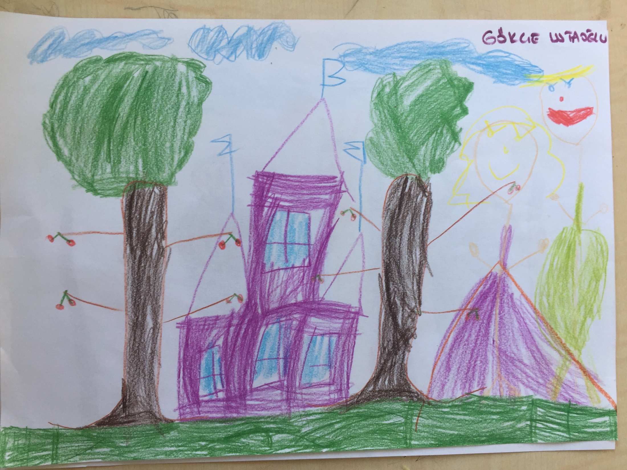

Slide 5
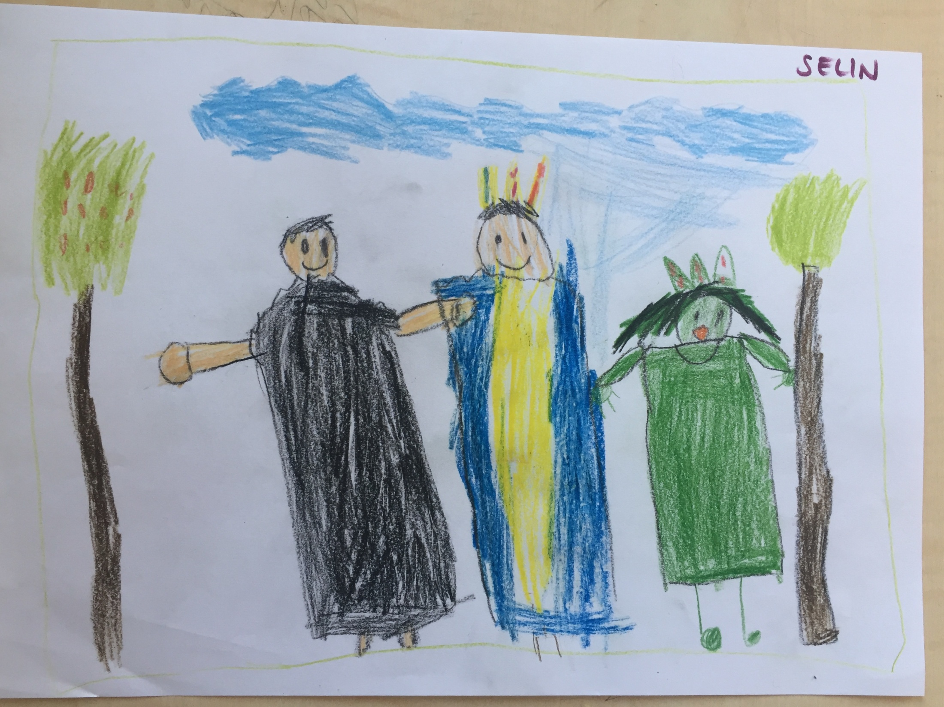

Slide 6
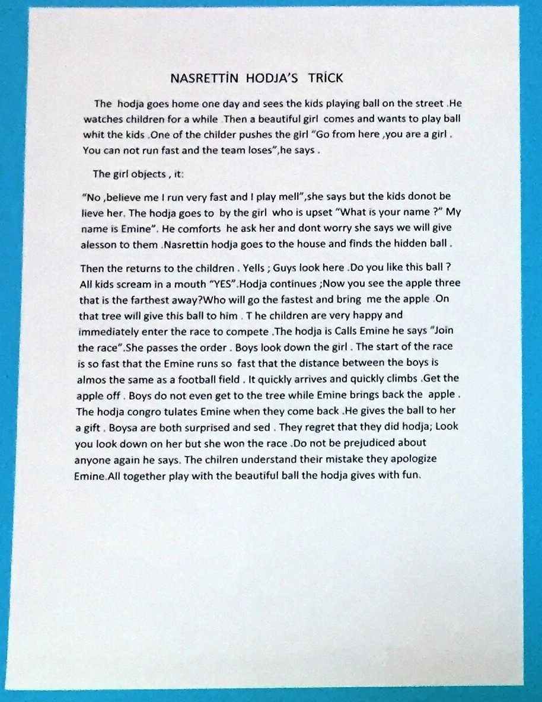

Slide 7
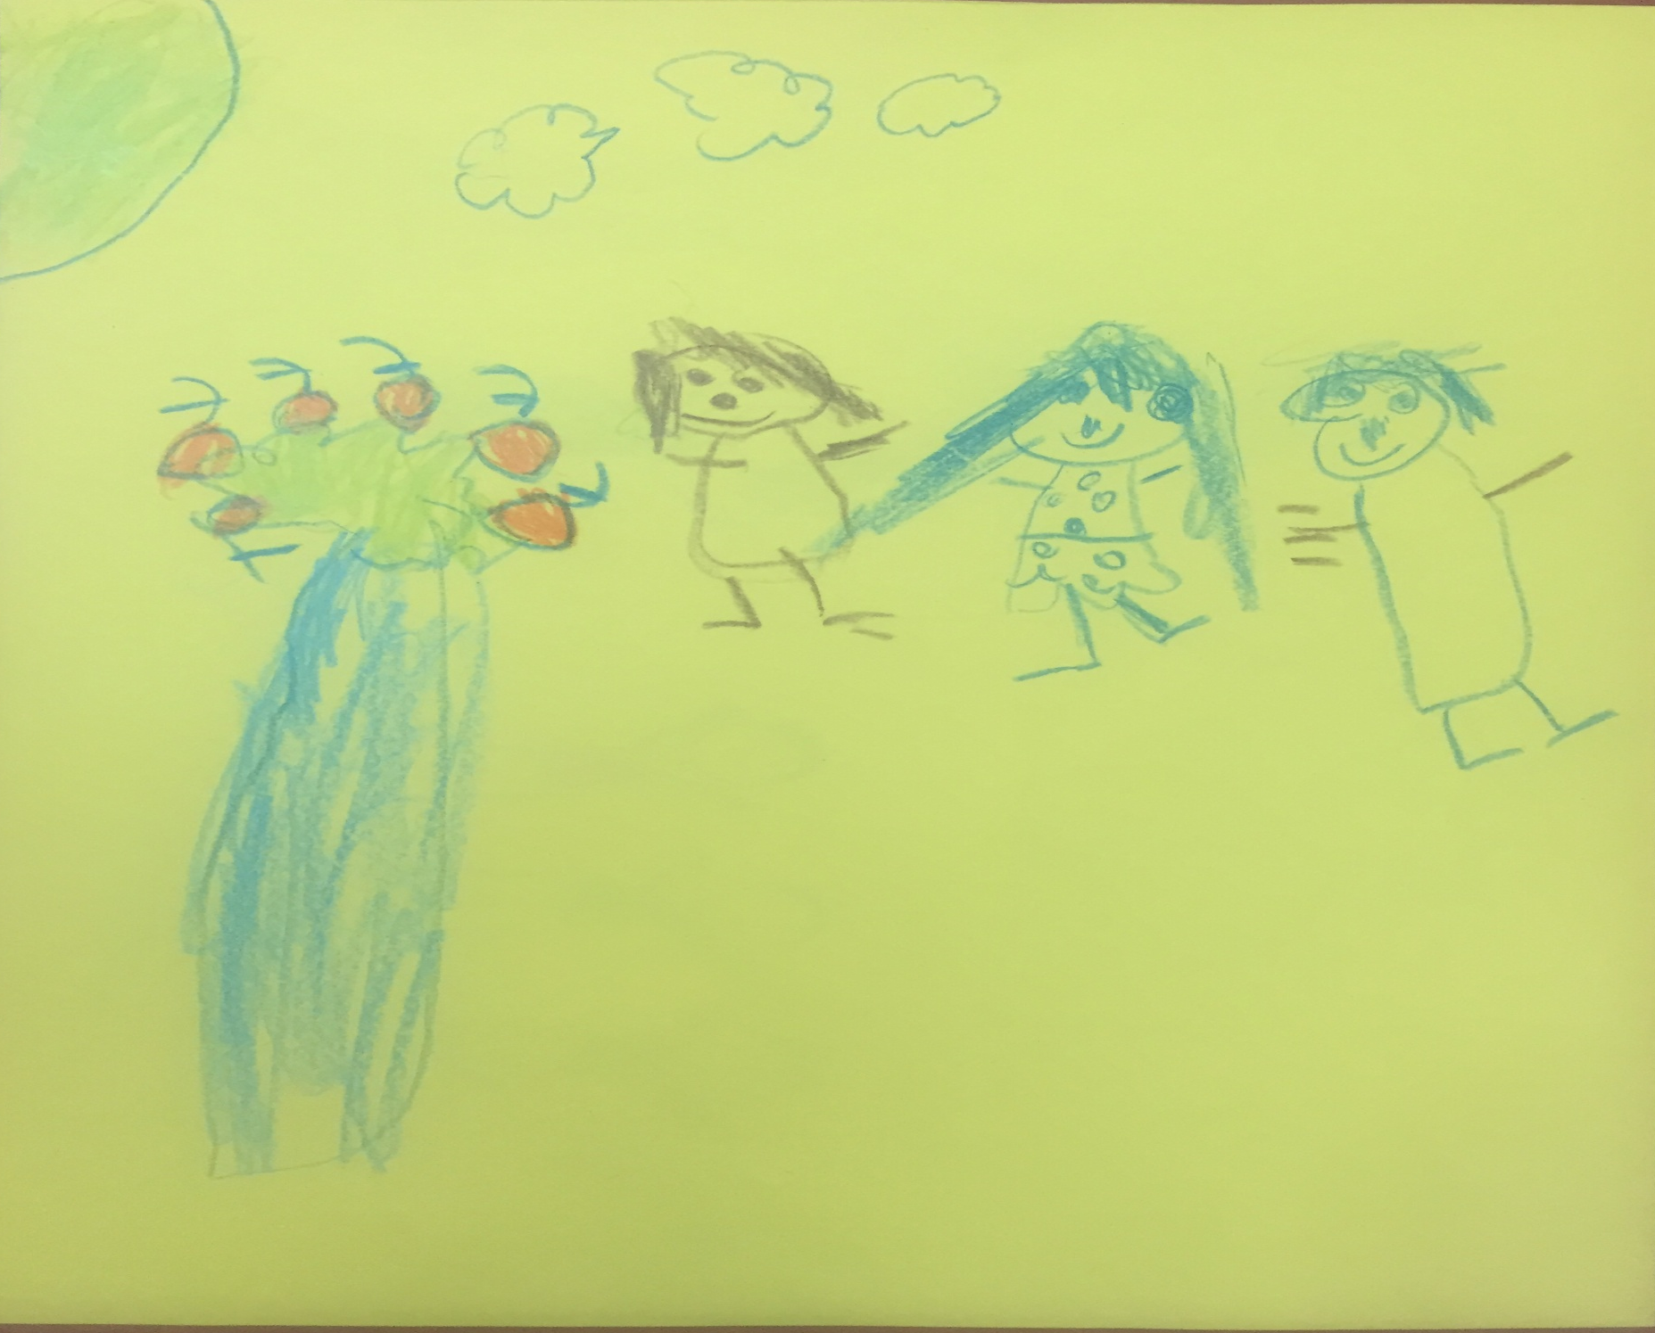

Slide 8
