Slide 1
10 tips for saving energy
Jakub Krzyzowski
Giulia Surano

Slide 2
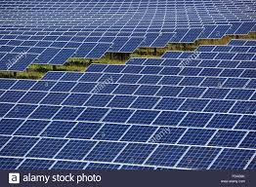
1. Using the solar panels

Slide 3
1. Text
Using solar panels to make ecological energy is good to environment.
When you are making energy frome solar panels you don’t have to take it from power station.

Slide 4
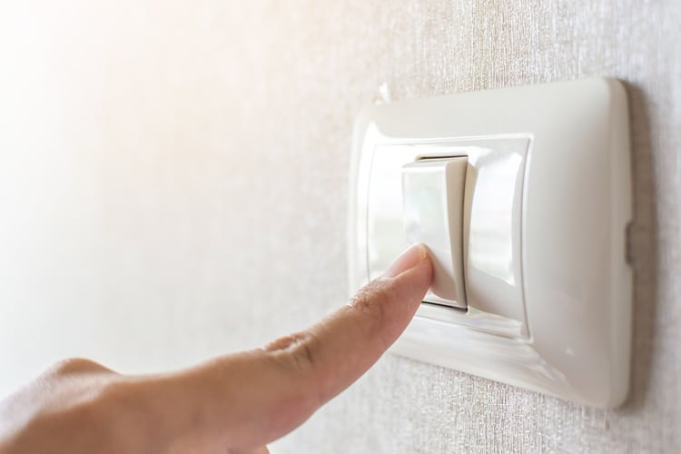
2. Turn off the light when you don’t have to use it.

Slide 5
2. Text
When you are saving energy you don’t have to take it from power station.
Saved energy you can use in other things.

Slide 6
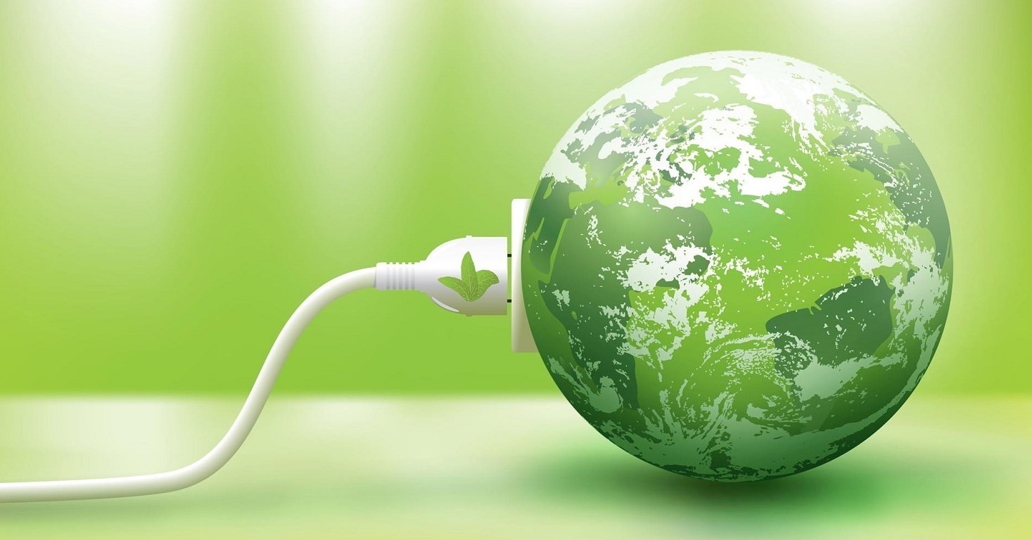
3.
Buying energy-saving items

Slide 7
3. Text
Like in 2 point saved energy you can use in other things.
When you are don’t use much energy, power station have to make less energy.

Slide 8
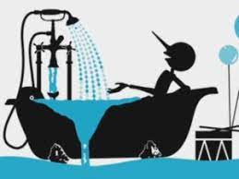
4. does not consume water

Slide 9
4. Text
water is a precious commodity so you have to be careful not to consume too much of it.

Slide 10
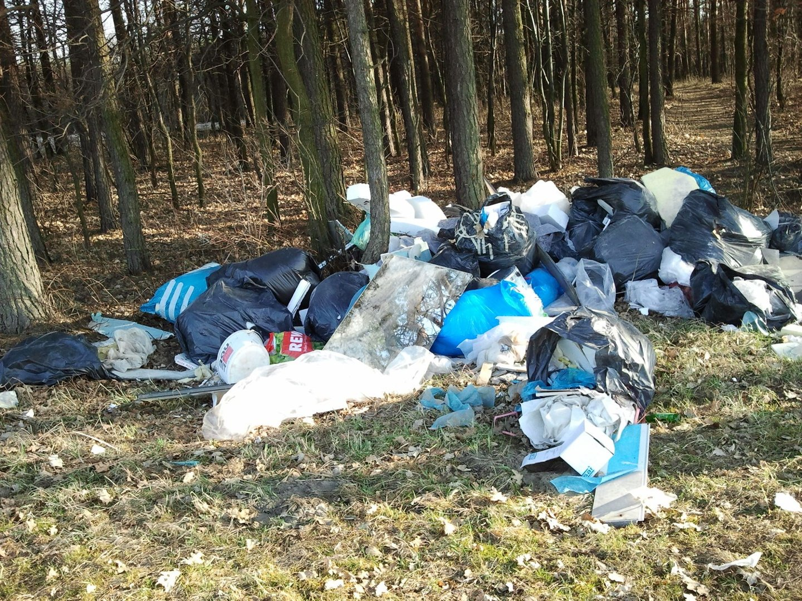
5. Don’t buy items when you don’t have to use them.

Slide 11
5. Text
When you buy things that you don’t have to use, older things are going on the rubish, and the factory don’t have to make it more.

Slide 12
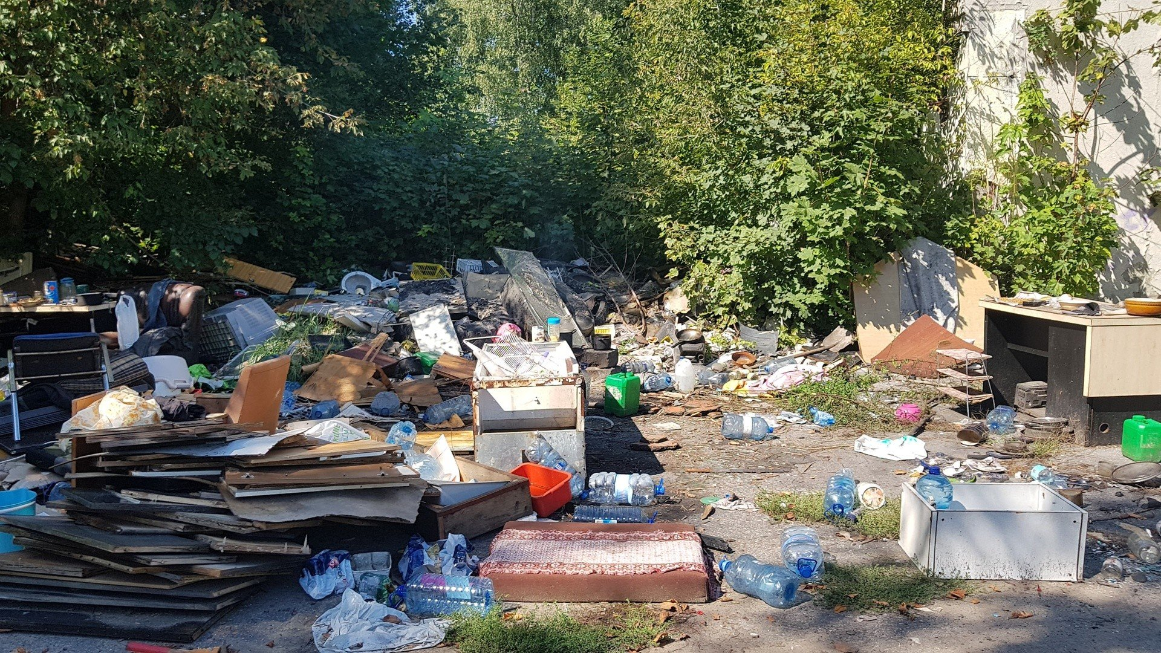
6. Don’t throw trash to the forest

Slide 13
6. text
Trash in forest, it is very common in Poland it is not healty for everyone.
Sometimes the forest is burning then this rubish is burning with this so it makes mor Co2.

Slide 14
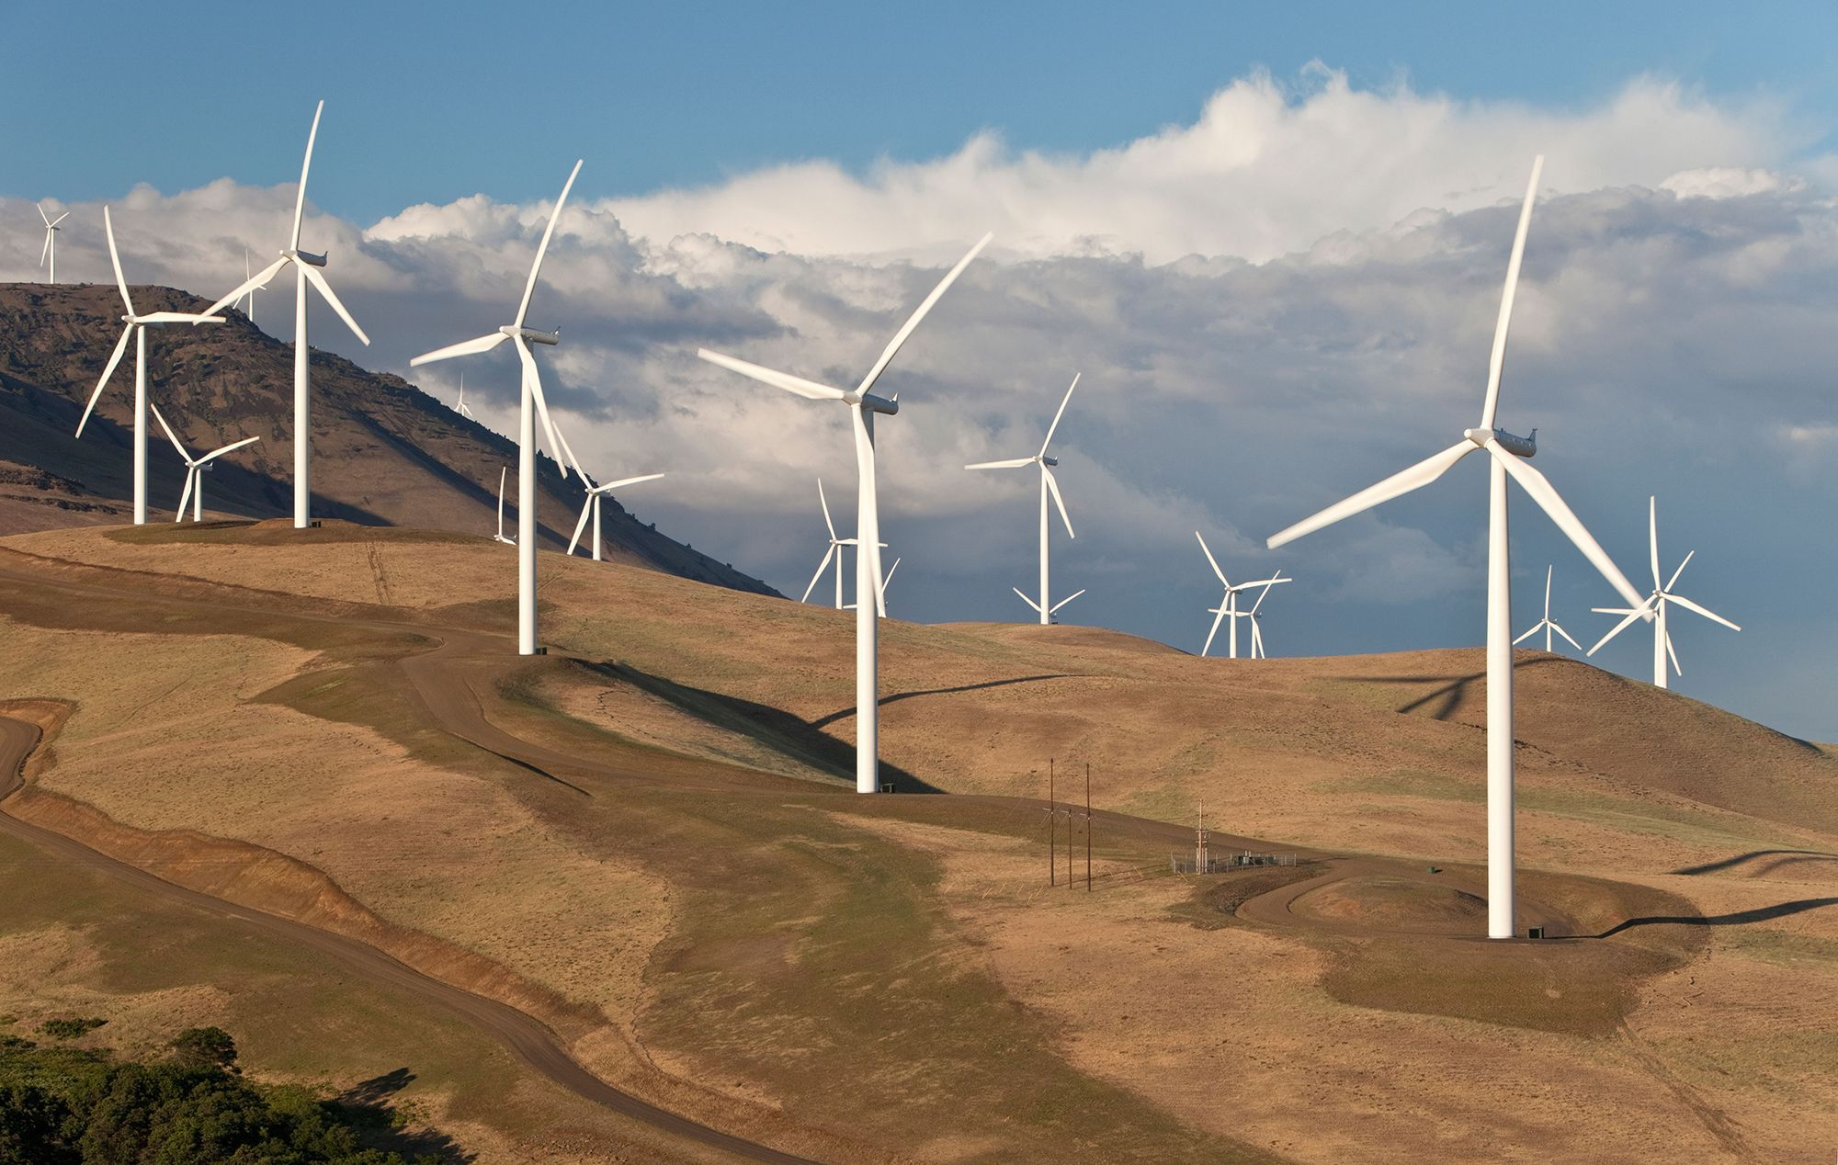
7. use wind energy

Slide 15
7. Text
Using wind energy is non-emision making energy plant that is not emitating Co2.

Slide 16
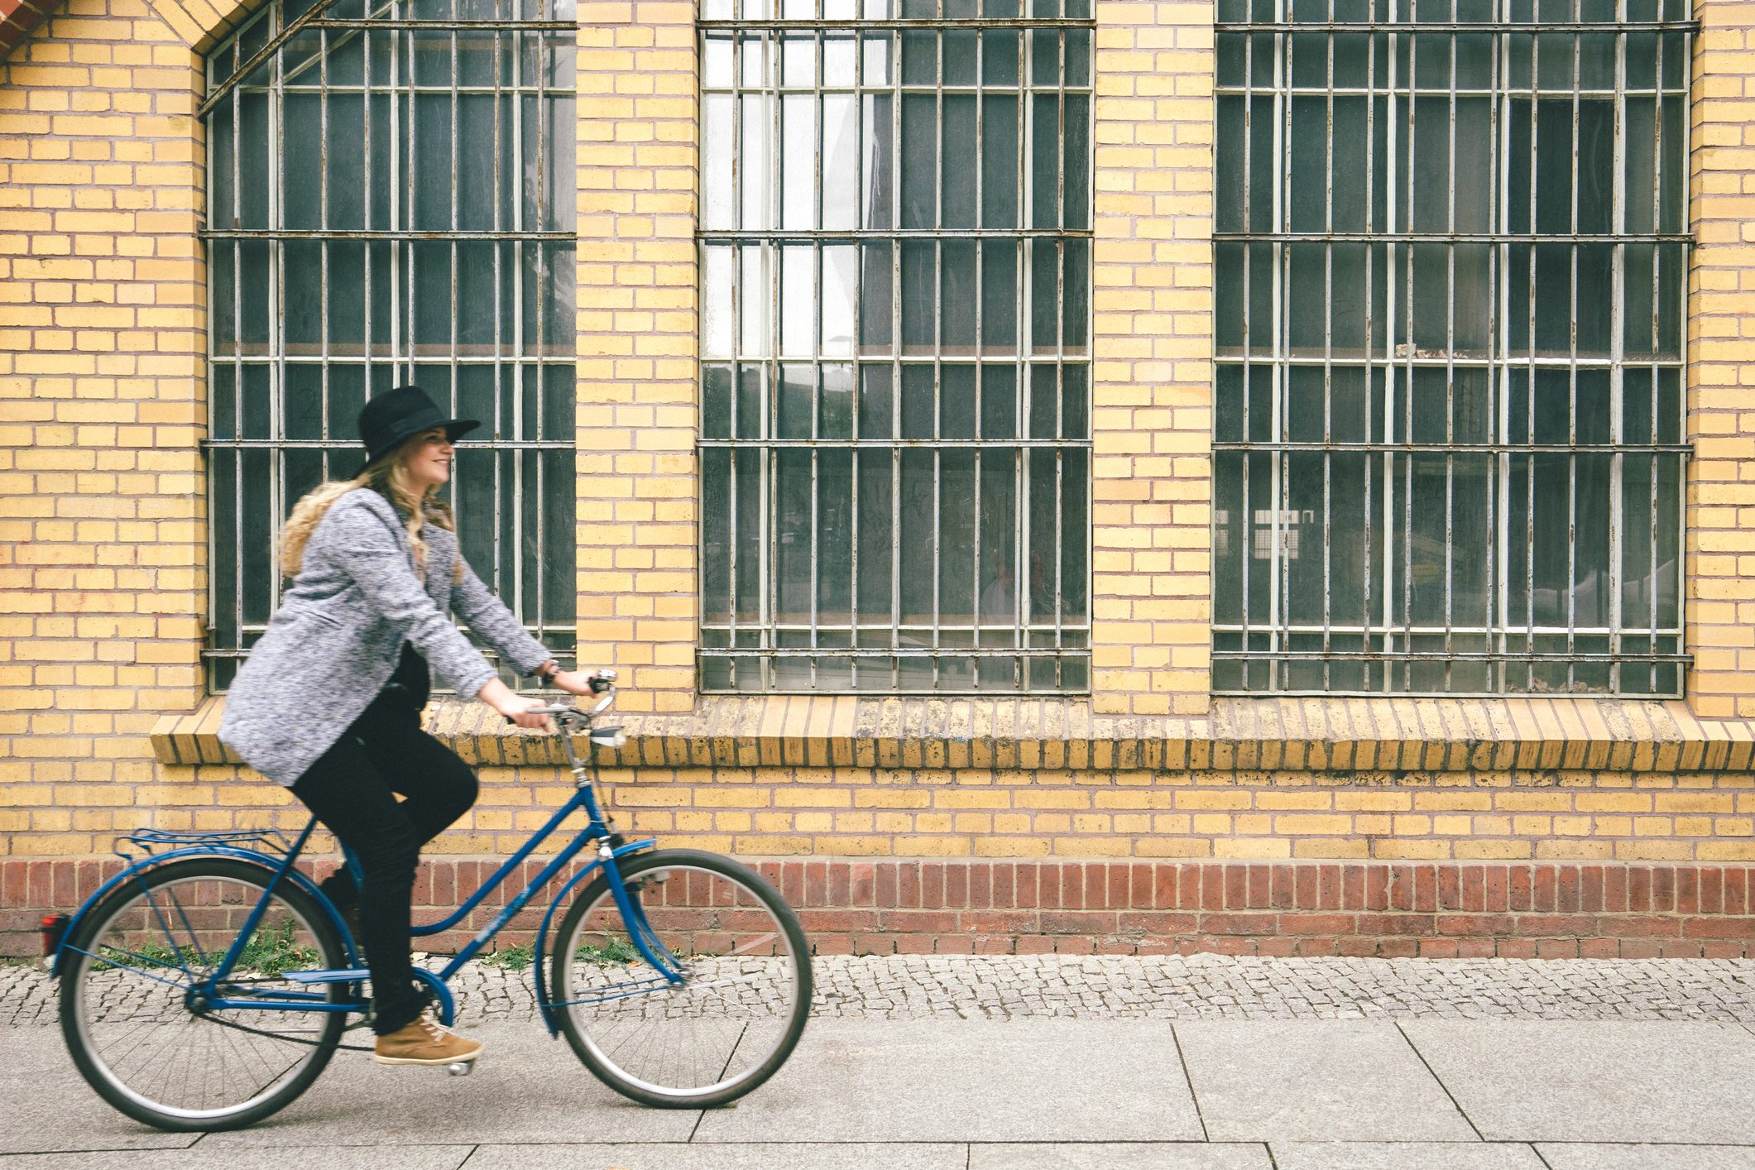
8. use cars less

Slide 17
8. text
Cars are emitating co2.
To make it less we can driving with bicycle or buy cars with blue motion or electric cars.

Slide 18
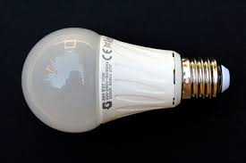
9. use led lamps

Slide 19
9. Text
Energy lamps are using less energy and giving light.

