Slide 1
Food transport
In Poland

Slide 2
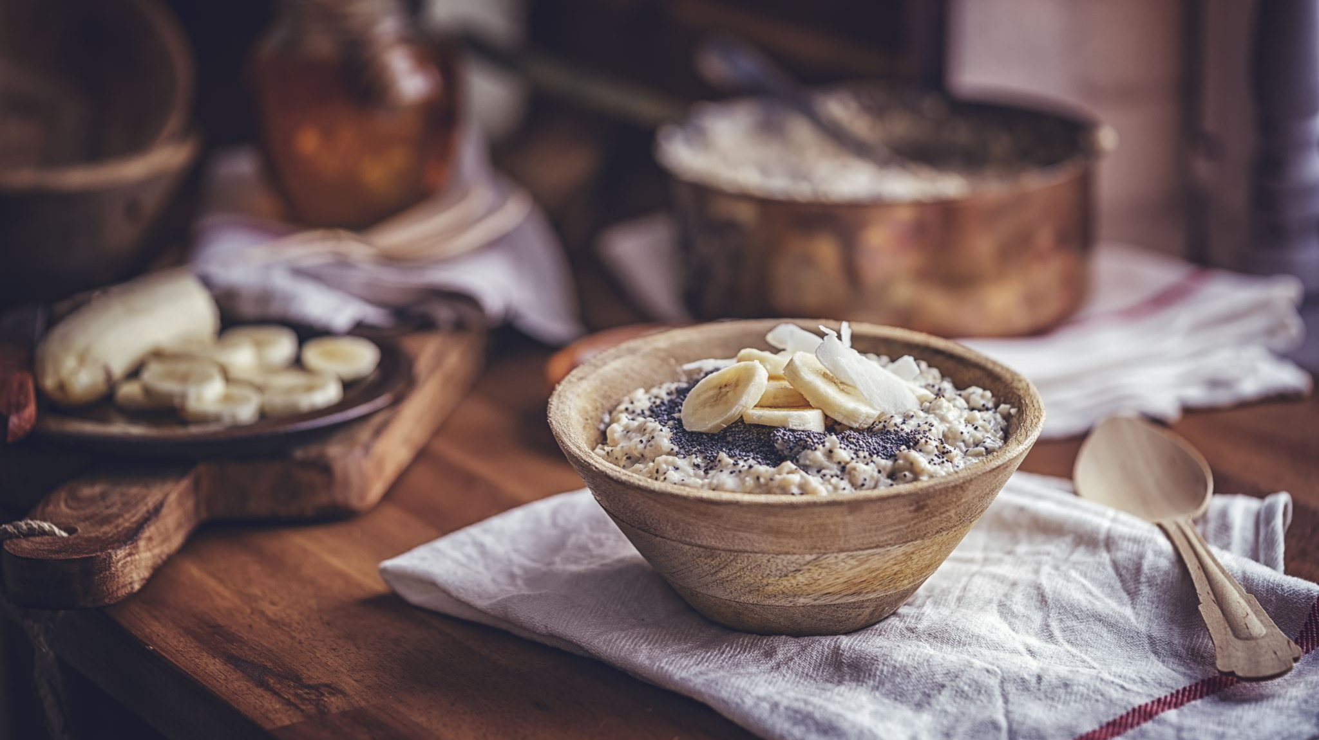
Where do we get dietary food from? In Poland, Polish dietary products such as Apples and tomatoes are very popular. German industries are also equally popular, producing vegan cheeses, for example. Also popular are companies: Mexican, Canadian, Italian and Greek

Slide 3
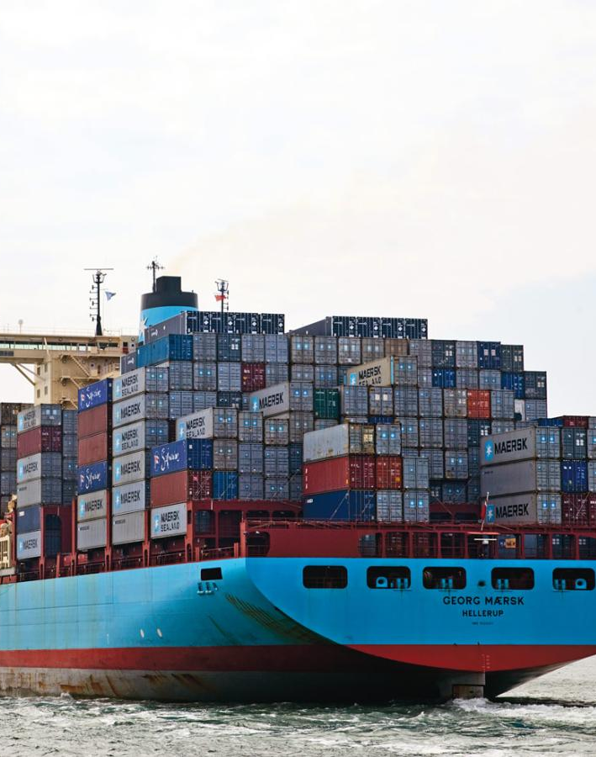
Methods of transporting food
Often healthy food is imported by sea, becouse ships have high capacity Planes are also popular when it comes to transporting food due to the speed and low price of transport. Trucks are just as often used, but only in quite close proximity.

Slide 4
Transport of dietary food in the EU
In the European Union it is very similar to the transport of food as in Poland only to the EU it is used on a higher scale. Due to the higher budget of Western countries, these goods are of higher quality.

