Slide 2
Healthy nutrıtıon
Berat yıldız
Adnan menderes ortaokulu

Slide 3
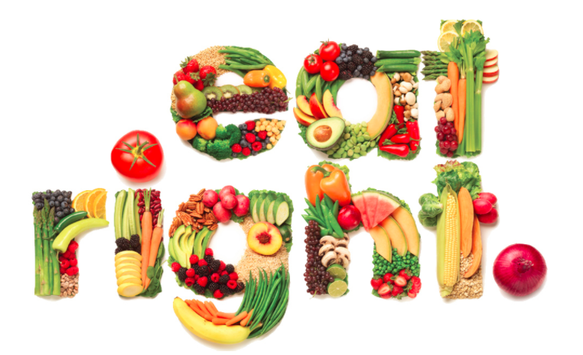
Healthy nutrıtıon
The United Nations has said that reduction of climate change impacts would only be possible with a worldwide diet change, away from animal products. Producing red meat has a big climate footprint, and eating too much of it can cause serious health problems.

Slide 4
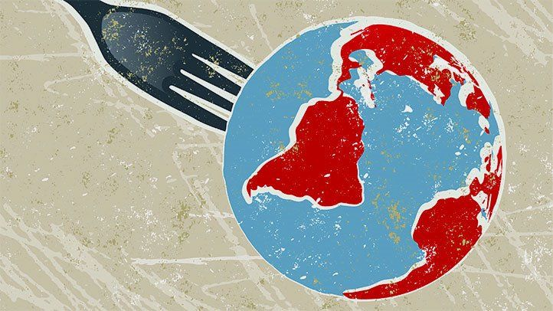
Healthy nutrıtıon
When it comes to living a sustainable life, diet plays a big role. The solution is to eat less red meat and more plants.
Be healthy
and save world
More
Plant
Less Meat

Slide 5
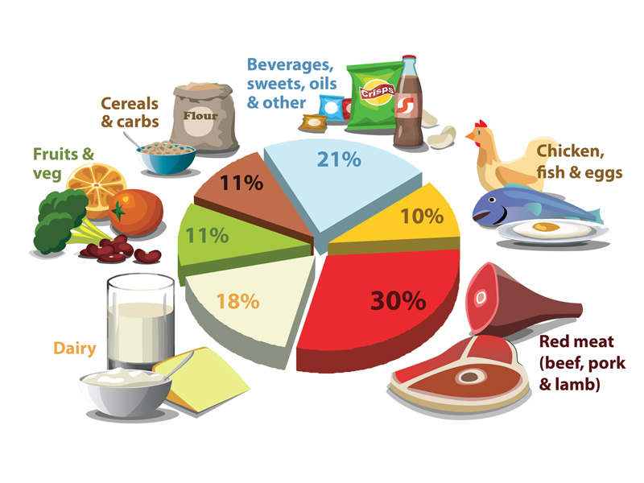
WHAT CAN WE DO FOR HEALTHY NUTRITION FOR SAVING THE WORLD
We should change our habits to be more healthy.
Vegan Diet: A vegan diet replaces all animal products with fruits, vegetables, and grains.
A vegetarian diet eliminates meat, poultry, and fish in favor of plant-based foods.
A flexitarian diet includes nuts, legumes, fruits, and vegetables, as well as moderate amounts of non-processed meat, fish, and dairy.
The Mediterranean diet is a mainly plant-based eating plan that prioritizes heart-healthy foods, such as olive oil and nuts, and for eating fish more than red meat.

Slide 6
THANK YOU FOR YOUR ATTENTION

