Slide 1
Erasmus + KA 229 – School exchange partnership
CATCH – Climate and Threats on Cultural Heritage
2020-1-ES01-KA229-082560_2
OS `DESPOT STEFAN VISOKI` - DESPOTOVAC - SERBIA

Slide 2
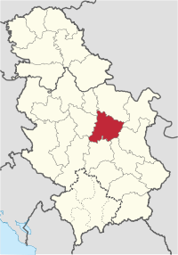
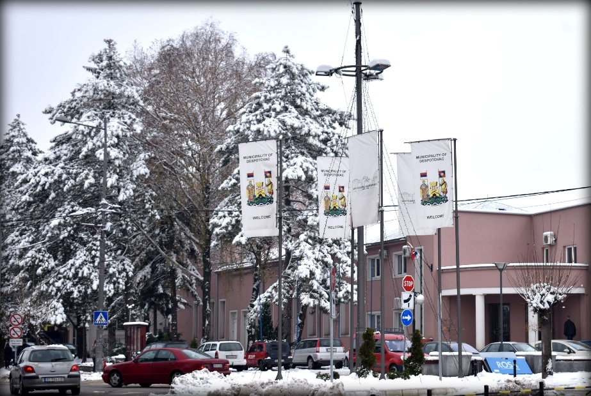
Despotovac
This is the town where I live. It is named Despotovac. It was named after Despot Stefan Lazarevic. It is in Pomoravlje District.

Slide 3
COAT OF ARMS AND THE FLAG OF DESPOTOVAC

Slide 4
This is our primary school `Despot Stefan Visoki`

Slide 5
Primary school "Despot Stefan Visoki" is located in Despotovac. It has the name of the famous Serbian ruler, the son of King Lazarus, Stefan the Great.
The school was founded in 1876 and since then it has had its present name. Today, about 500 students attend classes. The school has over 30 cabinets and classrooms, a hall for P.E. and outdoor sports fields.
Foreign languages that can be learned at school are: English, Russian and French. An extended stay for students of the junior class was organized at the school.

Slide 6
This is the Resava river. It springs below mountain Beljanica and it`s the largest river in the district.

Slide 7
This is mountain Beljanica, the highest peak is 1339 meters high.

Slide 8
This is Veliki Buk waterfall, it is also part of the river Resava. It is located in village Lisine.

Slide 9
This is Manasija Monastery. It is located 3 kilometers from the town. It is the largest endowment of Despot Stefan Lazarevic.

Slide 10
This is the Resava cave, located 20 kilometers from Despotovac. It was discovered in 1962, but was opened to visitors in 1972. It is currently a tourist destination.

Slide 11
THANKS A LOT FOR BEING WITH US!
MADE BY: KATARINA MILADINOVIC AND GEORGIJE
ZIVOJINOVIC
GREETINGS FROM OUR PROJECT STUDENTS TO
ALL OUR NEW FRIENDS AND THEIR TEACHERS.

