Slide 1
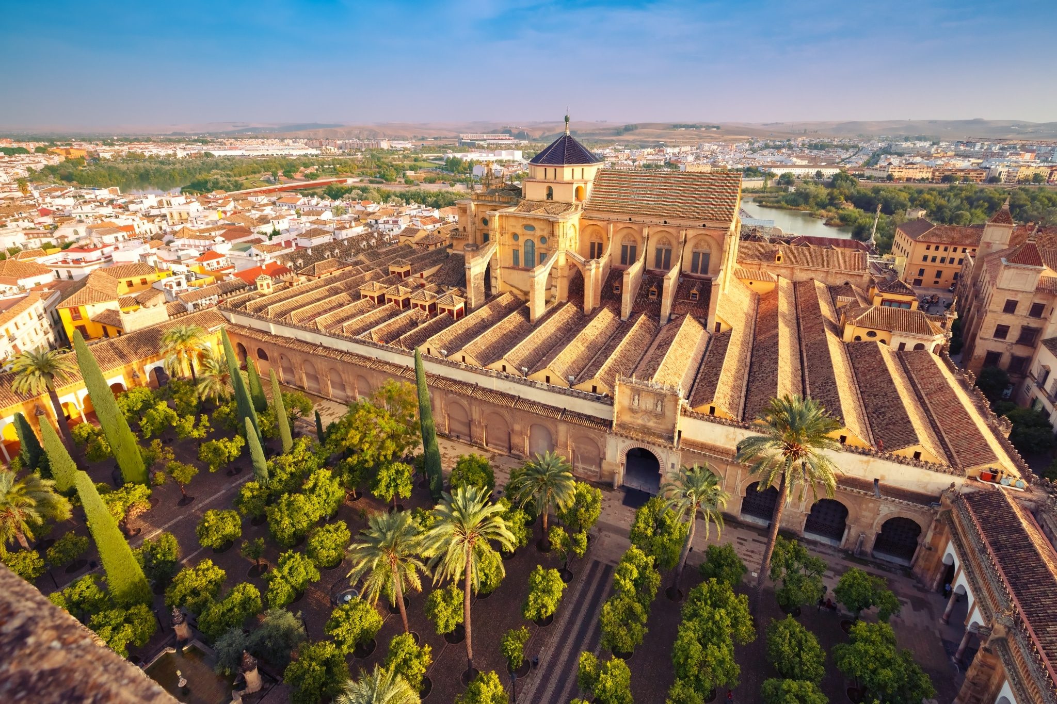
Córdoba

Slide 2
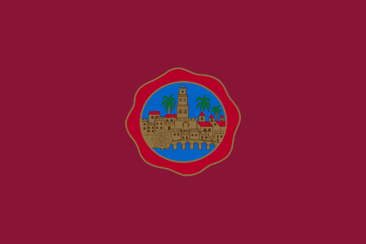
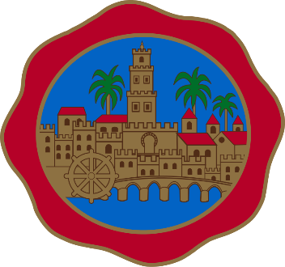
Córdoba is a Spanish city and municipality in Andalusia, capital of the province of the same name, located in a depression on the banks of the Guadalquivir and at the foot of Sierra Morena. It is home to a population of 326,039 inhabitants in 2020, being the third largest and most populous city in Andalusia after Seville and Malaga, and the twelfth in Spain. Its metropolitan area comprises eight municipalities, with a population of 360,298 inhabitants by 2020, the twenty-third most populous in Spain.
Flag of the city of Cordoba
Official coat of arms of the city of Cordoba
Cordoba is currently the city with the most Unesco World Heritage titles in the world. In 1984, the Mosque-Cathedral of Cordoba was included in the renowned list, a declaration that a decade later would extend to the entire historic center. The Cordobeses Courtyard Festival was designated an intangible cultural heritage of humanity in December 2012 and in July 2018 the Palatine city of Medina Azahara, on the outskirts of the urban center, was also declared a World Heritage Site. It also has one of the largest historical centers in Europe, with 246'73 hectares with monuments dating back to Roman times.

Slide 3
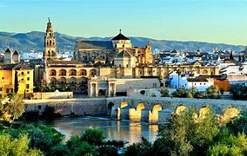
In 1238, after the christian reconquest of the city, its consecration was carried out as a cathedral of the diocese with the episcopal ordination of its first bishop, lope de fitero.6 the building houses the cathedral lobby of the diocese of córdoba, and because of its character as a catholic temple and episcopal seat, it is reserved for catholic worship. In 1523, under the direction of the architects hernán ruiz, the elder and his son, his renaissance cruciform basilica was built in a plateresque style. Today the whole complex is the most important monument of cordoba, and also of all andalusian architecture, along with the alhambra, as well as the most emblematic of hispanic-muslim u.S. Art. Declared a good of cultural interest2 and cultural heritage of humanity as part of the historic center of the city,7 was included by the public among the 12 treasures of spain in 20078 and was awarded as the best tourist attraction in europe and sixth in the world according to a tripadvisor contest.
Córdoba´s most famous monument is the Mezquita, or the mosque-catedral.
The mosque-cathedral of Cordoba,12 Santa Maria Madre de Dios" or "Grand Mosque of Cordoba", currently known as the Cathedral of the Assumption of Our Lady ecclesiasticalally, is a building in the city of Cordoba, Spain. In 2019 it surpassed two million visitors, being its historical record and making it one of the most visited monuments in Spain.3
It was built as a mosque in 784; until recently it was believed that after the appropriation by the Muslim conquerors of the Spanish-Roman basilica of St. Vincent Martyr4 and the reuse of some of the materials, being reserved for Muslim worship, but the most recent archaeological studies dismiss this hypothesis.5 The building was expanded during the Emirate of Córdoba and the Caliphate of Cordoba. At 23,400 square meters, it was the second largest mosque in the world on the surface, behind the Mosque of Mecca, and was subsequently surpassed by the Blue Mosque (Istanbul, 1588). The wall of the qibla was not oriented towards Mecca, but 51 degrees to the south; this was common in mosques in al-Andalus.

Slide 4
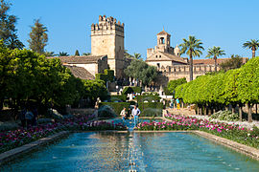
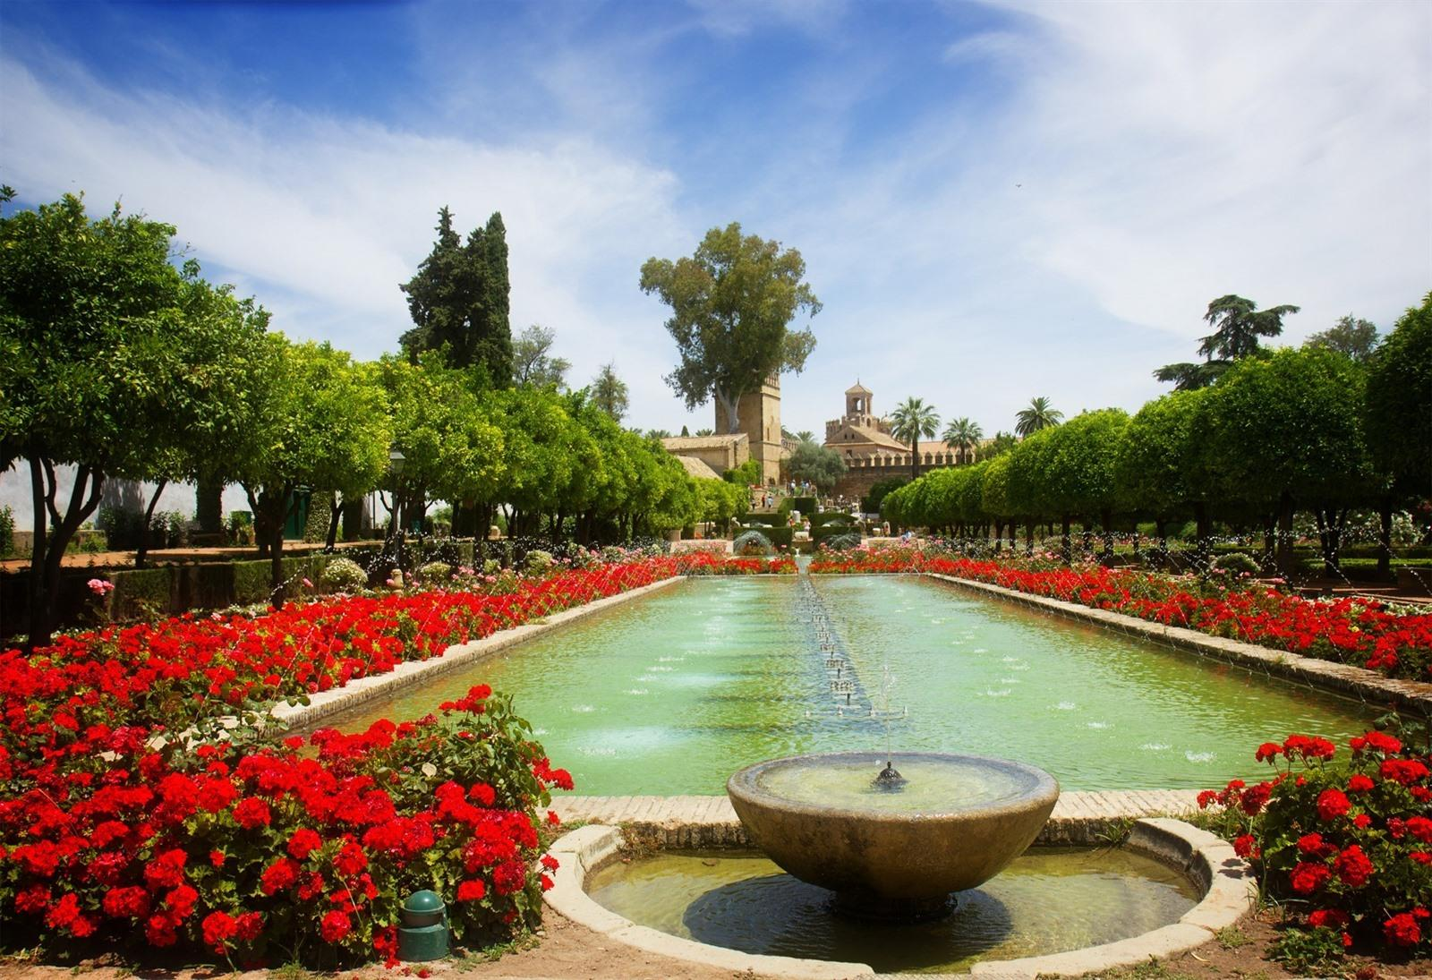
The second most important monument in Córdoba is The Alcazar de los Reyes Cristianos.
The Alcázar de los Reyes Cristianos is a military building in the city of Córdoba, Spain, located on one of the banks of the Guadalquivir River. The monarch Alfonso XI of Castile ordered its construction in 1328 on the former Andalusian Alcazar, formerly the residence of the Roman governor and customs. The architectural complex has a sober character on its exterior and splendid inside, with the magnificent gardens and patios that maintain a Mudejar inspiration.
The Alcázar has been declared a Cultural Interest Since 1931. It is part of the historic center of Cordoba, declared a World Heritage Site by Unesco in 1994. In 2019 it received 595,517 visitors, being the second most visited payment monument in Cordoba after the Mosque.
At night, since 2011, magical nights have been held in the Alcazar, a spectacle of light, water and sound that explains the history of the monument through an eye-catching staging.

Slide 5
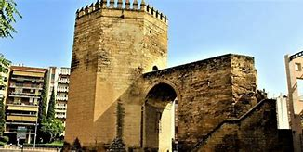
At the end, La Torre de la Malmuerta is an another really important monument of Cordoba´s city. It have a “fun” history to told to your friend on a spooky night. Legend has it that, on a stormy day when night fell, a nobleman who had spent many years fighting at the front for freedom finally returned home. It was then that servants told him that his wife, the reason he had wanted to emerge unscathed from the war, had cheated on him with his friend. Angry and unacfirmed, he decreed to murder his own cousin and lock forever in a tower that had been his beloved, without food or drink, so that he would die in the most painful way. Still, some say that the Angel, sympathized with her fate and seeing that she had faithfully awaited her husband's return, brought her food every day so that she would die naturally. Others say that's impossible, and she's really dead. Like every legend, there are many versions, all of them just as true. From there we can get the name "La Malmuerta", in Spanish it is a compound word meaning the dead evil.
It began to be built in 1404, finishing in 1408, and was built on the remains of a Muslim tower. His mission was to defend the gates of Rincon and Colodro. Its construction was commissioned by King Henry III of Castile to the first corrector of the city of Córdoba, Penedro Sánchez. Under the arch you can see the royal weapons and an inscription that was already read with difficulty in 1873, and which appeared collected in the book Paseos por Córdoba. When his defensive function was lost, it was used as a prison for nobles. Then, in the eighteenth century, the Cordoba sage Gonzalo Antonio Serrano made his astronomical observations from it. For some time at the end of the twentieth century it hosted the Chess Federation.
The Malmuerta´s Tower

Slide 6
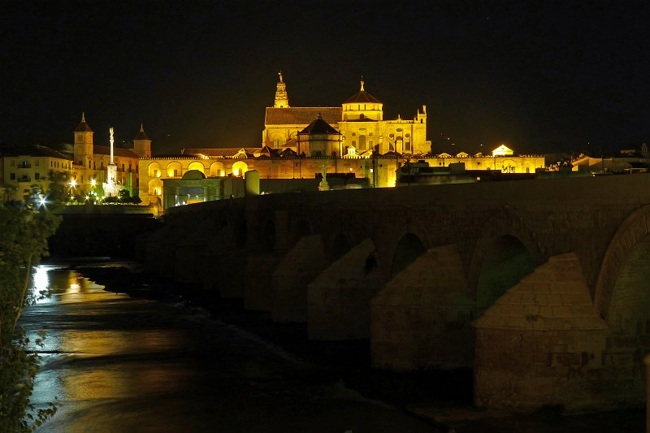
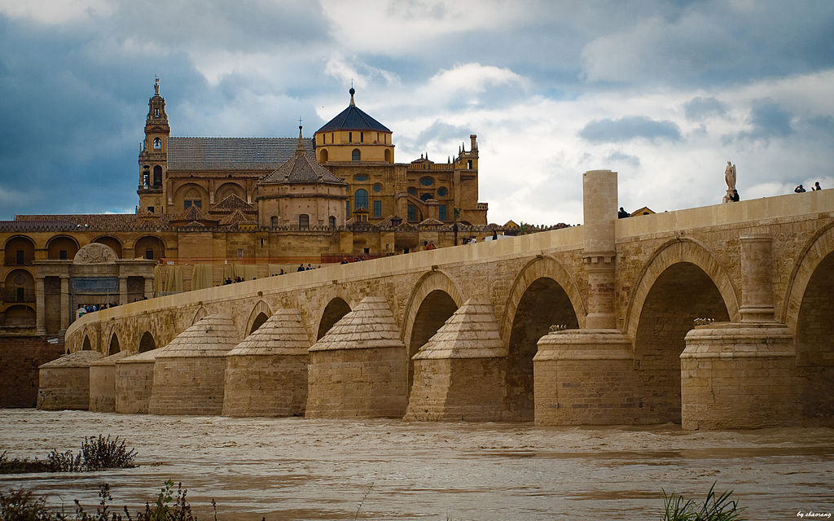
Then there is The Roman Bridge of Cordoba located on the Guadalquivir River as it passed through Cordoba, and it linkes the Campo de la Verdad neighborhood with the Cathedral Quarter. Also known as the Old Bridge, as it was the only bridge that the city had for twenty centuries, until the construction of the San Rafael Bridge in the mid-20th century. On January 9, 2008, the largest remodeling that the Roman Bridge has ever had was inaugurated. Since 1931, the bridge, together with the Bridge Gate and the Calahorra Tower, has been declared a cultural interest in the category of Monument. In addition, it is part of the historic center of Cordoba that was declared a World Heritage Site by Unesco in 1994.
It has a length of about 331 meters and is composed of 16 arches, although it originally had 17. It was one of the most important means of entry into the city from the southern part of the Iberian Peninsula because it is the only point to cross the river without using any type of boat. Probably the Via Augusta that went from Rome to Cadiz passed through it. In the center of the bridge is the triumph of the San Rafael, the oldest of the Triumphs, dating from 1651, the work of the sculptor Bernabé Gómez del Río. In more recent times, the Roman Bridge became the access to the city for travelers who came from the south of the city, so the southern faithful of the city was located at the gate of the Bridge.
In addition, the Bridge was an integral part of the national road N-4, being crossed by travelers who went down from the center of Spain to the south and vice versa.

Slide 7
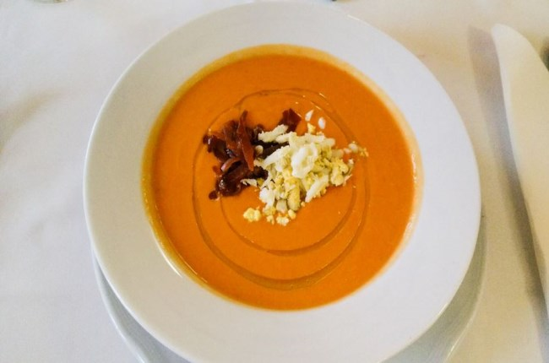
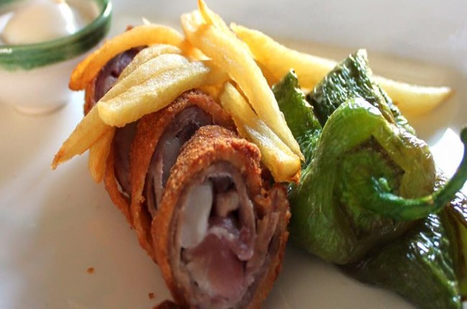
TYPICAL CÓRDOBA FOOD
The typical gastronomy and food of Cordoba is one of the best known within Andalusia and throughout Spain based on the use of natural products and ingredients in the elaboration of its recipes, such as olive oil.
Salmorejo
Salmorejo is a cream very typical of the province of Córdoba, although, due to its light texture and consistency, it is usually also served as an accompaniment to other foods, being used as a sauce.
Flamenquines
Flamenquín Cordobés is one of the most typical dishes you can eat in Cordoba and is present in most of its bars and restaurants.
It consists of a curl-shaped breading where the meat is wrapped with the ham, which are then battered into flour and egg and fried in a frying pan with plenty of hot olive oil.

Slide 8
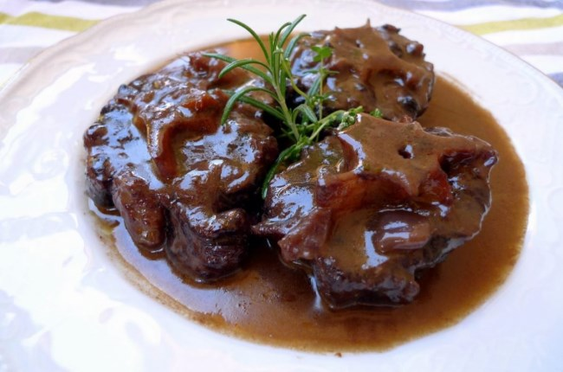
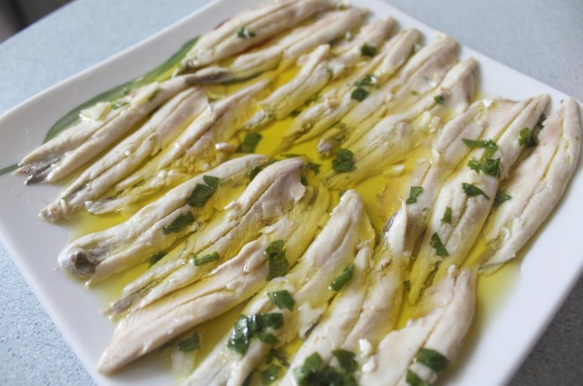
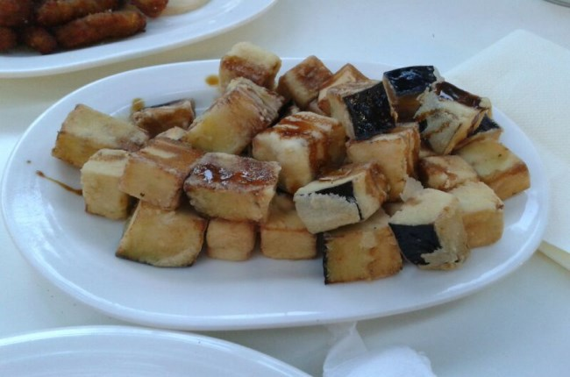
Rabo de toro
Another of the most traditional Cordoba meals is the bull's tail, an exquisite stew with a very ancient origin. It is essentially a stew, whose main ingredient is bull's or cow's tail.
Fried eggplant with honey
Honey-fried aubergines are another of the most popular dishes in the province of Córdoba, and in recent times have also become one of the most sought after tapas in the bars and other establishments of the various municipalities of that province.
Boquerones in vinegar
At the time of the aperitif in any establishment in our country, the anchoies in vinegar become undoubtedly one of the most requested. In Cordoba, as in other corners of our geography, they are a very popular dish, and in addition to a very easy elaboration.

Slide 9
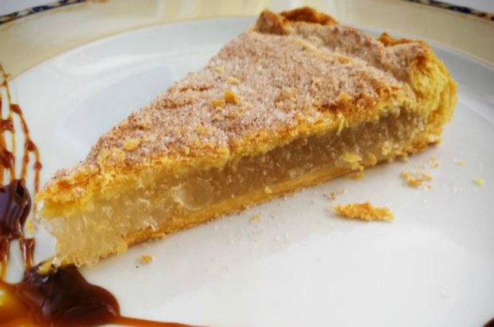
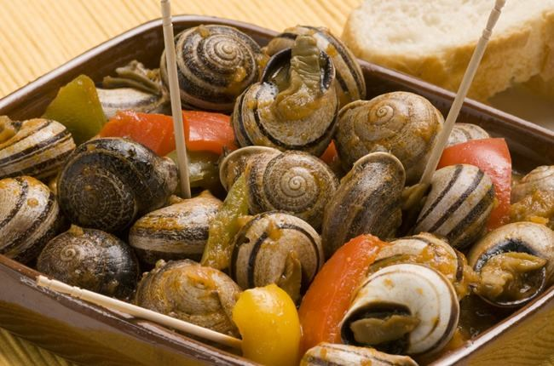
Snails
To finish, another typical of Cordoba gastronomy are snails, which are usually made in sauce, although there are various variants, depending in much of the area.
It is a stew in which snails are cooked along with different complements, such as tomatoes, onions, red peppers, garlic, bread from the previous day, wine, mint and some species such as cumin, saffron, pepper, nutmeg and sweet paprika.
Cordoba cake
Cordoba cake is one of the most typical sweets and desserts in Cordoba that we can try. It is very typical to consume it on November 17, when the day of the patron saints of Cordoba, Santa Victoria and San Acisclo is celebrated.
It consists of a puff pastry cake, which is usually filled with products such as angel hair or cider. Sometimes even with ham.

