Slide 2
EURO EURO

Slide 3
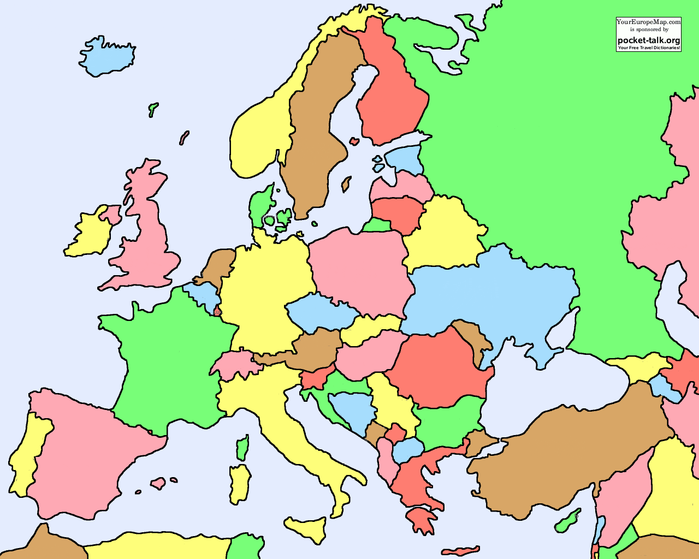
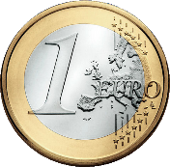
Finland
Sweden
Estonian
Latvia
Denmark
Lithuania
United
Kindrom
Ireland
Nederland
Poland
Luxemburg
Belgium
Germany
Czech R.
Slovakia
Austria
Hungary
France
Slovenia
Romania
Croatia
Bulgaria
Portugal
Italy
Spain
Greece
Cyprus
Malta

Slide 4
