Slide 1
GOOD PRACTICES ON FINANCIAL LITERACY IN TURKEY

Slide 2
Financial Literacy in Turkey
There are many attempts by government, NGOs and universities for developing financial literacy of students and people in Turkey.

Slide 3
FO-DER
FODER-Financial Literacy and Access Assosciation is an organization which aims to create an eco-sysytem for a financially literate Turkey. It has a lot of activities on the topic.

Slide 5
During ‘Learn Money Week’ on 10th-17th March 10.000 people in primary school were given training on ‘Secrets of Wealthy Future’.

Slide 6
In the first module of the training people are taught how to decide short and long term saving objectives and how to reach these objectives by planning.

Slide 7
In the second module it is aimed at teaching spending, donating, investment and saving issues to pupils and showing the differences among them and the effects of them on wealth.

Slide 8
In the third and last module of the training, it is aimed at creating discussion atmosphere by embodying the people’s having trained and by emphasizing the expression. It is also aimed at connecting the training and real life.

Slide 10
SAVE -- SHARE -- SPEND

Slide 11
3 KUMBARA (3 MONEYBOXES)
This training programme has been conducted with the cooperation of Doğuş Group, Ministry of National Education, Financial Education and Access Association.
http://3kumbara.org/

Slide 12
3 Kumbara Financial Literacy Training Programme teach primary school pupils that money is not an aim but a medium in order to manage their pocket money. It is aimed at making pupils learn the concepts like need, wish, saving, income, expenditure, share.
3 kinds of moneyboxes-Saving, Sharing and Spending have been prepared and a new application has started in Turkey.

Slide 14
Evin Hesap Uzmanı Kadın
(Woman-Account Expert of Home)
http://evinhesapuzmanikadin.org/

Slide 15
“Evin Hesap Uzmanı Kadın” project has been prepared in order to enable women aged between 18-35 to participate economics actively, improve their level of financial literacy, make them know their rights with the contribution of SGK (Social Insurance Institution), MasterCard and TurkishWIN.

Slide 18
BÜTÇESİNİ BİLEN GENÇLER ve ÇOCUKLAR
(YOUTH AND CHILDREN WHO KNOW THEIR BUDGET)

Slide 19
Yıldız Teknik University Department of Economics within the framework of 19th May Youth and Sports Day gives financial education with their volunteers to primary school pupils and high school students.

Slide 20
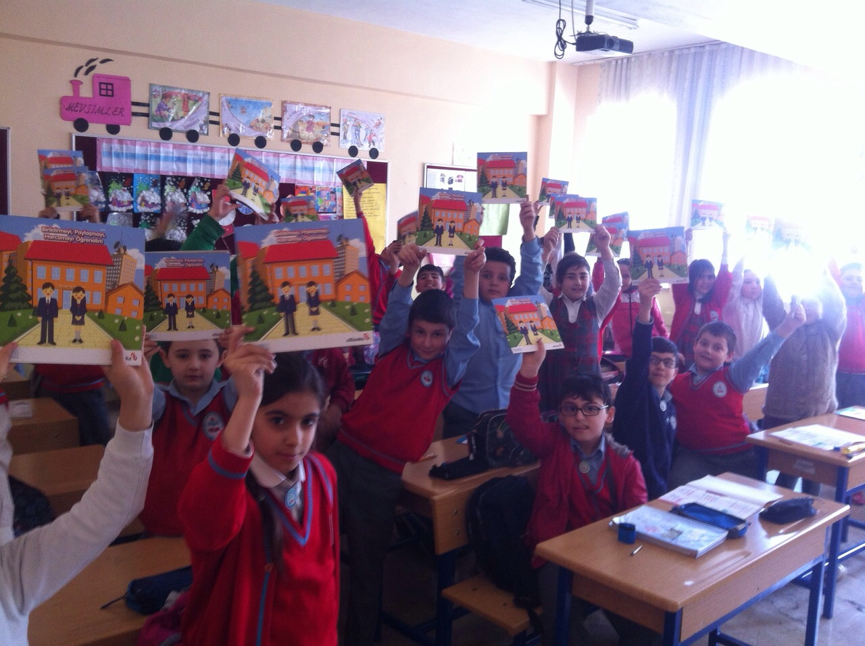
With this project it is aimed at creating economical reflections for students, families and country.

Slide 22
http://www.fo-der.org/tag/butcesini-bilen-cocuklar/

Slide 23
FO - DER ; MYBNK
http://www.fo-der.org/tag/mybnk/

Slide 24
A rewarded project from NGO called Mybnk who was established for managing youth’s money and support entrepreneurship got the training on Money Works, Money Twist, Unidosh.

Slide 25
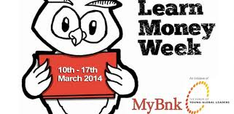
Project team adapted 3 MODULES for Turkey. It is aimed to be finished in May 2016 including giving trainings, all evaluation and reporting.

Slide 26
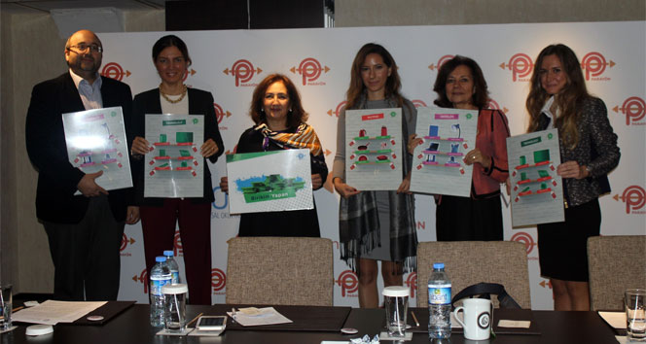
It is aimed at reaching 6800 young people with the trainings using nonformal learning methodology to different socio-economic groups.

Slide 28
TEB AİLE AKADEMİSİ TEB FAMILY ACADEMY PROJECT
http://www.teb.com.tr/aileakademisi/

Slide 29
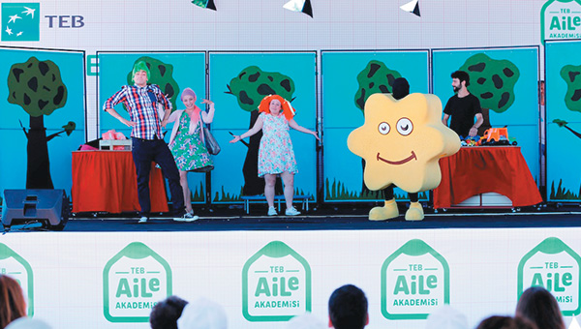
With the thought of ‘’Economy starts in the family’’ TEB Bank started the organization with the aim of raising awareness on financial literacy and training people.

Slide 30
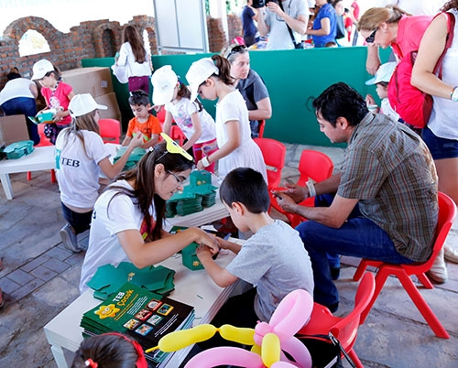
TEB Bank created teams including volunteers and branch managers of the banks. They gave financial literacy training to 70.000 people in a year.

Slide 31
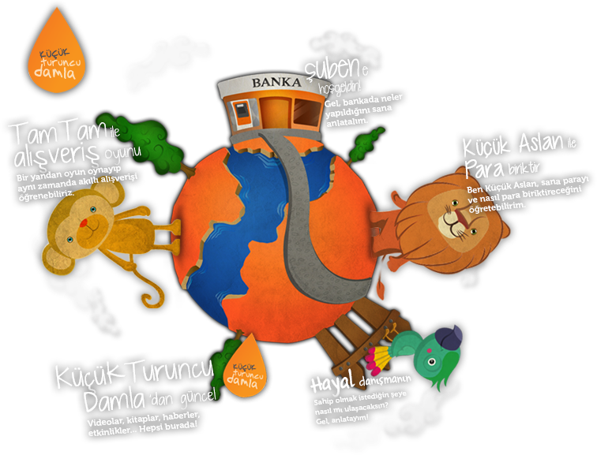
ING Bank Turuncu Damla
(ING Bank Orange Drop)

Slide 32
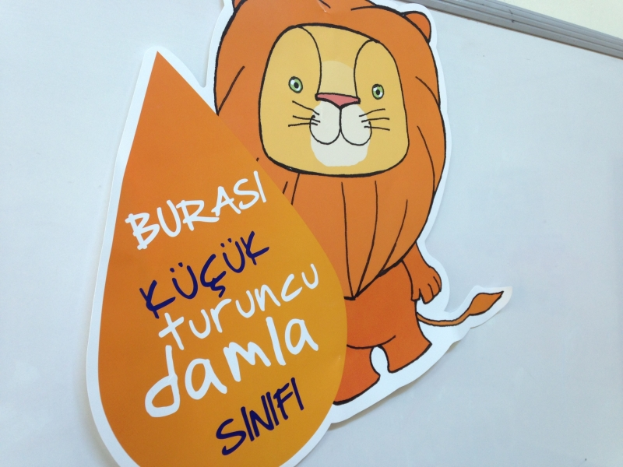
With Orange Drop project the bank aims to gain children conscious of need and wish in their early ages and support them to improve smart shopping behaviours.

Slide 33
They have 8 themes in 8 weeks including future perception, restricted source perception and budget, smart shopping, saving against wish, being patient, waiting wishes and group decisions. Pupils learn Orange Drop trainings with their teachers. So both pupils’ natural learning atmospheres do not go bad and also it can be seen permanent training outputs in children.

Slide 35
The impact our finances have throughout our lifetime on the way we live is immense, that is why it's never too early to start learning about money.
Schools are developing financial literacy curriculums and after school programs, while many non-profit and for-profit organizations are also taking this initiative.
www.turuncudamla.com

Slide 38
THANK YOU

