Slide 1
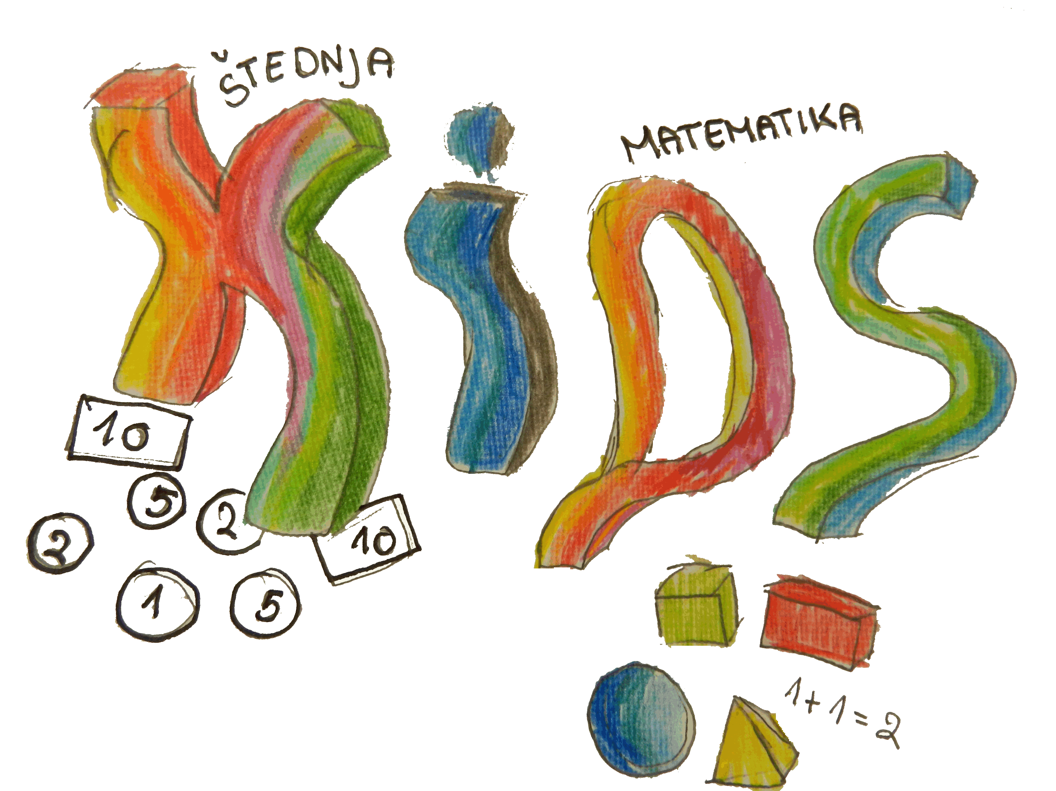
Erasmus+ KA2 - Cooperation and Innovation for Good Practices
Keep Invest Donate Spend
I. Primary School Čakovec, Croatia

Slide 2
I. Primary School Čakovec, Croatia
800 students
(7-15 years old)
60 teachers
Erasmus+ KA2 - Cooperation and Innovation for Good Practices
I.primary school Čakovec, Croatia
Keep Invest Donate Spend

Slide 3
Erasmus+ KA2 - Cooperation and Innovation for Good Practices
I.primary school Čakovec, Croatia
Keep Invest Donate Spend

Slide 4
10 Reasons Why Schools Should Teach Financial Literacy
To Our Kids
Erasmus+ KA2 - Cooperation and Innovation for Good Practices
I.primary school Čakovec, Croatia
Keep Invest Donate Spend

Slide 5
They don’t know enough.
They start younger.
There are greater temptations.
They have more debt options.
They have more debt in general.
Erasmus+ KA2 - Cooperation and Innovation for Good Practices
I.primary school Čakovec, Croatia
Keep Invest Donate Spend

Slide 6
Student loans are costlier.
People go bankrupt younger.
They start saving later.
The government won’t always have their backs.
Not everyone is given the same chance.
Erasmus+ KA2 - Cooperation and Innovation for Good Practices
I.primary school Čakovec, Croatia
Keep Invest Donate Spend

Slide 7
Our Objectives
Erasmus+ KA2 - Cooperation and Innovation for Good Practices
I.primary school Čakovec, Croatia
Keep Invest Donate Spend

Slide 8
to make the pupils learn to control their money,
make savings,
Erasmus+ KA2 - Cooperation and Innovation for Good Practices
I.primary school Čakovec, Croatia
Keep Invest Donate Spend

Slide 9
to teach money management and make children a sharer in the family
Erasmus+ KA2 - Cooperation and Innovation for Good Practices
I.primary school Čakovec, Croatia
Keep Invest Donate Spend

Slide 10
to make them be leaders,
take initiative
and establish empathy
Erasmus+ KA2 - Cooperation and Innovation for Good Practices
I.primary school Čakovec, Croatia
Keep Invest Donate Spend

Slide 11
to gain creative, reflective and critical thinking,
make comments, make an inference,
gain calculating and budgeting skills
Erasmus+ KA2 - Cooperation and Innovation for Good Practices
I.primary school Čakovec, Croatia
Keep Invest Donate Spend

Slide 12
to make learning about money with fun,
sharing key values, habits, tools and skills for financial success
Erasmus+ KA2 - Cooperation and Innovation for Good Practices
I.primary school Čakovec, Croatia
Keep Invest Donate Spend

Slide 13
to develop creativity, teamwork, collaboration, digital skills and skills for lifelong learning in the international community
Erasmus+ KA2 - Cooperation and Innovation for Good Practices
I.primary school Čakovec, Croatia
Keep Invest Donate Spend

Slide 14
Activities
(Pupils - Parents - Teachers)
Erasmus+ KA2 - Cooperation and Innovation for Good Practices
I.primary school Čakovec, Croatia
Keep Invest Donate Spend

Slide 15
What is money?
How was money created and how it evolved through history?
What are financial institutions?
Erasmus+ KA2 - Cooperation and Innovation for Good Practices
I.primary school Čakovec, Croatia
Keep Invest Donate Spend

Slide 16
What is saving?
How can we save?
How can we spend goods rationally and responsibly?
Why is it important to save?
Erasmus+ KA2 - Cooperation and Innovation for Good Practices
I.primary school Čakovec, Croatia
Keep Invest Donate Spend

Slide 17
posters, cards
Erasmus+ KA2 - Cooperation and Innovation for Good Practices
I.primary school Čakovec, Croatia
Keep Invest Donate Spend

Slide 18
piggybank
mascots
Erasmus+ KA2 - Cooperation and Innovation for Good Practices
I.primary school Čakovec, Croatia
Keep Invest Donate Spend

Slide 19
augmented reality
3D modeling and printing
Erasmus+ KA2 - Cooperation and Innovation for Good Practices
I.primary school Čakovec, Croatia
Keep Invest Donate Spend

Slide 20
website
quizzes
Erasmus+ KA2 - Cooperation and Innovation for Good Practices
I.primary school Čakovec, Croatia
Keep Invest Donate Spend

Slide 21
computer games
robots
Erasmus+ KA2 - Cooperation and Innovation for Good Practices
I.primary school Čakovec, Croatia
Keep Invest Donate Spend

Slide 22
workshops
Erasmus+ KA2 - Cooperation and Innovation for Good Practices
I.primary school Čakovec, Croatia
Keep Invest Donate Spend

Slide 23
wishtree
planting tree
Erasmus+ KA2 - Cooperation and Innovation for Good Practices
I.primary school Čakovec, Croatia
Keep Invest Donate Spend

Slide 24
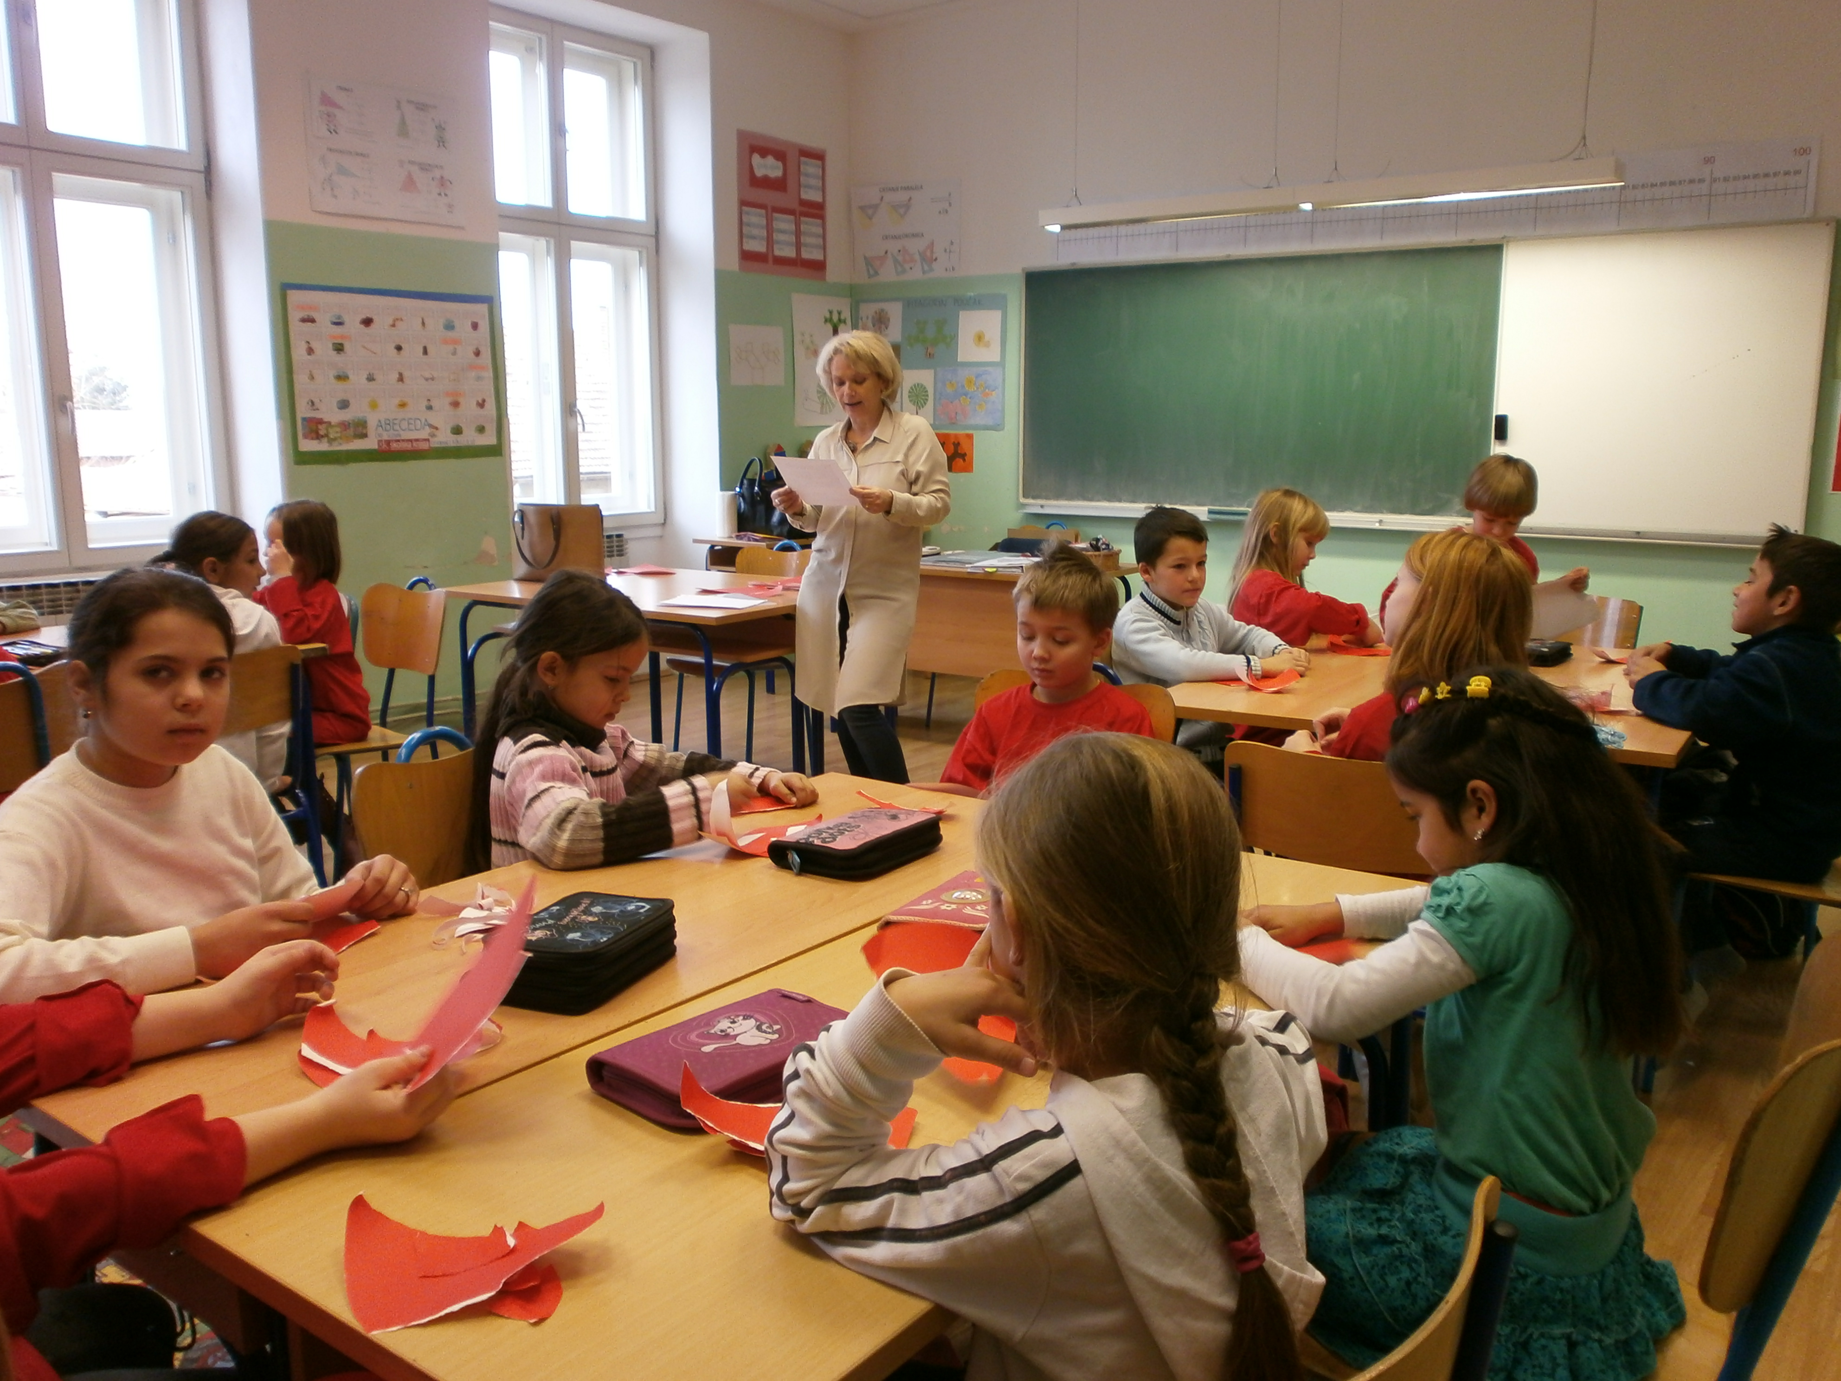
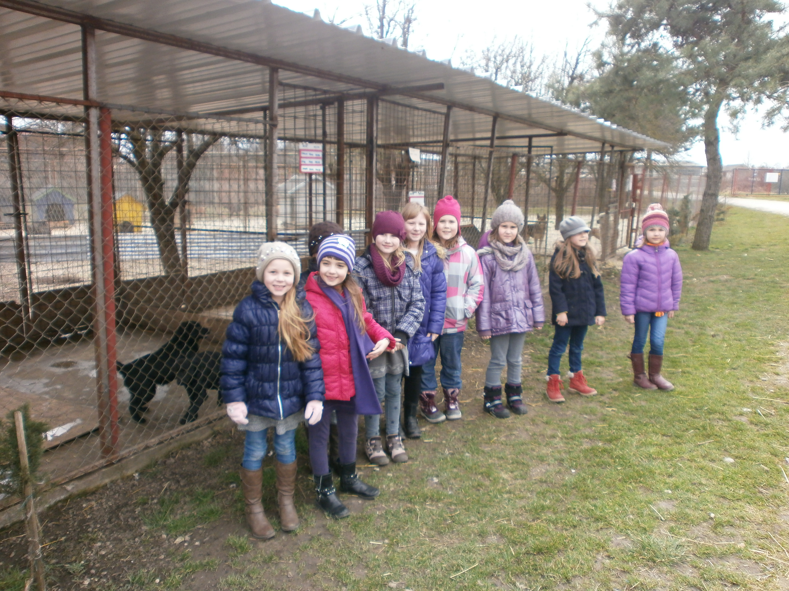
tale
comics
calendars
Erasmus+ KA2 - Cooperation and Innovation for Good Practices
I.primary school Čakovec, Croatia
Keep Invest Donate Spend

Slide 25
social games
Erasmus+ KA2 - Cooperation and Innovation for Good Practices
I.primary school Čakovec, Croatia
Keep Invest Donate Spend

Slide 26
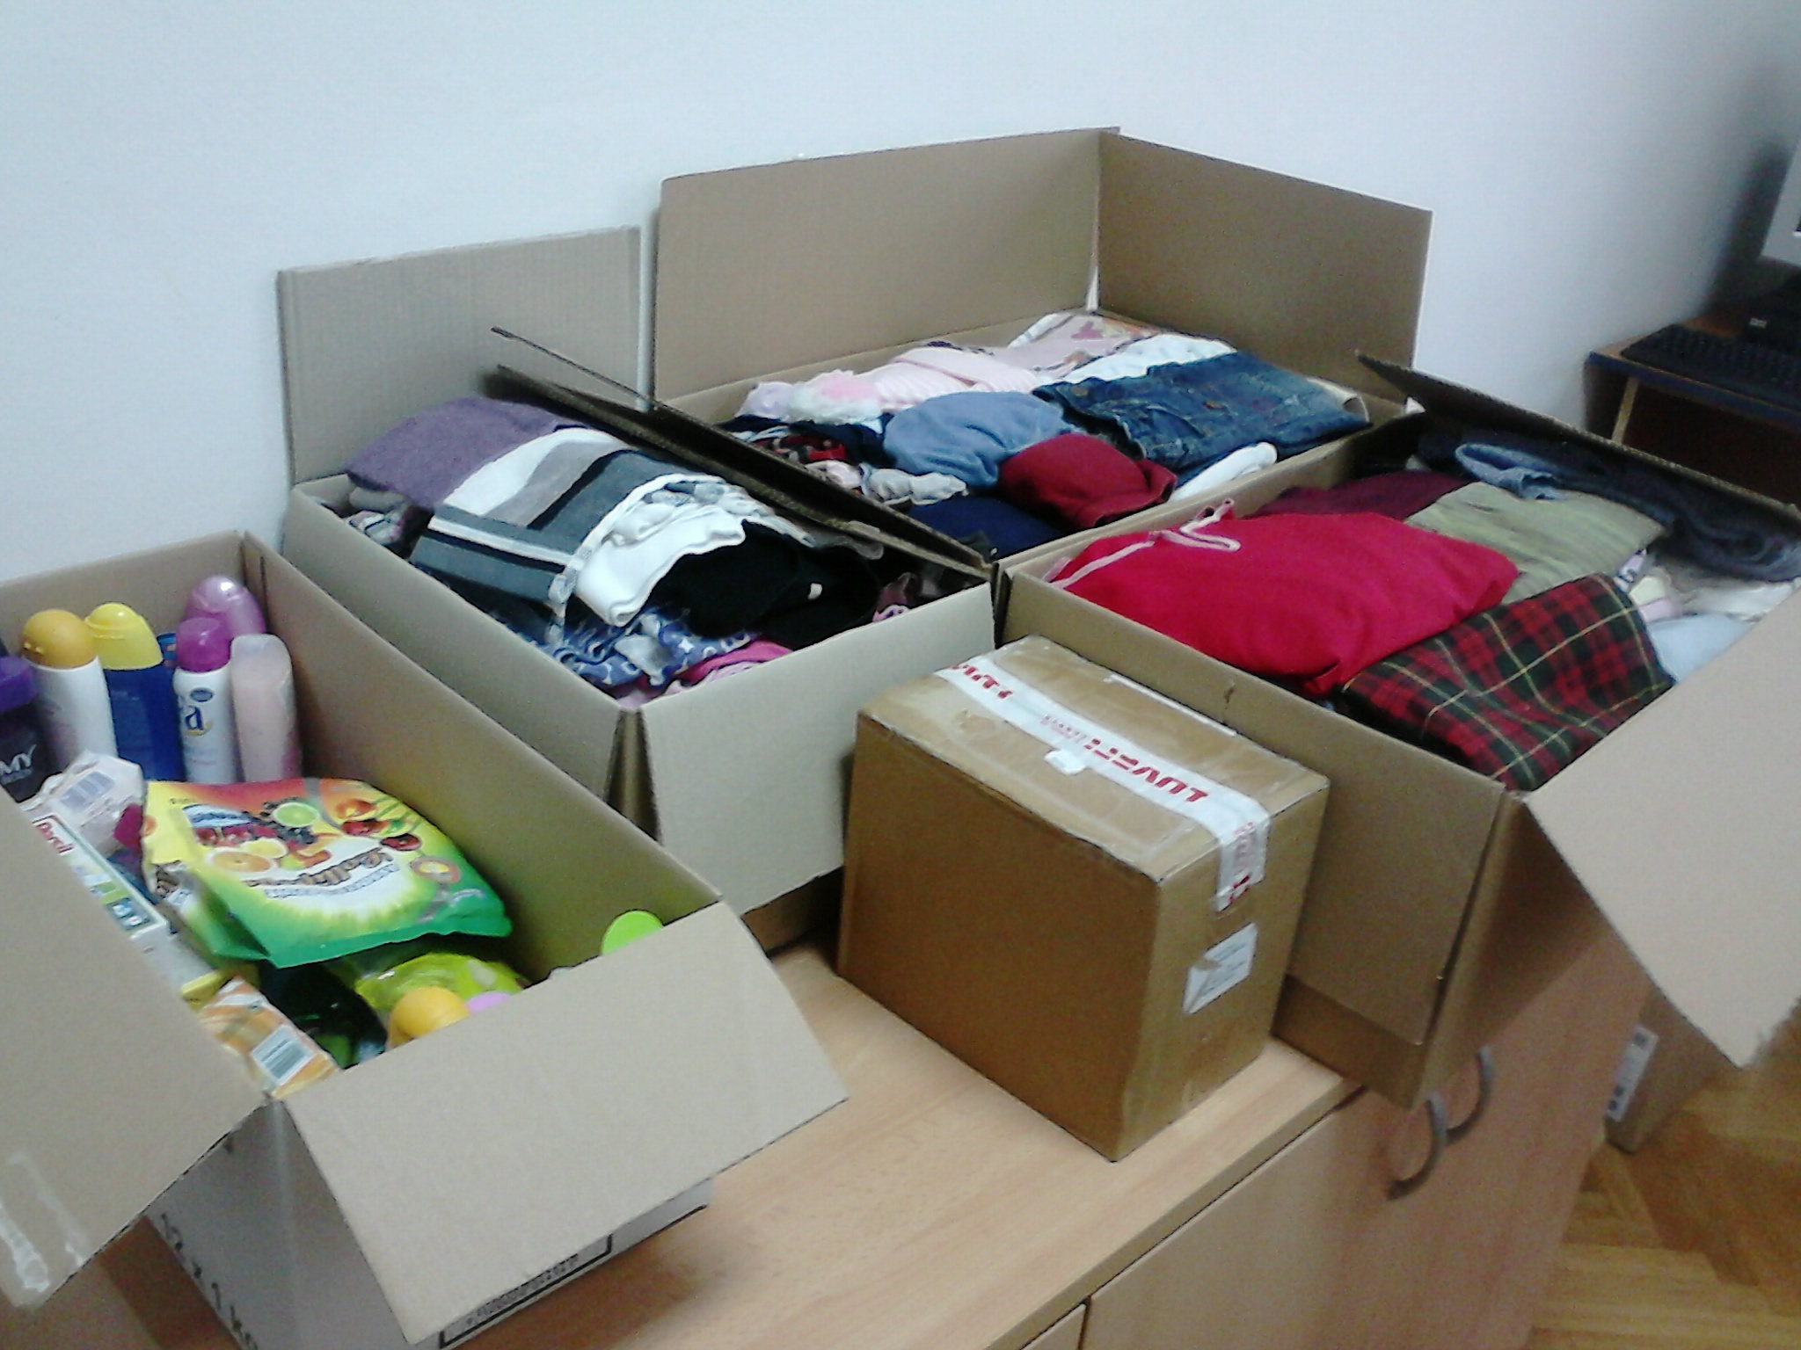
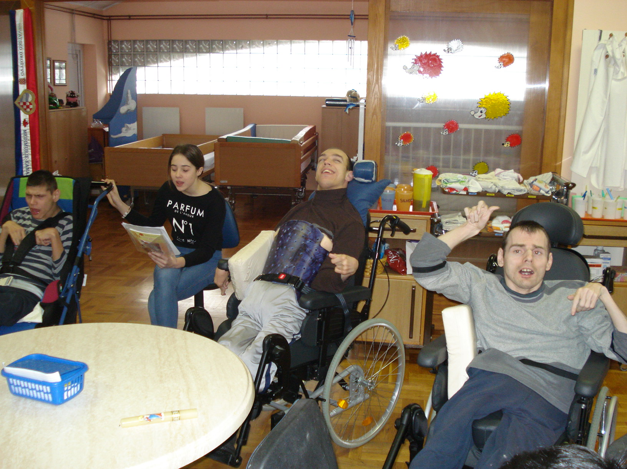
charity
Erasmus+ KA2 - Cooperation and Innovation for Good Practices
I.primary school Čakovec, Croatia
Keep Invest Donate Spend

Slide 27
bank visit
collection of old coins
pocket money diary
Erasmus+ KA2 - Cooperation and Innovation for Good Practices
I.primary school Čakovec, Croatia
Keep Invest Donate Spend

Slide 28
Activities
(Pupils - Parents - Teachers)
Erasmus+ KA2 - Cooperation and Innovation for Good Practices
I.primary school Čakovec, Croatia
Keep Invest Donate Spend

Slide 29
most children learn from their parents
our most important partners are our parents
first we need to teach and motivate parents
Erasmus+ KA2 - Cooperation and Innovation for Good Practices
I.primary school Čakovec, Croatia
Keep Invest Donate Spend

Slide 30
to teach children rational and responsible behavior
workshops:
on giving
planning budget
how to reduce costs and increase income
Erasmus+ KA2 - Cooperation and Innovation for Good Practices
I.primary school Čakovec, Croatia
Keep Invest Donate Spend

Slide 31
Actives
(Pupils - Parents - Teachers)
Erasmus+ KA2 - Cooperation and Innovation for Good Practices
I.primary school Čakovec, Croatia
Keep Invest Donate Spend

Slide 32
how to teach financial literacy
exchange of practice
Erasmus+ KA2 - Cooperation and Innovation for Good Practices
I.primary school Čakovec, Croatia
Keep Invest Donate Spend

Slide 33
Financial security for tomorrow begins today!
Erasmus+ KA2 - Cooperation and Innovation for Good Practices
I.primary school Čakovec, Croatia
Keep Invest Donate Spend

Slide 34
Thank you for your attention!
ivana.ruzic@skole.hr
Erasmus+ KA2 - Cooperation and Innovation for Good Practices
I.primary school Čakovec, Croatia
Keep Invest Donate Spend

