Slide 1
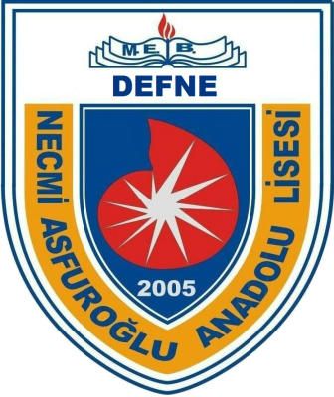
Necmi Asfuroglu Anatolian High School
CULTURAL COLORS
ERASMUS+ ka229 PROJECT 2020-2022
TURKEY

Slide 2
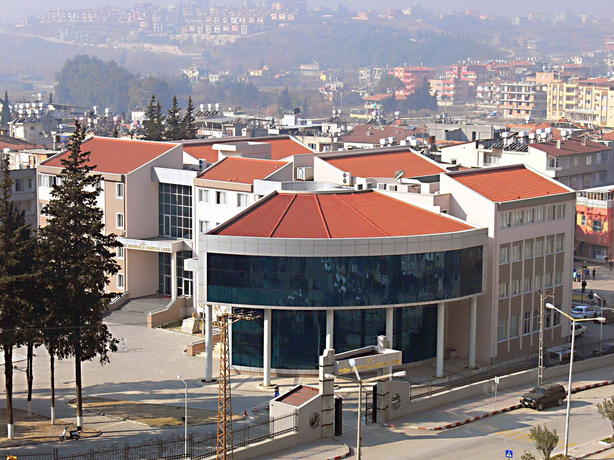
Necmi Asfuroglu Anatolian High School was established in 2005, Hatay.

Slide 3
Hatay is in the south of Turkey

Slide 4
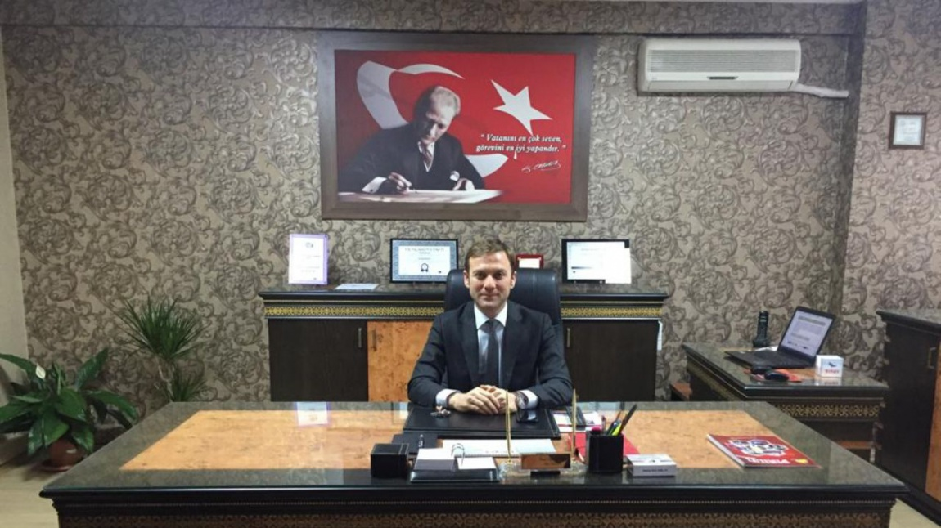
Headmaster, Mr Ömer Uğur AYDIN

Slide 5
There are 3 vice- headmasters and about 65 teachers

Slide 6
Our School, located in the central of Hatay, has 1217 students attending.

Slide 7
School Departments

Slide 8
Teachers Room

Slide 9
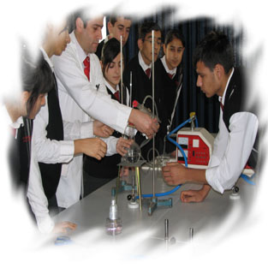
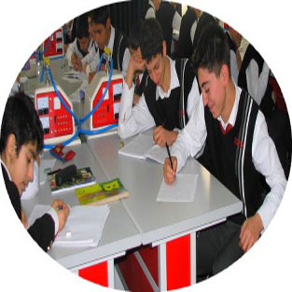
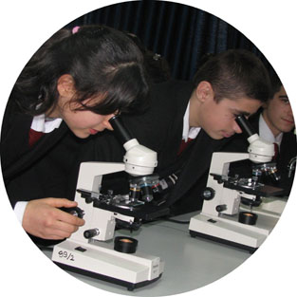
There are 3 labs - Physics, Chemistry and Biology

Slide 10
Music Room

Slide 11
Art Room

Slide 12
Guidance Room

Slide 13
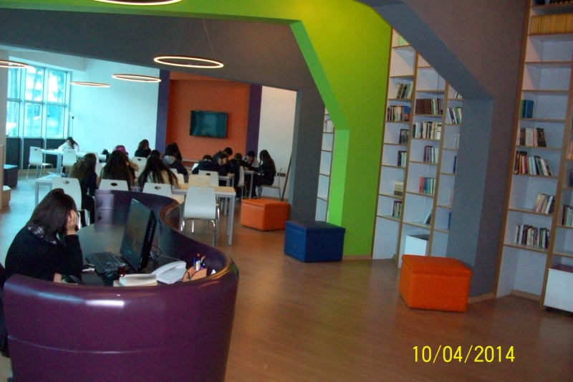
Z Style Library

Slide 14
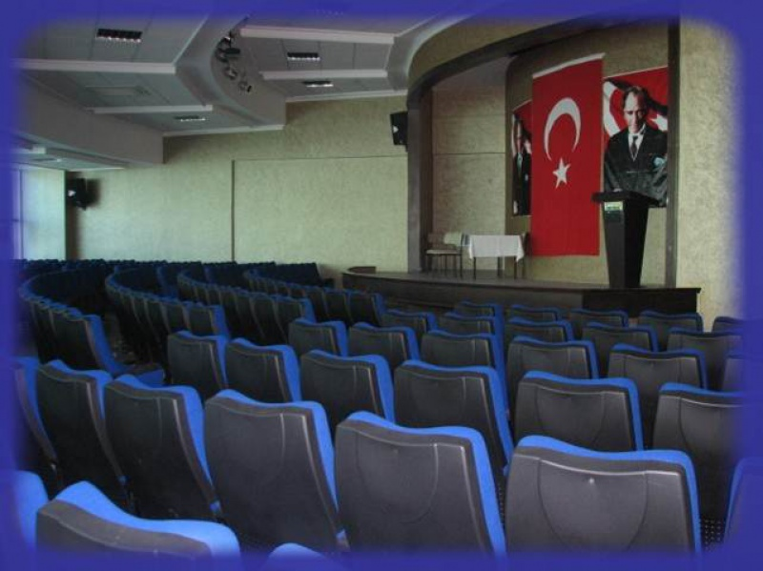
Auditorium

Slide 15
Schools in Turkey

Slide 16
Kinder Garden
(3-5 years old)
Secondary Schools
(11-14 years old)
High Schools
- General High Schools
- Liberal Arts High Schools
- Science High Schools
- Vocational High Schools
- Religion High Schools
(15-18 years old)
Primary Schools
(6-10 years old)
Exam for High Schools
Students in Turkey must attend these schools step by step.

Slide 17
System in General High School
The students get four years education.
Our students are between 14 and 18 years old.
School starts at 8.00 am o’clock, ends 03.20 pm.
There are 8 lessons in a day and duration of one lesson is 40 minutes.
There are totally 7 short breaks(10 mins) and lunch break between 12.00 am – 01.00 pm.
There are no classes on weekends.
There are 34 students in a class.

Slide 18
Lessons
Main Courses
Additional Courses
Maths
Physics
Chemistry
Biology
Literature
English
German
History
Geography
Art
Music
Gym
Religion
Philosophy
Extra Maths
Extra Physics
Extra Chemistry
Extra Biology
IT
Human Rights and Democracy
Health and Traffic
Project Preparing
Sociology

Slide 19
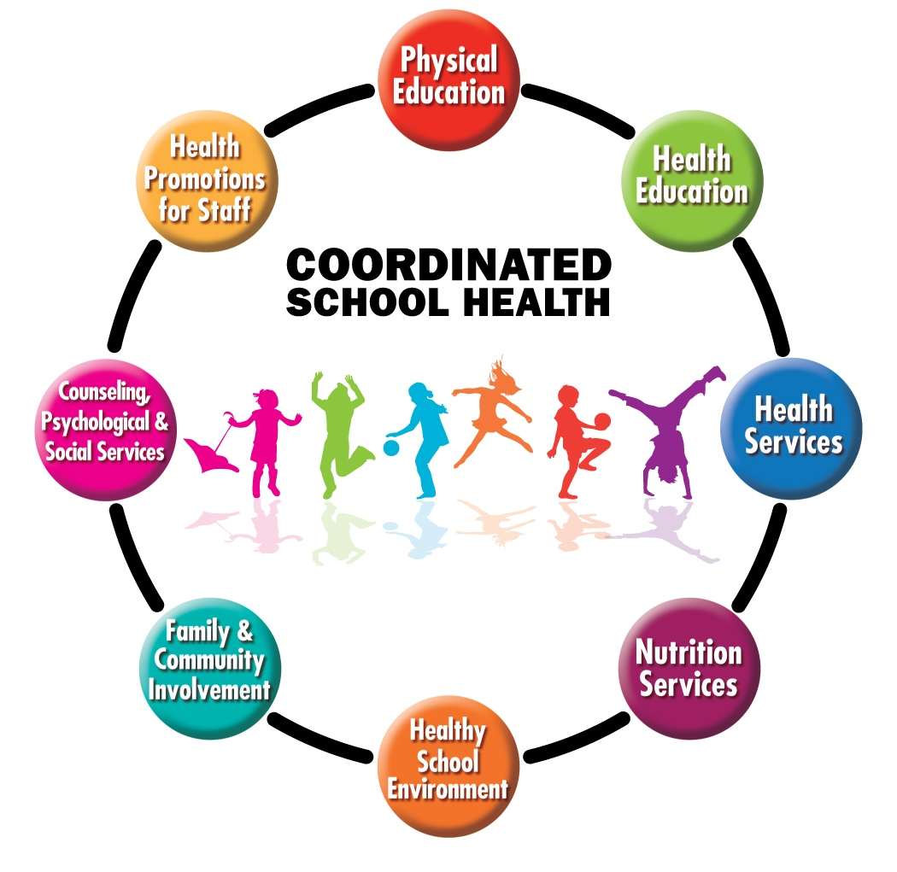
Health, Gym and Science Lessons
Literature(6 hours)
English(4 hours)
German(2 hours)
in a week.
We have 9 Literature teachers, 7 English teachers and 3 German teachers

Slide 20
On Lessons
Literature
English
German
History

Slide 21
Auditorium, classes and school yard are mostly based on constructive method. (aimed)
The teacher guides the students. (aimed)
The teacher is a model for the students. (aimed)
Four basic skills are taken into consideration
Different techniques are applied in different skills

Slide 22
Extracurricular Activities

Slide 23
1) EU Projects
We have currently 7 Erasmus+ projects at school. (KA229).
We have several e-Twinning projects. These projects are about Literacy, Maths, English, Cultures, Traditional Foods etc..

Slide 24
2) Local and National Sport Competitions

Slide 25
Basketball

Slide 26
Bocce

Slide 27
Badminton

Slide 28
Volleyball

Slide 29
Swimming

Slide 30
Futsal

Slide 31
3) Music

Slide 32
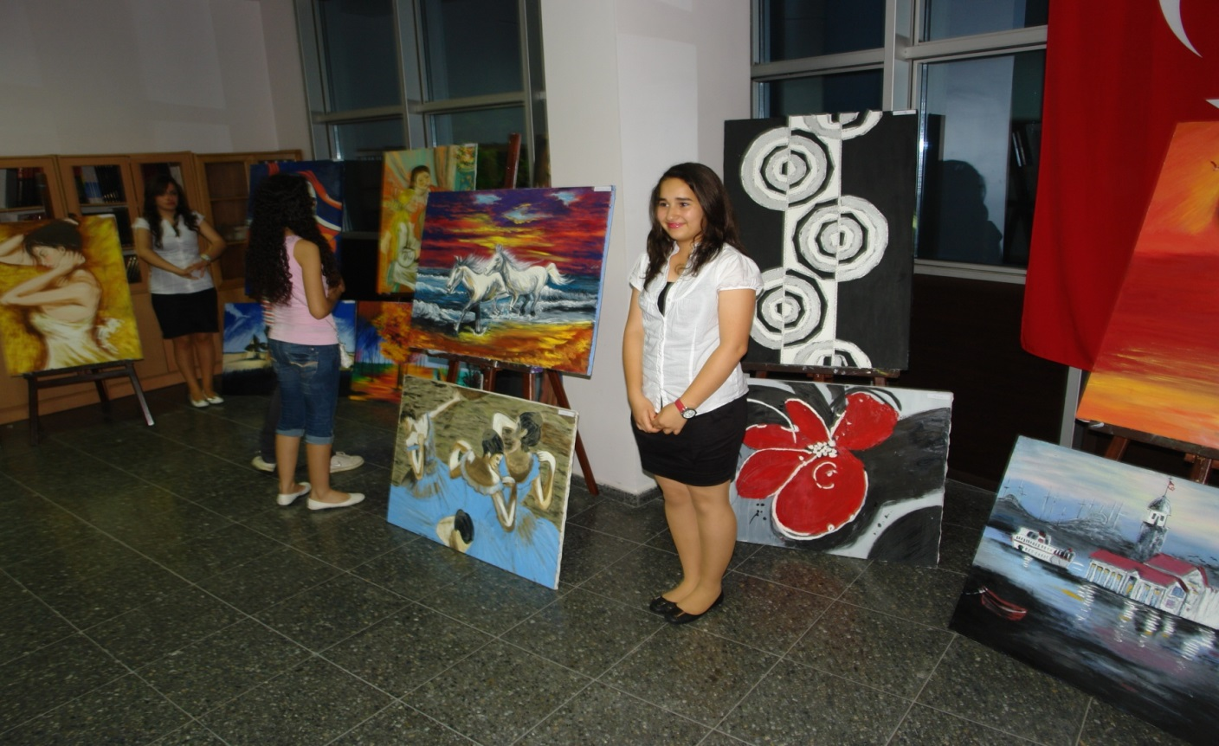
4) Art

Slide 33
5) Theater and Drama

Slide 34
6) Chess

Slide 35
7) Book Fairs

Slide 36
8) Science Fairs

Slide 37
9) Youth Week

Slide 38
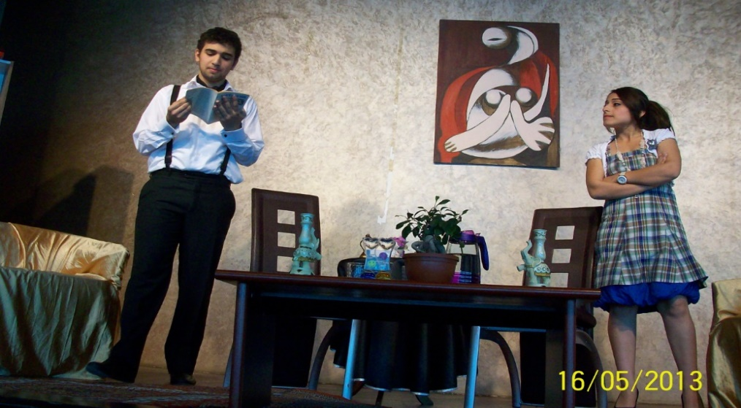
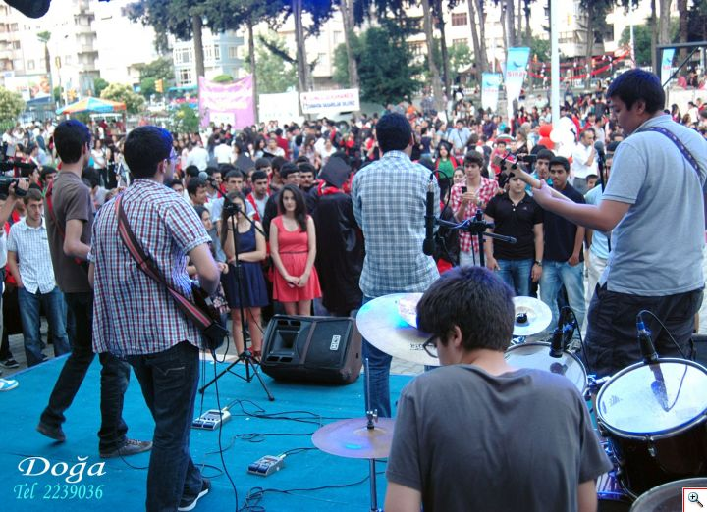
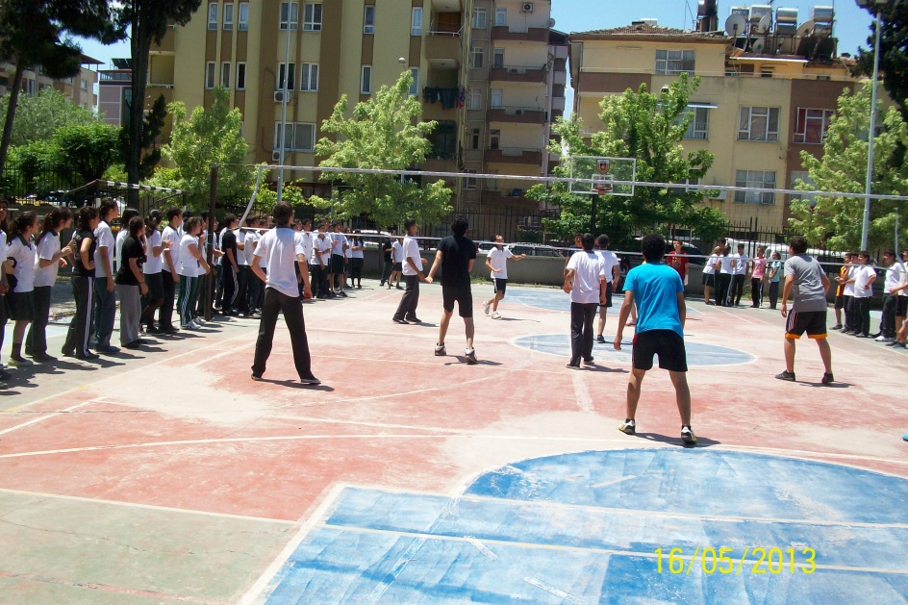

Slide 39
For Listening

